Slide 1
The State of Giving Today – An Overview of Charities and Donors
Karen Gano
Elizabeth Boris
Dr. Una Osili

Slide 2
Trends in Civil Society
March 21, 2017
Give and Take: Consumers, Contributors, and Charity
Elizabeth T. Boris, Ph.D.
Urban Institute Fellow
Center on Nonprofits and Philanthropy,
Waldemar A. Nielsen Chair of Philanthropy
Georgetown University

Slide 3
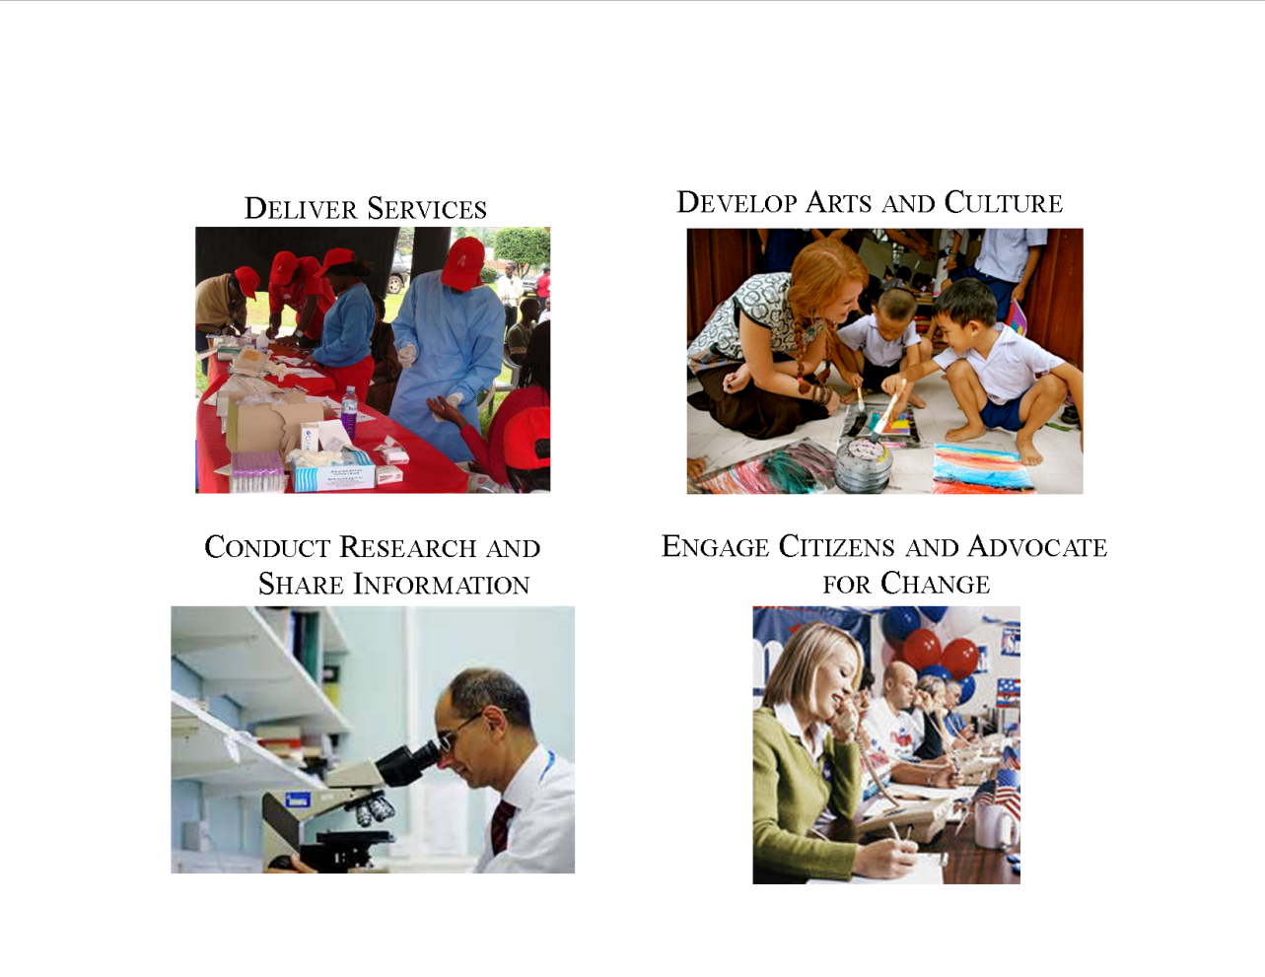
Types of Activities

Slide 4



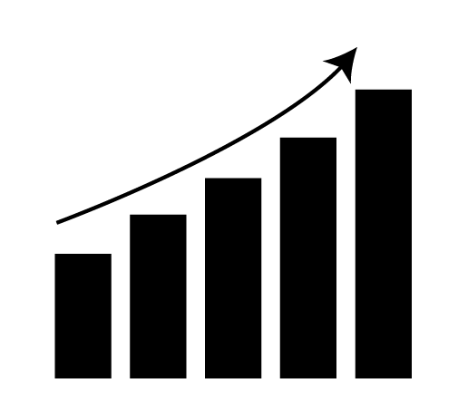

Roles in society
Contributions to individual and community well-being
Impact on civic engagement
Economic impacts
Relationships with government and business

Slide 5
Characteristics of U.S. Nonprofits
Diversity
Mission and Activities
Governance
Staffing
Revenue Sources
Size & Age
Community
Clients & Members

Slide 6
U.S. Nonprofits by Organization Type
2014

Slide 7
Nonprofits* 1.41 million
2013
  Revenue $2.26 trillion
Expenses $2.10 trillion
Assets
$5.17 trillion

Slide 8
Economic Impact
Contributed
5.4%
of GDP in 2014
Employed
14.4 million
Individuals in 2013

Slide 9
Charities*
293,103
2013
  Revenue $1.73 trillion
Expenses $1.62 trillion
Assets
$3.32 trillion

Slide 10
Charitable Nonprofits by Type
2013

Slide 11
Charities’ Expenses by Size
2013

Slide 12
Charities’ Sources of Revenue
2013

Slide 13
Government Contracts and Grants with Charitable Nonprofits
Nearly 350,000 contracts and grants with Nonprofits (average 6 per organization) in 2012
Over $137 billion worth of contracts and grants in 2012

Slide 14
Charitable Foundations: 2013
87,142
Private, corporate, operating and community foundations in the U.S.
$798.2 billion
Total Assets
$55.3 billion
Giving Overall
$56.2 billion
Gifts Received

Slide 15
Volunteering
2014
62.8 million people volunteered
25.3% of the population
They volunteered an estimated total of 8.7 billion total hours
    Valued at $179.2 billion

Slide 16
  Total private contributions increased to $373.25 billion
  Congregations receive 32% of total
Source: GivingUSA

Slide 17
Estimated Distribution of Private Contributions
2015
Source: GivingUSA

Slide 18
Civil Society Trends
Performance Measurement
Tax & Regulatory Policy
Financial & Capacity Challenges
Transparency
Big Data
Accountability
Fee for Service & Enterprises
Economic & Social Impact
Online & New Giving Tools
Impact Investing &
Social Impact Bonds

Slide 19
Trends Affecting Civil Society
Globalization of Economy
Political Polarization
Environmental Degradation
Changing Demographics
Federal & State Budget Deficits
Growing Income Inequality
Health Care Reform
Tax Reform
Immigration Reform

Slide 20
Sector Research
Achievements, Impacts, Innovation
Self-Regulation
Donor and Volunteer Motivations
Relationships w/Governments & Businesses
What Works & Why
Advocacy & Social Change
Civic & Social Capital Building

Slide 21
Sector Research
Achievements, Impacts, Innovation
Self-Regulation
Donor and Volunteer Motivations
Relationships w/Governments & Businesses
What Works & Why
Advocacy & Social Change
Civic & Social Capital Building

Slide 22
What the Forms 990 Reveal
  The Nonprofit Sector is growing in numbers and resources but those resources are not uniformly distributed
  The Sector is diverse by size and type of organizations
  We can assess financial indicators (revenues, expenses, assets and their components) by size, type, geography and many other variables
  We can use the Form 990 as a sampling frame for surveys and analyses of discrete characteristics
  We can identify outliers and look up their Forms 990 to see what they do, who they serve, their finances, and their governance processes
  We can combine Form 990 data with other administrative data sets, labor statistics, census of services, etc. for a wide variety of studies
  With the advent of digitized Form 990 data, we will be able to do these and other analyses quickly and inexpensively
Notes:
providing funds to nonprofit organizations allows states to have greater reach and more of an impact across their state
governments and nonprofit organizations often address the same social issues and serve the same people, so quite a few respondents spoke about having complementary missions and values as a meaningful benefit to working with nonprofits.
State agency respondents recognize that nonprofit organizations have highly developed insight and expertise working with certain populations. As one respondent said, “Nonprofit organizations have their finger on the pulse of what’s happening in the communities in which they’re serving
State agency respondents seemed to appreciate that nonprofit organizations have greater flexibility to act faster and with fewer procedural hurdles than government agencies.

Slide 23
Utility of Forms 990 for Regulators
  Digitized Forms 990 will permit more extensive analyses of financial information then has been possible to date. For example, program expenses as a percentage of all expenses might be used as a screening tool to understand trends, to analyze differences among charities and to identify outliers.
  Using Statistics of Income Sample data for 2012, we find that the percentage of program expenses to total expenses increases with the size of the organization:
    78.49 percent for those with less than $100,000 in expenses
    87.25 percent for those with $10 million or more.
    Economies of scale and greater capacity likely factors in the differences between large and small organizations.
Notes:
providing funds to nonprofit organizations allows states to have greater reach and more of an impact across their state
governments and nonprofit organizations often address the same social issues and serve the same people, so quite a few respondents spoke about having complementary missions and values as a meaningful benefit to working with nonprofits.
State agency respondents recognize that nonprofit organizations have highly developed insight and expertise working with certain populations. As one respondent said, “Nonprofit organizations have their finger on the pulse of what’s happening in the communities in which they’re serving
State agency respondents seemed to appreciate that nonprofit organizations have greater flexibility to act faster and with fewer procedural hurdles than government agencies.

Slide 24
Utility of Forms 990 for Regulators
  Looking just at Human Services Charities, average program services expenses are 85.7 percent of total expenses.
  Drilling down to specific program areas, those averages vary from 80.2 percent for Science and Technology to 91.4 percent for the Food, Agriculture and Nutrition and the Mutual Benefit Categories.
  Looking at sub-categories (where numbers in the sample are small and thus only illustrative, not reliable), we see even greater divergence:
    94.3 percent averages for philanthropy and voluntarism groups
    62.1 percent average for veterans and military groups
  Such analyses can be the starting point for understanding different operating patterns as well as investigation of outliers.
Notes:
providing funds to nonprofit organizations allows states to have greater reach and more of an impact across their state
governments and nonprofit organizations often address the same social issues and serve the same people, so quite a few respondents spoke about having complementary missions and values as a meaningful benefit to working with nonprofits.
State agency respondents recognize that nonprofit organizations have highly developed insight and expertise working with certain populations. As one respondent said, “Nonprofit organizations have their finger on the pulse of what’s happening in the communities in which they’re serving
State agency respondents seemed to appreciate that nonprofit organizations have greater flexibility to act faster and with fewer procedural hurdles than government agencies.

Slide 25
Utility of Forms 990
  In reviewing the outliers from the SOI sample, there were a number of facilities, religious groups, and public foundations, suggesting that there are some program elements, such as buildings or endowments, that might lead specific types of groups to have different levels of program expenses.
  Size of the organization is a clear factor and perhaps age of the organization might reveal start-up costs that are outside the average for that type of organization.
  Other intervening variables might be:
    Retiring CEOs that draw down accrued or deferred retirement benefits.
    A year with a one time large gift or contract followed by a lean year—one year is not enough to assess an organization’s status.
  Statistical analyses will reveal trends, but close analysis will be necessary to understand those patterns.
Notes:
providing funds to nonprofit organizations allows states to have greater reach and more of an impact across their state
governments and nonprofit organizations often address the same social issues and serve the same people, so quite a few respondents spoke about having complementary missions and values as a meaningful benefit to working with nonprofits.
State agency respondents recognize that nonprofit organizations have highly developed insight and expertise working with certain populations. As one respondent said, “Nonprofit organizations have their finger on the pulse of what’s happening in the communities in which they’re serving
State agency respondents seemed to appreciate that nonprofit organizations have greater flexibility to act faster and with fewer procedural hurdles than government agencies.

Slide 26
Conclusions
Civil Society is vibrant, diverse and growing, but our knowledge base is still fairly primitive, especially at the state and local levels.
  Scope and dimensions research is well underway
  Management and financial research is growing
  Economic impact estimates are becoming more robust
  Performance research and data gathering is in demand, but capacity to collect, analyze and use performance data is quite limited
  Outcomes of specific programs on communities and populations are increasingly evaluated, but synthesis and knowledge sharing is weak
  Civic engagement research is in its infancy
  Policy and budget analyses research is limited
  Legal research is growing
  Regulatory research, including fraudulent conduct, is a neglected area of analysis.
Notes:
providing funds to nonprofit organizations allows states to have greater reach and more of an impact across their state
governments and nonprofit organizations often address the same social issues and serve the same people, so quite a few respondents spoke about having complementary missions and values as a meaningful benefit to working with nonprofits.
State agency respondents recognize that nonprofit organizations have highly developed insight and expertise working with certain populations. As one respondent said, “Nonprofit organizations have their finger on the pulse of what’s happening in the communities in which they’re serving
State agency respondents seemed to appreciate that nonprofit organizations have greater flexibility to act faster and with fewer procedural hurdles than government agencies.

Slide 27

Urban Institute
2100 M Street NW
Washington, DC 20037

Slide 28
References
Boris, Elizabeth T. and C. Eugene Steuerle, eds. Nonprofits & Government: Collaboration & Conflict, 2016, third edition.
Foundation Center, 2017. Foundation Stats. www.foundationcenter.org.
Giving USA Foundation, 2015.
McKeever, Brice. The Nonprofit Sector in Brief: Public Charities, Giving and Volunteering, 2015. Urban Institute.
Pettijohn, Sarah et al. Nonprofit-Government Contracts and Grants: Findings from the 2013 National Survey, 2013. Urban Institute. www.urban.org/nonprofitcontracting.cfm

Slide 29
Other Resources
  Center on Nonprofits and Philanthropy, the Urban Institute http://www.urban.org/center/cnp/index.cfm
  The Johns Hopkins Center for Civil Society Studies. http://www.ccss.jhu.edu/index.php?section=content&view=20
  The Foundation Center. http://foundationcenter.org/
  Giving USA Foundation. Giving USA. http://www.givingusareports.org/
  National Center for Charitable Statistics, the Urban Institute, http://nccs.urban.org.
  Nonprofit and Voluntary Sector Quarterly (NVSQ) http://nvs.sagepub.com/
  Nonprofit Management and Leadership (NML). http://onlinelibrary.wiley.com/journal/10.1002/(ISSN)1542-7854
  Stanford Social Innovation Review
  Volunteering in America. http://www.volunteeringinamerica.gov
  Bureau of Labor Statistics, Volunteering in the U.S., http://www.bls.gov/news.release/pdf/volun.pdf
  Icon credit, Slide #5, Stephen Borengasser, DeadType, Urban Institute
  Icon credit, Slide #7, Ferran Brown, Urban Institute
  Photo credit, Slide #2, http://www.flickr.com/photos/53258658@N08/5925958386

Slide 30

The State of Giving Today:
An Overview of Donors
Una Osili, Ph.D.
Professor of Economics
Director of Research
March 2017

Slide 31
Today’s Presentation
What are the key forces shaping philanthropy?
  How is the philanthropic landscape changing?
How will trends shape the future?

Slide 32
DATA TRENDS REVEAL CHANGING LANDSCAPE

Slide 33
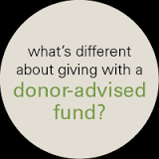

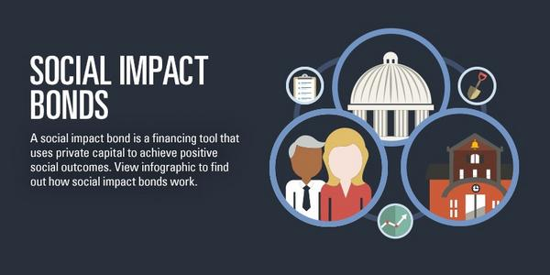




Philanthropy Now and in the Future
Notes:
Fidelity Charitable Gift Fund has topped the list of this year’s Philanthropy 400, The Chronicle of Philanthropy’s annual ranking of the 400 largest charities. The charities are ranked based on how much is raised from private sources. This is the first time a charity focused on donor-advised funds has taken over the top spot on the list.

Slide 34
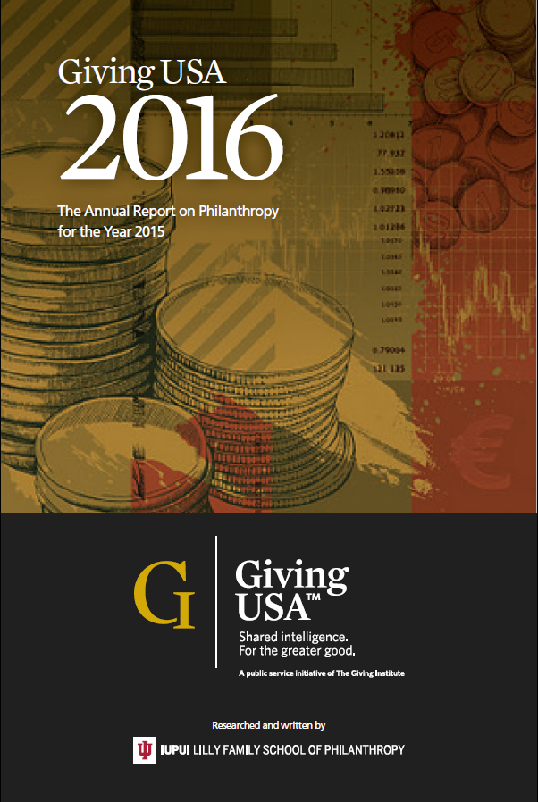
GIVING USA

Slide 35
Project and Content Scope
Sources
U.S. households/individuals
U.S. based IRS-registered charities
U.S. businesses/corporations
U.S. estates
U.S. foundations
Uses
U.S. religious organizations
Uses
Notes:
The longest-running, annual report on U.S. charitable giving (since 1956)
Data on sources and uses of giving (40-year trends)
Comparison of giving data to key economic trends
Almanac-style contextual analysis of trends of giving by source and use, including newest academic research

Slide 36
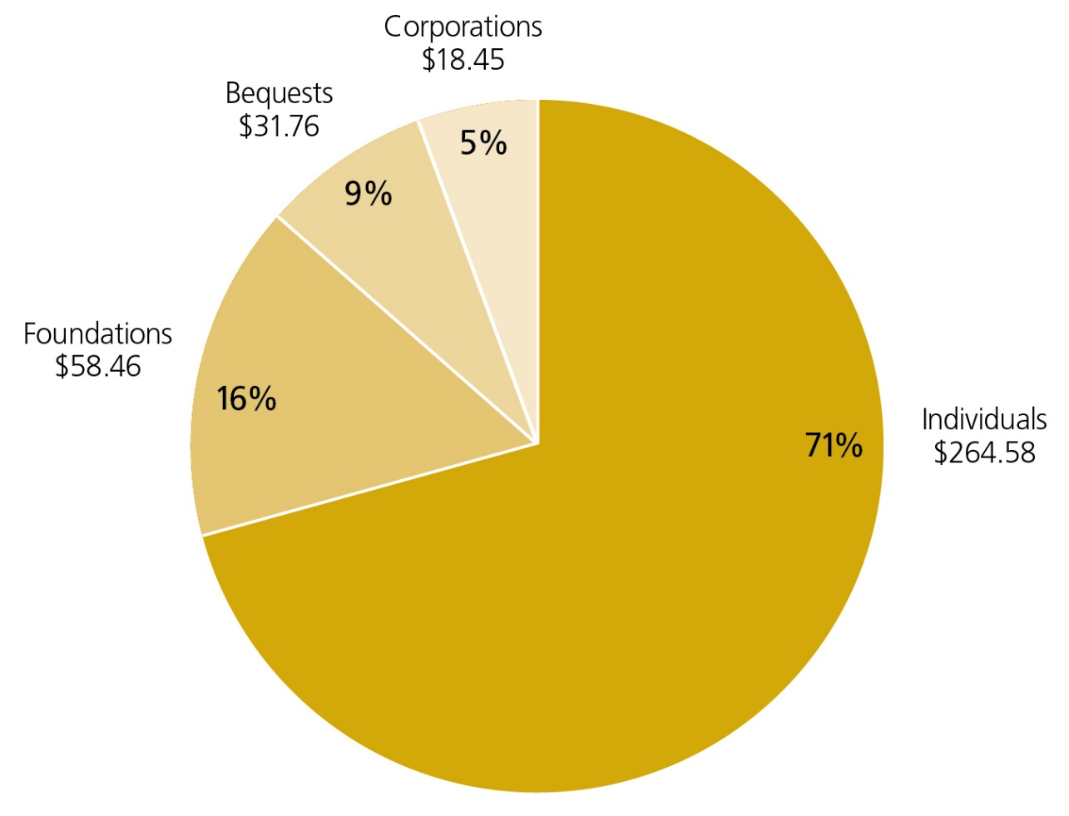
Individuals Donate A Majority of Gifts
2015 Contributions: $373.25 Billion by Source
SOURCE: Giving USA Foundation | GIVING USA 2016
Notes:
Giving by individuals comprised 71 percent of total giving in 2015.¹
Giving by foundations—which includes grants made by independent, community, and operating foundations—amounted to 16 percent of all gifts made in 2015.²
Giving by bequest accounted for 9 percent of all gifts made in 2015.
Giving by individuals, bequest, and family foundations amounted to an estimated 87 percent of total giving in 2015.³
Giving by corporations comprised 5 percent of total giving in 2015.

Slide 37
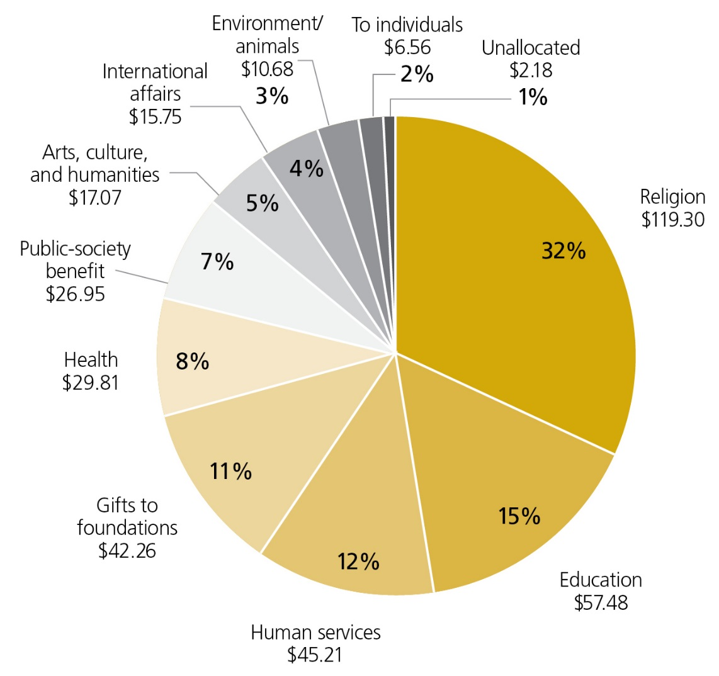
Religion Receives A Majority of Contributions
SOURCE: Giving USA Foundation | GIVING USA 2016
Notes:
Religious organizations received the largest share of charitable dollars in 2015, at 32 percent of the total.⁴
The education subsector received the second-largest share of charitable dollars in 2015, at 15 percent of the total.
Human services organizations received 12 percent of total charitable dollars in 2015, ranking third of total gifts received.
Gifts to independent, community, and operating grantmaking foundations amounted to the fourth-largest share of charitable dollars in 2015, with 11 percent of the total.
The health subsector received the fifth-largest share of charitable dollars in 2015, at 8 percent of the total.
Public-society benefit organizations received 7 percent of total charitable dollars in 2015, ranking sixth of total gifts received.
The arts, culture, and humanities subsector received the seventh-largest portion of charitable dollars in 2015, at 5 percent of the total.
Gifts to the international affairs subsector amounted to the eighth-largest share of charitable dollars in 2015, with 4 percent of the total.
Environment/animals organizations received 3 percent of total charitable dollars in 2015, ranking ninth of total gifts received.
Gifts made directly to individuals amounted to 2 percent of total charitable dollars in 2015.

Slide 38
Trends in Charitable Giving by Source, 1975-2015
Total
Individuals
Foundations
Bequests
Corporations
SOURCE: Giving USA Foundation | GIVING USA 2016

Slide 39
Religious Giving Has Been Declining As Share of Total Donations Since the 1980s
SOURCE: Giving USA Foundation | GIVING USA 2016
Notes:
What’s included in the giving to religion category?
Giving USA’s tabulation of giving to the religion subsector includes giving to support religious congregations and houses of worship; the organizing or national offices of denominations and faith groups; missionary societies; religious media (including print and broadcast); and organizations formed for religious worship, fellowship, or evangelism. Contributions to faith-based organizations offering healthcare, education, or social services, as well as those working interna­tionally, are not included in Giving USA’s estimate for giving to religion. Rather, they are categorized within the other subsectors according to purpose.
Giving USA’s primary data source for estimating contributions to religious organizations in 2014 was the Evangelical Council for Financial Accountability (ECFA). Estimates for 2014 were derived from calculating the average rate of change of giving to ECFA member organizations for the last three years. This rate of change is applied to a base amount of giving to all types of religious organizations, including non-Christian houses of worship.
ECFA reported a 6.9 percent increase between 2012 and 2013 for contributions made to ALL reporting ECFA member organizations. These organizations include religious organizations that are categorized in both Giving USA’s religion categories and the other types of subsectors. Using giving only to religious organizations included in Giving USA’s definition of religious organizations (see above), Giving USA estimates that giving to religion increased by 6.0 percent in 2013 and by 2.5 percent in 2014.
Why does religious giving continue to grow so slowly?
Giving to religion continued to relatively slow rates of growth in 2014, a trend that began in the mid-1980s when it reached 57 percent of the total. In the last five-year period, 2010–2014, religious giving comprised just 33 percent of the total.
At a rate of growth of 2.5 percent, estimated giving to religion outpaced the rate of inflation in 2014 (1.6 percent). Giving to religion has realized somewhat unsteady growth in the last few years. The estimated growth of 2.5 percent marks a slightly slower pace of growth when compared with revised estimates that show giving to religion rose 6.0 percent in 2013 over 2012. Since the end of the recession in mid-2009, giving to religion has experienced an average annual rate of growth of 4.4 percent—making it the sixth fastest growing subsector out of nine.
Several reasons account the relatively slow rate of growth in giving to religion:
1.) Declining rates of membership at houses of worship:
A Pew survey released in 2015 revealed that, from 2007 to 2014, the religiously unaffiliated share increased by 6.7 percent, from 16.1 percent to 22.8 percent. During the same period, the U.S. Christian population declined by 7.8 percent, from 78.4 percent to 70.6 percent. In contrast, non-Christian faiths remained steady or increased slightly.
In a 2012 study, the Pew Forum on Religion & American Life found that Mainline and Evangelical Protestant denominations are experiencing the greatest loss in membership and attendance in recent years. People who strongly identify with the Evangelical faith community, in particular, reportedly often give a high percentage of their income to religion. If former Evangelical Protestants move, they might correspondingly reduce their contributions to religion.
2.) Giving to religiously identified organizations that are not in the religious subsector:
Giving to religion in Giving USA includes giving to support religious congregations and houses of worship; the organizing or national offices of denominations and faith groups; missionary societies; religious media (including print and broadcast); and organizations formed for religious worship, fellowship, or evangelism.
Giving to support organizations that are religiously oriented or identified, such as Catholic Charities or World Vision, is not included in this category. Rather, giving to these other types of organizations are typically included in giving to international affairs, human services, health, or education.
A Connected to Give study released in 2013 clarified the charitable landscape with two broad categories: “‘religiously identified organizations’ (RIOs) and ‘not religiously identified organizations’ (NRIOs).” RIOs include a variety of faith-based organizations separate from the traditional congregation. Though only 41 percent of all U.S. giving funds congregations specifically, an additional 32 percent supports RIOs. Thus, more than seven in ten charitable dollars appears to be religiously motivated.
3.) Declining rates of giving to congregations (at least Christian ones):
Data for the year 2012 reveal that giving to churches represented only 2.2 percent of personal income, marking the lowest level since 1968. The percentage of people attending worship services has been falling for decades, so while people attending continue to give, often at very high percentages of their income, religious giving from the overall population reflects lower levels of attendance.
4.) There also appear to be attendance effects at play:
One report found that in North American churches with attendance of at least 1,000 report, there is an inverse relationship between size and per capita giving.
Historically, religious giving just barely keeps pace with people’s income. In many households, income is also flat or even declining.
5.) Difference in definition: Note that Giving USA categorizes religious organizations very narrowly, which can explain some differences seen between Giving USA and other reports on religious giving.
Which large religious-oriented charities actually reside in the giving to religion subsector?
In short, very few. Giving USA uses a very narrow version of giving to religion, including gifts made to houses of worship, mission groups, national offices for religious congregations, and religious media. As noted above, Giving USA does not categorize as religion those organizations offering healthcare, education, or social services, as well as those working interna­tionally.

Slide 40
Data reveal impact of National and global economic forces

Slide 41
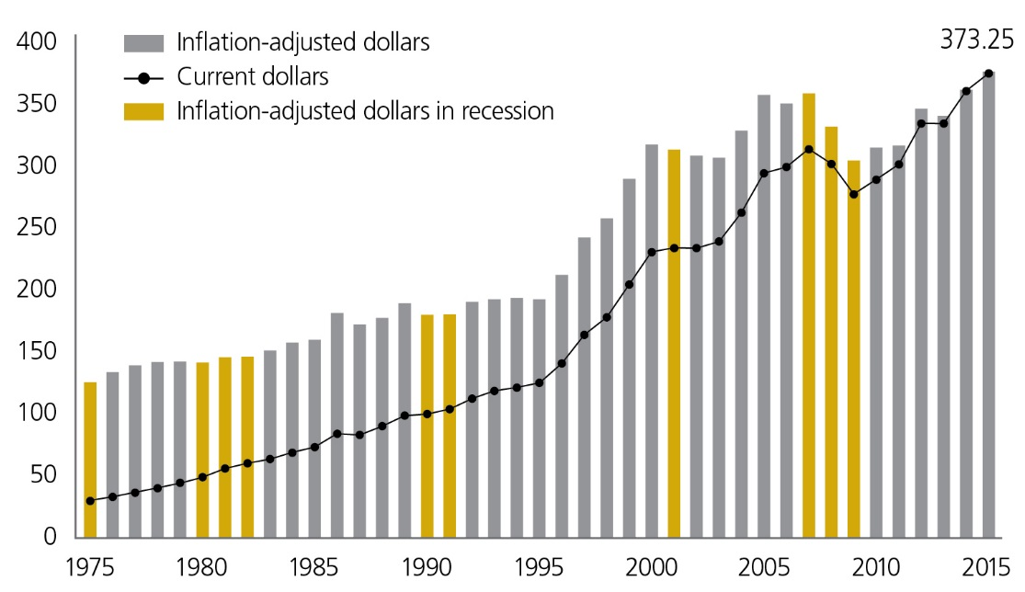
Giving Is Influenced by Economic Conditions:
Total Giving, 1975−2015 (in Billions of Dollars)
SOURCE: Giving USA Foundation | GIVING USA 2016
Notes:
Total giving reached $373.25 billion in 2015, a 4.1 percent increase in current dollars and a 4.0 percent increase in inflation-adjusted dollars.¹¹
Total charitable giving has increased in current dollars every year since 1975, with the exception of three years that saw declines: 1987, 2008, and 2009.¹² The average rate of change in total giving in current dollars since 1975 is 6.7 percent, making the rate of change between 2014 and 2015 lower than average.
Adjusted for inflation, total charitable giving has decreased 9 times since 1975. The average rate of change in total giving in inflation-adjusted dollars since 1975 is 2.7 percent, making the inflation-adjusted rate of change between 2014 and 2015 higher than average.
The year 2009 was the last year of the Great Recession. For the years 2009 to 2015, the rate of change in total inflation-adjusted giving is 23.0 percent. Total charitable giving has grown $69.70 billion in inflation-adjusted dollars since 2009.
In 2015, total giving and giving by foundations and corporations matched or exceeded their previous inflation-adjusted highs. On the recipient side of giving, all but four charitable subsectors have matched or exceeded their previous inflation-adjusted highs. Giving to health, public-society benefit, international affairs, and foundations have not yet surpassed their prior peaks.

Slide 42
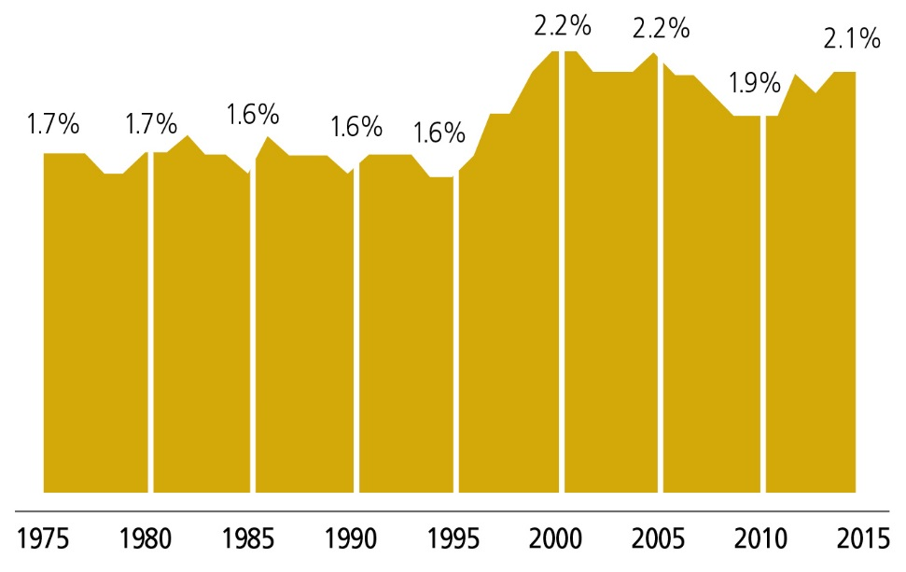
Total Giving As A Percentage of Gross Domestic Product, 1975−2015 (in Inflation-Adjusted Dollars, 2015 = $100)
SOURCE: Giving USA Foundation | GIVING USA 2016
Notes:
Several economic factors influence how much donors give to charity each year. Gross Domestic Product (GDP) is one of those factors. GDP is defined as the market value of all goods and services produced within a country’s borders within a specific period of time. It is one of the most important factors considered in measuring the status of a nation’s economic health.³⁰
GDP increased in inflation-adjusted dollars by 3.3 percent between 2014 and 2015.³¹ This rate of change is compared with inflation-adjusted growth in total giving of 4.0 percent. Total giving as a percentage of GDP in 2015 was 2.1 percent.
Prior to the 40-year period 1975–2015, total giving was consistently at or above 2.0 percent of GDP. This percentage fell to below 2.0 percent throughout most of the 1970s, 1980s, and 1990s. Total giving as a percentage of GDP rose to 2.0 percent and above through most of the 2000s, but then dropped to 1.9 percent in the years 2009 to 2011. Total giving as a percentage of GDP was 2.1 percent for three of the four years, 2012–2015.

Slide 43
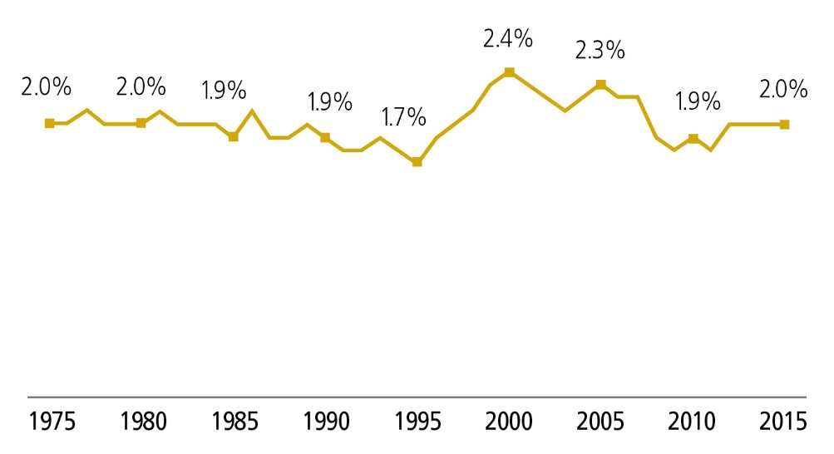
Individual Giving Remains Constant at
About 2% of Disposable Personal Income
SOURCE: Giving USA Foundation | GIVING USA 2016
Notes:
Disposable personal income is tied to a household’s total income, which is a key determinant in how much a household gives. For many households, how much they give depends on their spendable income, or disposable (personal) income. This type of income is that which is available after taxes have been paid.³³
In 2015, disposable income increased 3.7 percent (in current dollars) from 2014. This is compared with growth in disposable income of 4.2 percent between 2013 and 2014.³⁴
Individual giving as a percentage of disposable personal income (in current dollars) remained stable at 2.0 percent in 2015, the same percentage as in the years 2012 to 2014.
In the last 40 years, individual giving as a percentage of disposable personal income was at its highest in 2000, when it reached 2.4 percent. Its lowest point was in 1995, when it dropped to 1.7 percent.

Slide 44
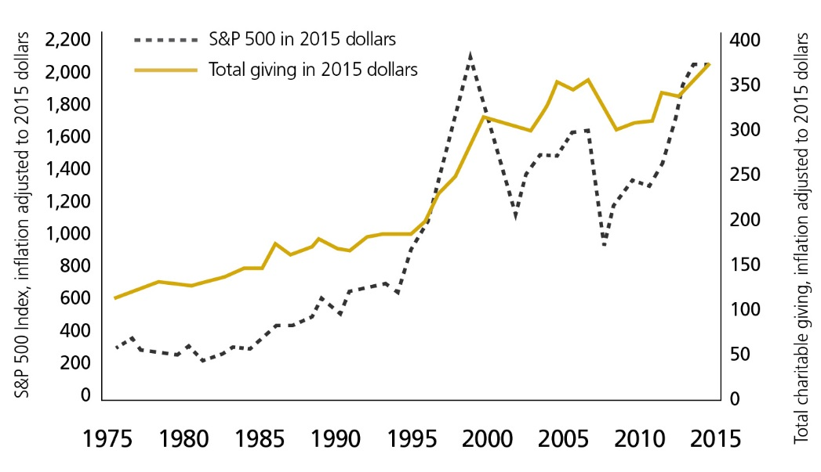
Overall Giving Fluctuates with S&P 500
Total charitable giving graphed with the Standard & Poor's 500 Index, 1975-2015 (in billions of inflation-adjusted dollars, 2015 = $100)
SOURCE: Giving USA Foundation | GIVING USA 2016
Notes:
Research has found a statistically significant correlation between changes in total giving and values on the Standard & Poor’s 500 Index (S&P 500). Because stock market values are an indicator of financial and economic security, households and corporations are more likely to give when the stock market is up.
The direction of change and the robustness of growth in total giving generally lag slightly behind the S&P 500. However, policy changes that affect giving can alter the connection between giving and stock values.
The S&P 500 generally sees more dramatic changes from year to year than total giving. The inflation-adjusted range of change in the S&P 500 in the last 10 year period (2005 to 2015) was -40.8 percent to 27.7 percent.³² This is compared with inflation-adjusted total giving ranging from a change of -8.0 percent to 9.2 percent during this same period.
The S&P 500 declined 0.8 percent in inflation-adjusted dollars between 2014 and 2015. This is compared with an increase in inflation-adjusted total giving of 4.0 percent.

Slide 45
Largest Fundraising Charities and Their Share of Private Philanthropy in 2015
Charitable Contributions to The Top 25 Fundraising Charities
Rank | Charity | Total private support $ millions
Estimated Total Private Gifts
100% = $373 billion
1 | Fidelity Charitable Gift Fund
2 | United Way Worldwide *
3 | Feeding America
4 | Schwab Charitable Fund
5 | Catholic Charities USA *
6 | Salvation Army *
7 | The Task Force for Global Health *
8 | Stanford University
9 | National Christian Foundation *
10 | Silicon Valley Community Foundation
11 | Vanguard Charitable Endowment Program
12 | The Y *
13 | Food for the Poor
14 | Harvard University
15 | American Lebanese Syrian Associated Charities/St. Jude Children's Research Hospital
16 | Boys & Girls Clubs of America *
17 | National Philanthropic Trust
18 | Goodwill Industries International *
19 | Direct Relief *
20 | Habitat for Humanity International *
21 | World Vision
22 | American Cancer Society *
23 | Patient Access Network Foundation
24 | Compassion International
25 | AmeriCares Foundation
Received by
the 400 largest charities
Received by the rest
(includes ~1 million
charities and thousands
of religious organizations)
NOTE: Annual ranking of organizations that receive the most each year in private donations
¹ Includes affiliates
Source: The Chronicle of Philanthropy at: https://philanthropy.com/interactives/phil400

Slide 46
DATA REVEAL Changing Donor motivations, expectations

Slide 47
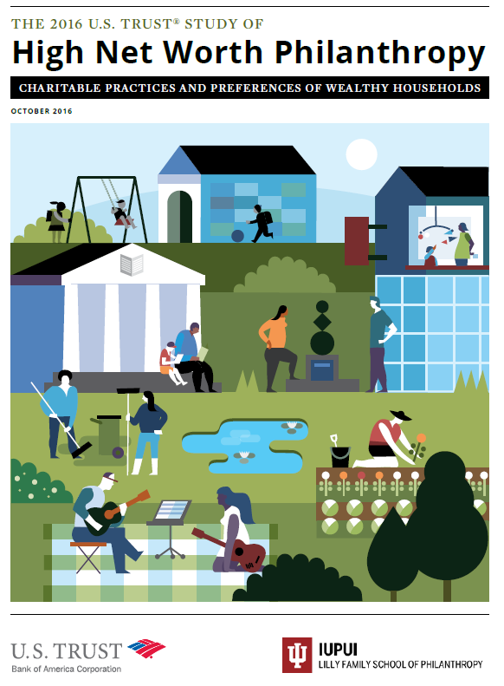
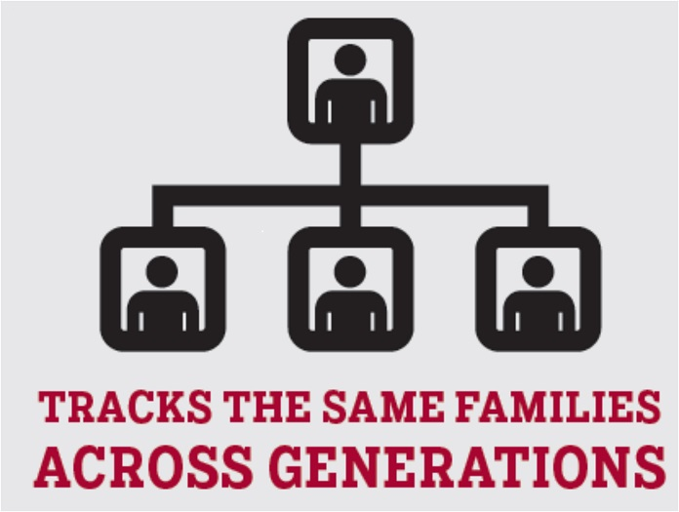
Philanthropy Panel Study (PPS)
Longitudinal individual giving data
Bank of America Studies of
High Net Worth Philanthropy
Notes:
Philanthropy Panel Study:
A module within the long-running Panel Study of Income Dynamics (PSID)
Only longitudinal study of American philanthropy
National representative sample: 10,000 households
As couples split and children leave home, these new households also surveyed
Bank of America Studies:
Studies the giving patterns, priorities, and attitudes of American’s wealthiest households
Giving patterns, perceptions, motivations, decision-making, values, traditions, volunteering, demographics
“New frontier” questions: Donor strategies, giving outcomes, donor’s economic and political priorities
12-page survey fielded to 20,000 high net worth donors in America’s wealthiest neighborhoods
Only included households with income greater than $200,000 and/or net worth more than $1,000,000 (excluding the monetary value of their home)
In 2012, national random sample of 700 households; average net worth of responding households $10.7 million

Slide 48
Donor incidence over time, 2000−2008
SOURCE: Philanthropy Panel Study
Notes:
Oldest generations are more likely to give and give more, on average.
Millennials: Average total giving, $557; 33 percent give
Gen X: Average total giving, $1,488; 59 percent give
Boomer: Average total giving, $2,613; 69 percent give
Silent & Great: Average total giving, $2,54; 77 percent give
From 2007 to 2009, we see an increased likelihood of giving over time only in those households headed by individuals 65+ (from 75.5 percent in 2007 to 79.8 percent in 2009).
America's newest generation, the Millennials, is in the middle of this coming-of-age phase of its life cycle. Its oldest members are approaching age 30; its youngest are approaching adolescence.
Who are they? How are they different from -- and similar to -- their parents? How is their moment in history shaping them? And how might they, in turn, reshape America in the decades ahead?
Silent and Great (Pre-boomers)
Born 1945 or earlier
Boomer
Born 1946 to 1964
Generation X
Born 1965 to 1980*
Millennials (Generation Y)
Born 1980 to 2000*
* Some may end Generation X in 1976 and some may classify Millennials as born 1977 until the late 1990s

Slide 49
Oldest generations more likely to give
and give more, on average
SOURCE: Philanthropy Panel Study

Slide 50
How High Net Worth Donors
Determine the Impact of Their Giving
The organization to which you donated
Direct engagement
with nonprofits
How do you determine whether your giving is or is not having the impact you intended? Do you rely on information from…*
Own perception
Nonprofit reports
Public reporting
Information from staff/advisor
The population or area that
you donated to support
Peers
The Media/Internet
Other
*The percentages in this figure were calculated based on the 21.7 percent of high net worth donors who monitor the impact of their giving only.
SOURCE: 2016 U.S. Trust Study of High Net Worth Philanthropy
Notes:
21.7 percent of high net worth individuals monitor the impact of their giving, relying on information from many sources. Of the 21.7 percent of high net worth donors who monitor the impact of their giving, the most common source of information comes directly from the organization to which the donors contributed (79.2 percent). Other important sources of information regarding the impact of one’s giving come from direct engagement with non-profits (potentially through volunteering) (46.4 percent) and from one’s own perception of impact (41.1 percent).

Slide 51
Confidence in Societal Institutions
to Effect Change
Individuals
55.8%
Nonprofit
organizations
68.3%
How much confidence do you have in the ability of the following groups to solve societal or global problems, now and in the future?
Religious
institutions
43.4%
Small-to mid- sized
businesses
57.7%
Large
corporations
50.7%
Supreme Court/
Federal judiciary
53.8%
President/
Federal executive branch
45.4%
Congress/
Federal legislative branch
36.5%
State or local government
54.5%
Notes:
High net worth households have the most confidence in individuals (87.2 percent reporting either “some” or “a great deal”) and nonprofit organizations (86.6 percent reporting “some” or “a great deal”) to solve societal or global problems. Sizeable proportions of wealthy households held “hardly any” confidence in Congress/Federal legislative branch (58.7 percent), the President/Federal executive branch (46.6 percent), and state or local governments (41.8 percent).
Subgroup Findings:
Women and younger individuals were significantly more likely to express confidence in nonprofit organizations’ ability to solve societal or global problems.
2014 Study:
A Great Deal of Confidence--
Individuals (40.6%)
Nonprofit organizations (30.9%)
Religious Institutions (22.0%)
Small to mid-sized businesses (13.3%)
Large corporations (7.9%)
Federal executive branch (7.6%)
State or local government (4.5%)
Congress (1.1%)

Slide 52
Impact of technology on philanthropy

Slide 53



Impact of technology on philanthropy

Slide 54
Online Giving:
A Small But Growing Piece of the Pie
SOURCE: Blackbaud | 2016 Charitable Giving Report
Notes:
Source: Blackbaud, 2016 Charitable Giving Report
In 2016, 7.2% of total fundraising came from online giving. This was a slight increase from 7.1% in 2015. This is based on an analysis of data from 3,908 organizations with $24.1 billion in total fundraising in 2016.
Large nonprofits have re-established their presence in driving online giving across their fundraising programs. For large organizations, 7.7% of fundraising revenue came from online donations in 2016. This was followed by small nonprofits at 6.2% and medium-sized organizations at 5.1%.
Public Society & Benefit organizations have replaced Medical Research as the sector raising the highest percentage of their total fundraising revenue from online gifts. Year-over-year increases with Arts & Culture and Healthcare nonprofits saw digital giving increase its share over overall fundraising.
Online giving remains less than 10% of total fundraising as we approach 20 years since the first online donation. As a point of comparison, the U.S. Department of Commerce estimates that ecommerce sales in the third quarter of 2016 accounted for 8.2% of total sales. The nonprofit sector is now lagging behind consumer trends for online activity.

Slide 55
Crowdfunding As A New Tool of Fundraising
SOURCE: Massolution/Crowdsourcing.org | 2015CF Crowdfunding Industry Report
Notes:
Source: Massolution/Crowdsourcing.org | 2015CF Crowdfunding Industry Report
http://crowdexpert.com/crowdfunding-industry-statistics/
Total Global Crowdfunding Industry estimated fundraising volume in 2015: $34 Billion
Breakdown:
Donation: $2.85B
Reward: $2.68B
P2P Lending: $25.1B
Equity: $2.56B
Royalty: $405M
Hybrid: $811M

Slide 56
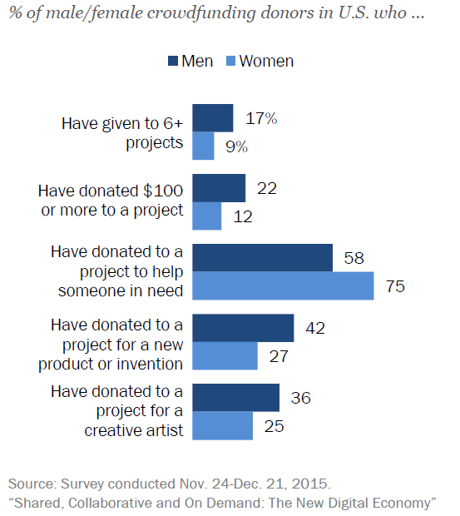
Gender Differences in Crowdfunding Donors
SOURCE: Pew Research Center | Shared, Collaborative and On Demand: The New Digital Economy
Notes:
Source: Pew Research Center
Full report: http://www.pewinternet.org/2016/05/19/collaborative-crowdfunding-platforms/
Female crowdfunding donors are more likely to contribute to help someone in need; men tend to contribute to a wider variety of projects, especially those funding new products or inventions
Overall, women are a bit more likely than men to donate to a crowdfunding project of any kind: 24% of women and 19% of men have done this. But among project contributors, men are much more active than women – both in terms of the number and type of projects they fund and the size of the contributions they make.
Male donors are roughly twice as likely as female donors to have contributed to six or more projects (17% of male donors have done so, compared with 9% of female donors), and also nearly twice as likely to have contributed more than $100 to an individual project (22% vs. 12%). They are also substantially more likely to have contributed to projects seeking to fund a new product or invention, as well as projects for a musician or other creative artist. On the other hand, women are significantly more likely than men to contribute to a project to help someone in need – 75% of female donors have contributed to this type of project, compared with 58% of men.
Looking within the male donor population, younger men in particular stand out for their interest in funding projects relating to new products or inventions. Nearly half of men ages 18-49 who have contributed to a crowdfunding project (48%) have given to a project to fund a new product or invention – a figure that is substantially higher than the share of similarly aged women (31%), older women (20%) or older men (27%) who have done so. By the same token, younger male donors (that is, those ages 18-49) are substantially less likely to have contributed to a project to help someone in need – just 54% have done so, compared with 75% of younger women, 74% of older women and 67% of older men.

Slide 57
THE FUTURE OF PHILANTHROPY

Slide 58






Slide 59




High Net Worth Households’
Future Giving Levels
Relative to my charitable giving in the past, in the next three years, I plan to…
Which factors may contribute to that change?
81.1%
20.5%
A change in financial capacity
As I become a more experienced donor
35.7%
19.2%
A change in life circumstance
A change in the federal tax policy
30.8%
3.8%
Changes in the perception of the needs of an organization or cause
Don’t know
Continue
giving at the
same contribution
level
Increase my contribution
level
Don’t
know
Decrease my
Contribution
level
23.8%
3.0%
Community or global events, including disasters
Other
SOURCE: 2016 U.S. Trust Study of High Net Worth Philanthropy
Notes:
LEFT SIDE FIGURE: When asked about their future giving plans, the majority of high net worth donors intend to continue giving at the same contribution level over the next three years (55.1 percent). However, a sizeable minority plan to increase their contribution level (28.2 percent). Very few wealthy donors plan to decrease their contribution level over the next three years (3.4 percent).
Subgroup Findings:
African Americans, women, and younger individuals are significantly more likely to plan to increase their giving in the next three years.
2014 Study:
Increase = 35.4%
Continue giving = 49.5%
Decrease = 6.1%
Don’t know = 9.0%
RIGHT SIDE FIGURE: Predicted changes in high net worth donors’ charitable giving depends primarily on personal factors. 81.1 percent of wealthy donors who expected to either increase or decrease their charitable giving over the next three years explained that this change was due to financial capacity. Smaller percentages attributed the change to life circumstances (35.7 percent) or changes in the perception of the needs of organizations (30.8 percent).

Slide 60
Thank You!
Una Osili, Ph.D.
Professor of Economics
Director of Research
philanthropy.iupui.edu

