Slide 1
Medicare Shared Savings Program
Terri L. Postma, MD, CHCQM
Medical Officer
Performance-Based Payment Policy Group, Center for Medicare,
Centers for Medicare & Medicaid Services (CMS),
Department of Health and Human Services
February 25, 2015

Slide 2
Agenda
Overview of the Shared Savings Program
Observations from PY1 results
Looking ahead

Slide 3
ACO Vision
An ACO promotes seamless coordinated care
Puts the beneficiary and family at the center
Remembers patients over time and place
Attends carefully to care transitions
Manages resources carefully and respectfully
Proactively manages the beneficiary’s care
Evaluates data to improve care and patient outcomes
Innovates around better health, better care and lower growth in costs through improvement
Invests in team-based care and workforce

Slide 4
CMS’s ACO Strategy: Creating Multiple Pathways with Constant Learning and Improving
MSSP: Track 1 & Track 2
Pioneer
ACO
Model
Advance Payment

Slide 5
Interagency Coordination
Antitrust Agencies (FTC/DOJ): Antitrust Policy Statement
http://www.ftc.gov/tips-advice/competition-guidance/industry-guidance/health-care/accountable-care-organizations
IRS: http://www.irs.gov/uac/Tax-Exempt-Organizations-Participating-in-the-Medicare-Shared-Savings-Program-through-Accountable-Care-Organizations
OIG/CMS: Interim Final with Comment
http://oig.hhs.gov/compliance/accountable-care-organizations/

Slide 6
Participation is Growing Rapidly
405 ACOs have been established, including 89 new Shared Savings ACOs for 2015
7.2 million assigned beneficiaries in 47 states, plus DC and PR
CMS expects continued growth in the Shared Savings Program in 2016 and annually thereafter.

Slide 7
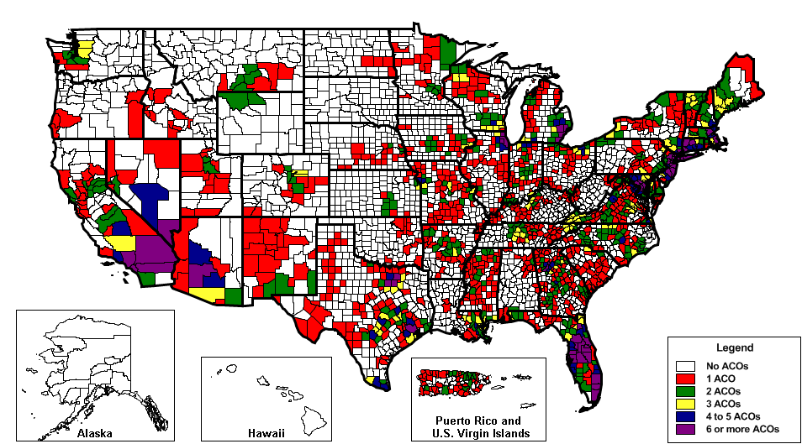
Participation is Growing Rapidly
ACO-Assigned Beneficiaries by County (includes 2012-2014 starters)

Slide 8
Signs of Success - Improving Quality
Nearly all ACOs successfully reported quality measures and earned PQRS incentives.
Shared Savings Program ACOs improved on 30 of 33 quality measures. Quality improvement was shown in such measures as patients’ ratings of clinicians’ communication, beneficiaries’ rating of their doctor, health promotion and education, screening for tobacco use and cessation, and screening for high blood pressure.
Shared Savings Program ACOs achieved higher average performance rates on 17 of the 22 Group Practice Reporting Option Web Interface measures reported by other Medicare FFS providers reporting through this system.
In 2013 alone, over 125,000 eligible professionals who were ACO providers or suppliers qualified for their incentive payments for reporting their quality of care through the Physician Quality Reporting System (PQRS) These providers will also avoid the PQRS payment adjustment in 2015 because they demonstrated the ability to report quality measures through their ACO.

Slide 9
Signs of Success - Improving Costs
First year results showed 58 Medicare Shared Savings Program (MSSP) ACOs held spending $705 million below their targets and earned performance payments of more than $315 million as their share of savings.
One ACO in Track 2 overspent its target by $10 million and owed shared losses of $4 million.
An additional 60 ACOs reduced health care costs compared to their benchmark but did not qualify for sharing in savings.

Slide 10
Signs of Success – Improving Care
ACOs are engaging in a variety of innovative care coordination and practice redesign activities with local providers in their communities.
ACOs are using medial record and Medicare claims data to assist them in redesigning care and monitoring their performance.
ACOs identified physician engagement, patient engagement, care transitions, and post-acute care as key issues and are working on strategies to improve in these areas.

Slide 11
Lessons Learned – Medicare Shared Savings Program
Importance of strong clinical leadership
Communication and transparency
Practice redesign
Innovative care coordination
The value of data and dashboards
Pick a few things to improve first, then build on success

Slide 12
Looking Ahead
New group of Medicare Shared Savings Program ACOs started January 1, 2015.
New groups will start January 1, 2016.
Seeking comment on proposed rule changes (due Feb 6, 2015)

Slide 13
The CMS Vision
Retain and increase the number of ACOs operating in the program
Gradually shift more organizations to higher performance-based risk tracks
Use CMS Innovation Center authority to test the next generation of ACOs
Foster environment for providers to work together to improve care through better information and data sharing, and better engagement of physicians and patients
Provide a forum for sharing learnings to identify strategies that are working well and identify areas for improvement

Slide 14
Resources
Contact:
ACO@cms.hhs.gov
For more information, visit the Medicare Shared Savings Program website:
www.cms.gov/sharedsavingsprogram

