Slide 1
Getting There Together: Creating Sustainable Value Through New Partnerships
Kristen Miranda
Vice President, Strategic Partnerships and Innovation
Blue Shield of California
Federal Trade Commission & Department of Justice
Examining Health Care Competition – Workshop
February 25, 2015

Slide 2
Mission | Approach | Results | Lessons Learned | What’s Next
Our Mission - To create a new kind of partnership that enables us to:
Deliver care at below-market cost trends
Achieve financial results that are sustainable for all parties
Find and implement cost and quality improvements
Enhance the ACOs appeal to consumers and employers
Health Plan
Trust
Hospital
Medical Group

Slide 3
Where We Started
Mission | Approach | Results | Lessons Learned | What’s Next
2009
Service Categories | 2010 Target (pmpm) | 2010 No ACO (pmpm) | Savings needed ($M)
Total Facility | $ 203 | $ 223 | $ 9.9
Dignity Facilities | $ 153
OOA ER (Non-Dignity) | $ 10
All Other (Non-Dignity) | $ 39
Professional (1) | $ 125 | $ 132 | $ 3.7
Mental Health (capitated) | $ 10 | $ 10 | $ -
Pharmacy | $ 58 | $ 62 | $ 1.7
Ancillary | $ 7 | $ 8 | $ 0.2
Total pmpm | $ 403 | $ 435 | $ 15.5
40,700 CalPERS Members
$403 pmpm
Actual
$15M – a bold goal for partners
Hold Trend to 0% in 2010

Slide 4
Mission | Approach | Results | Lessons Learned | What’s Next
How We Accomplished It
Driving change through accountability, transparency and aligned incentives to:
Built on HMO platform – now implementing for PPO and Medicare Advantage
Unique collaboration with medical groups, hospitals and Blue Shield
Value-based payments and aligned incentives
Data integration and information sharing
Quality outcomes and member satisfaction
network integrated delivery model
Blue Shield
Medical Group
Hospital
integrated processes
clinical best practices
data integration
metrics and reporting
aligned incentives: each partner is responsible to contribute to cost savings and is at financial risk for any variance from targeted cost reduction goals

Slide 5
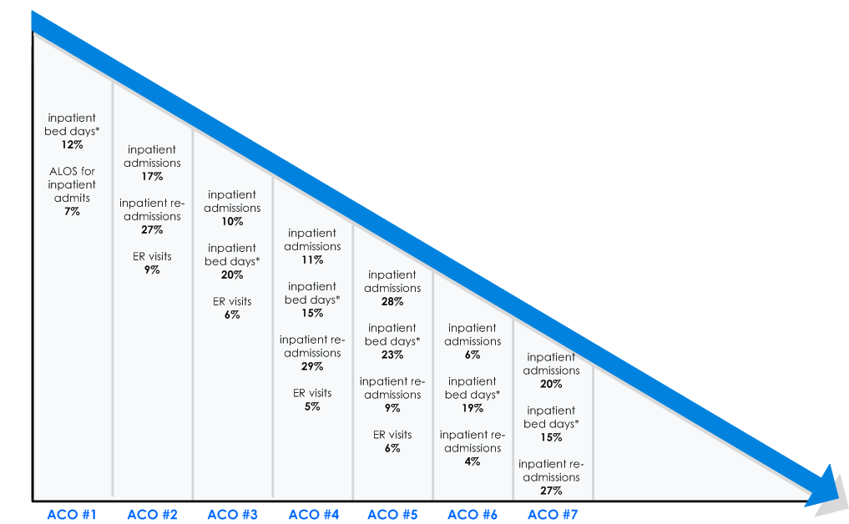
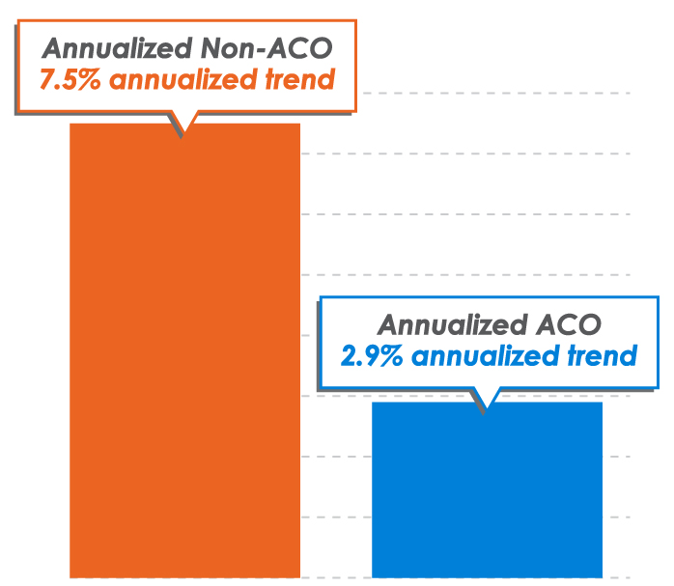
Program Results to Date
Mission | Approach | Results | Lessons Learned | What’s Next
Includes ACO partners with experience through CY 2013
Nearly $300 MM saved
> $40 PMPM
Includes ACO partners with sufficient claims to measure year-over-year trend
-
-
-
-
-
-
-
-
-
-
-
-
-
-
-
-
-
Data paid through 12/13
Comparison of baseline (pre ACO) to most recent completed ACO contract period
¹ trend as of Feb 2013
-
-
-
-
-
-
-
ACO 7
ACO 1
ACO 7
ACO 1
ACO 3
ACO 3
ACO 4
ACO 4
ACO 5
ACO 5
ACO 6
ACO 2
ACO 6
ACO 2
Notes:
Rationale for ‘risk adjusted bed days’ provided by Kevin Fulton: By risk adjusting days we remove the impact / change in days associated with changes is the ACOs risk profile. With changes to a population’s risk score we expect changes to inpatient days and admissions (we have found no correlation for with other metrics), and by comparing risk adjusted we try to removed that impact to the change.
ACO #1 =Hill/Dignity CalPERS (Sacramento)
ACO #2= Hill CCSF (San Francisco)
ACO #3= Brown & Toland CCSF (San Francisco)
ACO #4= St. Joseph’s (Orange Cty)
ACO #5= All Care (Stanislaus Cty)
ACO #6= John Muir (Contra Costa)
ACO #7 – Greater Newport/Hoag (Orange Cty)

Slide 6
Lessons Learned
Mission | Approach | Results | Lessons Learned | What’s Next
Senior leadership engagement is critical
Financial integration – upside and downside is key
Quality is key but quality alone is not enough
Hospitals must have a seat at the table – they are the biggest and most crucial cost element
Transparency is key to changing the dialogue between plans and providers
Financial model must link success/failure across partners - only this will compel a new kind of information sharing and collaboration
Program insights must be applied to a provider’s entire book of business
Success requires significant investment of time and resources across all partners
Clinical expertise and resources
Data aggregation (claims, Rx, authorizations)
Reporting/actionable information
Program management
And, critically – strategic alliances supported by contractual relationships work – ACOs do not necessarily require joint ventures where partner roles are clearly defined
Our future success – or failure – is inextricably linked

Slide 7
So far, so good….
but it isn’t enough

Slide 8
Bending the Cost Trend is Critical but Not Sufficient….
Mission | Approach | Results | Lessons Learned | What’s Next
Enhanced Member Experience
Best-in-class Quality
Collaborative Model with ACO Providers
Technology Integration
BSC established the Quality Council comprised of statewide provider leadership
Focusing on delivering best-in-class quality results through the unique partnership amongst ACOs to identify & implement best practice quality initiatives
BSC is working to make available both information and population/ patient management solutions to its providers in order to enable higher quality and lower cost care
BSC is working with our ACO provider partners to identify & implement additional benefits that enhance the member’s experience
Items being explored include a concierge type service & enhanced wellness offerings
BSC’s ACO program has evolved into a deep integration model with our providers
Feeling of mutual investment
Exceptional trust and transparency
expanding HMO ACOs to broaden statewide coverage
expanding ACOs to our PPO & Medicare Advantage business
using the Quality Council to enhance the member experience
launching products around the new ACO delivery model

Slide 9
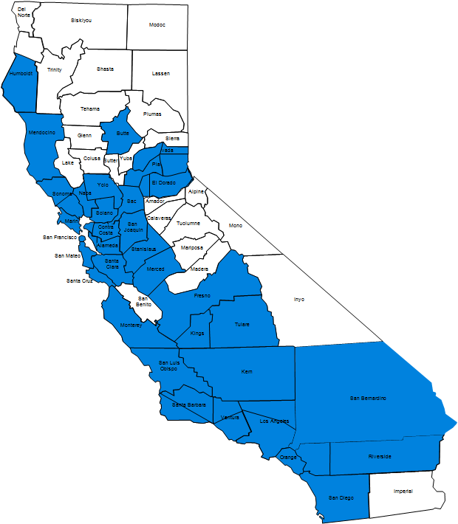
Where We’re Headed Next
Mission | Approach | Results | Lessons Learned | What’s Next
Breadth
Statewide Access: ACO partnership network covering all BSC business segments and available to 80% of Californians
+
Depth
Technical Integration: Real-time access to patient records Care applications Innovative Care Model: Personalized Evidence-based Patient-centered Care Models of the Future (Cancer +) Superior Customer Experience Efficient, Accessible Convenient Transparent
=
Transformation
High Quality: Top percentile care Care worthy of our family and friends Affordable: <3% trend Best price in market
And now
introducing:

