Slide 1
Marketplace models and premiums: Evidence from the first open enrollment period Kelly Krinn, University of Minnesota Pinar Karaca-Mandic, University of Minnesota and NBER Lynn Blewett, University of Minnesota

Slide 2
Hallmark of ACA
The Affordable Care Act (ACA) of 2010 included many provisions to make health insurance coverage more accessible and more affordable
ACA health insurance marketplaces enrolled over 8 million individuals during the first open enrollment period

Slide 3
Marketplace Models
Significant variation in state decisions regarding the design and implementation of states’ marketplace
Exchange Governance
Plan Management Strategy
Plan Management Authority

Slide 4
Governance
State-Based
Manage the marketplace
Online portal for consumers
Raising revenue to fund the marketplace
Encourage enrollment through marketing/consumer assistance
State-Federal Partnership
Federally Facilitated

Slide 5
Plan Management Strategy
State-Based Marketplace
Clearinghouse model (SBM-C)
All health plans that meet the published criteria are accepted to the Marketplace
Active purchaser (SBM-A)
States can directly negotiate premiums, provider networks, number and benefits of plans; and can contract with a select group of health plans
Partnership Marketplaces and Federally Facilitated Marketplaces all had the clearinghouse model

Slide 6
Plan Management Authority
In state-based marketplaces (SBMs) and in state-federal partnership marketplaces (SPM), state has the plan management authority
For example on approving qualified plans and being proactive in contracting with plans in regard to quality targets and premium rates
In federally facilitated marketplaces
State conducts plan management (FFMS)
Federal government conducts plan management (FFM)

Slide 7
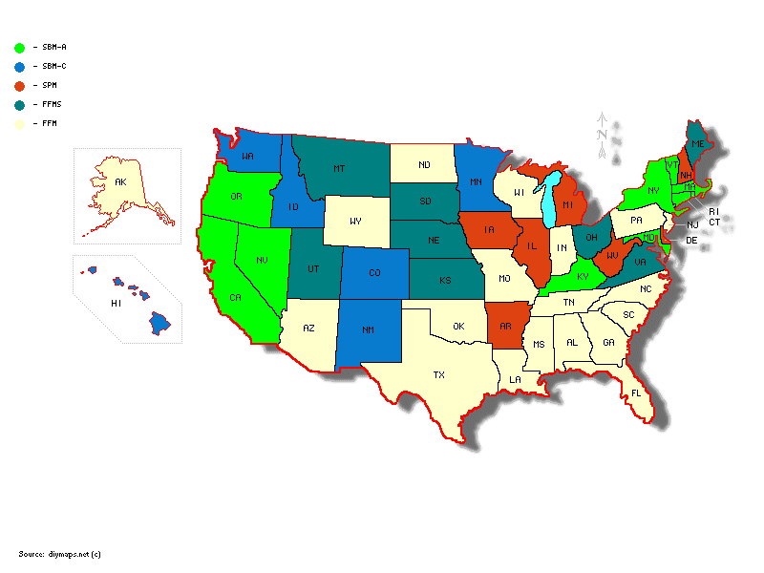
Each state is divided into geographic rating areas
for regulation purposes
SBM-A: 10 states; 67 rating areas
SBM-C: 7 states; 39 rating areas
SPM : 7 states; 56 rating areas
FFMS : 8 states; 58 rating areas
FFM : 19 states; 281 rating areas

Slide 8
Important questions
Did plan premiums vary across state-based, partnership, federally facilitated governance models?
Did premiums in state-based marketplaces with active purchaser models (SBM-A) differ from those with clearinghouse models (SBM-C)?
Did premiums in federally facilitated marketplaces with states performing plan management (FFMS) differ others with federal plan management authority (FFM)?

Slide 9
Our study
First look at marketplace implementation and assesses the premium differences across different marketplace models
Stratified analysis by plan type (bronze, lowest silver, second lowest silver and gold), and
Controlled for a rich set of plan characteristics and rating-area characteristics

Slide 10
Dependent variable: Premiums
State marketplace websites and U.S. HHS website
By rating area: premiums and plan information for
Lowest cost bronze, lowest cost silver, lowest cost gold and second lowest cost silver plans
Premiums for a 29 year old non-smoker individual
Health Insurance Exchange (HIX) Compare dataset
By rating area: premiums and plan information for all silver plans
Premiums for a 27 year old and a 50 year old non-smoker individual

Slide 11
Control variables at the rating area level - baseline
Number of participating insurance companies
Hospital HHI
Age-Race/ethnicity composition of population
Uninsurance rate, unemployment rate, median household income
Population health: Health status, diabetes, obesity, per-capita medical costs
Sources: Exchange websites, County Health Rankings, Dartmouth Atlas
Variables collected at the county level, and aggregated to rating area level

Slide 12
Control variables at the state level - baseline
Rate review authority: prior approval or not
Medicaid fee index
Baseline average premiums
Whether state recommended an essential health benefit (EHB) benchmark beyond the ACA default
Whether the state expanded Medicaid under the ACA Medicaid expansion option.
Sources: Kaiser Family Foundation and the National Conference of State Legislatures

Slide 13
Statistical model
Analysis 1: examined premiums of lowest cost plans by metal-type (bronze, silver, gold) as well as the second-lowest silver plans in each rating area
Unit of analysis: plan type for each rating area
Analysis 2: examined premiums of all silver plans
Unit of analysis: each silver plan in each rating area
Generalized estimating equations model
Log link, gamma distribution
Allow for correlation of errors within states
Key independent variables: marketplace model indicators (SBM-A, SBM-C, SPM, FFMS, FFM)
Also control for plan benefit design (copay, deductible, OOP max) and other controls listed earlier

Slide 14
Selected rating area characteristics by marketplace model
 | SBM-A | SBM-C | SPM | FFMS | FFM
Number of insurers participating in the marketplace | 5 (2.5) | 4.5 (1.4) | 4.1 (2.7) | 3.9 (1.5) | 3.2 (1.8)
% in a state with Medicaid expansion | 100 (0) | 82.1 (38.9) | 98.2 (13.4) | 29.3 (45.9) | 4.3 (20.3)
% in a state with state recommended EHB | 100 (0) | 59.0 (49.8) | 67.9 (47.1) | 37.9 (48.9) | 11.7 (32.3)
% obese | 25.9 (4.2) | 24.9 (4.6) | 30.8 (2.8) | 29.2 (2.9) | 31.0 (4.5)
% diabetes | 8.6 (1.5) | 7.5 (1.6) | 10.1 (1.9) | 9.4 (1.6) | 10.9 (2.1)
% uninsured | 15.3 (5.9) | 17.2 (5.3) | 15 (3.3) | 15.8 (2.7) | 20.3 (5.2)
Standard deviations in parentheses

Slide 15
Selected rating area characteristics by marketplace model
 | SBM-A | SBM-C | SPM | FFMS | FFM
Number of insurers participating in the marketplace | 5 (2.5) | 4.5 (1.4) | 4.1 (2.7) | 3.9 (1.5) | 3.2 (1.8)
% in a state with Medicaid expansion | 100 (0) | 82.1 (38.9) | 98.2 (13.4) | 29.3 (45.9) | 4.3 (20.3)
% in a state with state recommended EHB | 100 (0) | 59.0 (49.8) | 67.9 (47.1) | 37.9 (48.9) | 11.7 (32.3)
% obese | 25.9 (4.2) | 24.9 (4.6) | 30.8 (2.8) | 29.2 (2.9) | 31.0 (4.5)
% diabetes | 8.6 (1.5) | 7.5 (1.6) | 10.1 (1.9) | 9.4 (1.6) | 10.9 (2.1)
% uninsured | 15.3 (5.9) | 17.2 (5.3) | 15 (3.3) | 15.8 (2.7) | 20.3 (5.2)
Standard deviations in parentheses

Slide 16
Selected rating area characteristics by marketplace model
 | SBM-A | SBM-C | SPM | FFMS | FFM
Number of insurers participating in the marketplace | 5 (2.5) | 4.5 (1.4) | 4.1 (2.7) | 3.9 (1.5) | 3.2 (1.8)
% in a state with Medicaid expansion | 100 (0) | 82.1 (38.9) | 98.2 (13.4) | 29.3 (45.9) | 4.3 (20.3)
% in a state with state recommended EHB | 100 (0) | 59.0 (49.8) | 67.9 (47.1) | 37.9 (48.9) | 11.7 (32.3)
% obese | 25.9 (4.2) | 24.9 (4.6) | 30.8 (2.8) | 29.2 (2.9) | 31.0 (4.5)
% diabetes | 8.6 (1.5) | 7.5 (1.6) | 10.1 (1.9) | 9.4 (1.6) | 10.9 (2.1)
% uninsured | 15.3 (5.9) | 17.2 (5.3) | 15 (3.3) | 15.8 (2.7) | 20.3 (5.2)
Standard deviations in parentheses

Slide 17
Selected rating area characteristics by marketplace model
 | SBM-A | SBM-C | SPM | FFMS | FFM
Number of insurers participating in the marketplace | 5 (2.5) | 4.5 (1.4) | 4.1 (2.7) | 3.9 (1.5) | 3.2 (1.8)
% in a state with Medicaid expansion | 100 (0) | 82.1 (38.9) | 98.2 (13.4) | 29.3 (45.9) | 4.3 (20.3)
% in a state with state recommended EHB | 100 (0) | 59.0 (49.8) | 67.9 (47.1) | 37.9 (48.9) | 11.7 (32.3)
% obese | 25.9 (4.2) | 24.9 (4.6) | 30.8 (2.8) | 29.2 (2.9) | 31.0 (4.5)
% diabetes | 8.6 (1.5) | 7.5 (1.6) | 10.1 (1.9) | 9.4 (1.6) | 10.9 (2.1)
% uninsured | 15.3 (5.9) | 17.2 (5.3) | 15 (3.3) | 15.8 (2.7) | 20.3 (5.2)
Standard deviations in parentheses

Slide 18
Adjusted premiums by metal-type and marketplace model
 | Lowest cost bronze |  | Lowest cost silver |  | Second lowest cost silver |  | Lowest cost gold
 | Mean | P | Mean | P | Mean | P | Mean | P
 |  | Diff from SBM-C |  | Diff from SBM-C |  | Diff from SBM-C |  | Diff from SBM-C
SBM-A | $179.49 | 0.008 | $225.37 | 0.006 | $245.27 | <0.001 | $266.91 | 0.007
SBM-C | $157.53 | Ref | $196.92 | Ref | $205.30 | Ref | $233.96 | Ref
SPM | $182.51 | 0.004 | $229.87 | 0.003 | $242.72 | 0.001 | $272.92 | 0.003
FFMS | $185.14 | 0.003 | $224.02 | 0.019 | $234.91 | 0.014 | $268.97 | 0.012
FFM | $189.94 | <0.001 | $233.16 | <0.001 | $241.63 | <0.001 | $277.35 | <0.001

Slide 19
Adjusted premiums by metal-type and marketplace model
 | Lowest cost bronze |  | Lowest cost silver |  | Second lowest cost silver |  | Lowest cost gold
 | Mean | P | Mean | P | Mean | P | Mean | P
 |  | Diff from SBM-C |  | Diff from SBM-C |  | Diff from SBM-C |  | Diff from SBM-C
SBM-A | $179.49 | 0.008 | $225.37 | 0.006 | $245.27 | <0.001 | $266.91 | 0.007
SBM-C | $157.53 | Ref | $196.92 | Ref | $205.30 | Ref | $233.96 | Ref
SPM | $182.51 | 0.004 | $229.87 | 0.003 | $242.72 | 0.001 | $272.92 | 0.003
FFMS | $185.14 | 0.003 | $224.02 | 0.019 | $234.91 | 0.014 | $268.97 | 0.012
FFM | $189.94 | <0.001 | $233.16 | <0.001 | $241.63 | <0.001 | $277.35 | <0.001

Slide 20
Adjusted premiums by metal-type and marketplace model
 | Lowest cost bronze |  | Lowest cost silver |  | Second lowest cost silver |  | Lowest cost gold
 | Mean | P | Mean | P | Mean | P | Mean | P
 |  | Diff from SBM-C |  | Diff from SBM-C |  | Diff from SBM-C |  | Diff from SBM-C
SBM-A | $179.49 | 0.008 | $225.37 | 0.006 | $245.27 | <0.001 | $266.91 | 0.007
SBM-C | $157.53 | Ref | $196.92 | Ref | $205.30 | Ref | $233.96 | Ref
SPM | $182.51 | 0.004 | $229.87 | 0.003 | $242.72 | 0.001 | $272.92 | 0.003
FFMS | $185.14 | 0.003 | $224.02 | 0.019 | $234.91 | 0.014 | $268.97 | 0.012
FFM | $189.94 | <0.001 | $233.16 | <0.001 | $241.63 | <0.001 | $277.35 | <0.001

Slide 21
Adjusted premiums by metal-type and marketplace model
 | Lowest cost bronze |  | Lowest cost silver |  | Second lowest cost silver |  | Lowest cost gold
 | Mean | P | Mean | P | Mean | P | Mean | P
 |  | Diff from SBM-C |  | Diff from SBM-C |  | Diff from SBM-C |  | Diff from SBM-C
SBM-A | $179.49 | 0.008 | $225.37 | 0.006 | $245.27 | <0.001 | $266.91 | 0.007
SBM-C | $157.53 | Ref | $196.92 | Ref | $205.30 | Ref | $233.96 | Ref
SPM | $182.51 | 0.004 | $229.87 | 0.003 | $242.72 | 0.001 | $272.92 | 0.003
FFMS | $185.14 | 0.003 | $224.02 | 0.019 | $234.91 | 0.014 | $268.97 | 0.012
FFM | $189.94 | <0.001 | $233.16 | <0.001 | $241.63 | <0.001 | $277.35 | <0.001

Slide 22
Adjusted premiums of all silver plans by marketplace model
 | 27 year old |  | 50 year old
 | Mean | P | Mean | P
 |  | Diff from SBM-C |  | Diff from SBM-C
SBM-A | $258.25 | 0.023 | 395.56 | 0.56
SBM-C | $221.64 | Ref | 380.46 | Ref
SPM | $273.70 | 0.004 | 450.24 | 0.021
FFMS | $279.63 | 0.003 | 473.79 | 0.005
FFM | $263.79 | 0.012 | 446.62 | 0.020

Slide 23
Adjusted premiums of all silver plans by marketplace model
 | 27 year old |  | 50 year old
 | Mean | P | Mean | P
 |  | Diff from SBM-C |  | Diff from SBM-C
SBM-A | $258.25 | 0.023 | 395.56 | 0.56
SBM-C | $221.64 | Ref | 380.46 | Ref
SPM | $273.70 | 0.004 | 450.24 | 0.021
FFMS | $279.63 | 0.003 | 473.79 | 0.005
FFM | $263.79 | 0.012 | 446.62 | 0.020

Slide 24
Discussion
First look at ACA marketplace premiums by marketplace model
SBM with clearinghouse had the lowest premiums
Clearinghouse encourages more competition?
Maybe too early for active purchaser model to be active
No statistically significant difference between SPM, FFMS and FFM
Limited to first year of the marketplaces
Provide a benchmark going forward

Slide 25
Thank You

