Slide 1
Healthcare Competition Workshop
Kim Holland, Vice President, State Affairs
February 24, 2015

Slide 2
Meeting Market Demands
As with other consumer goods and services, insurers develop products in response to market demands
The market is demanding insurance products of high value, i.e. relatively low cost (the biggest barrier to individuals obtaining the health services they need), high quality (broad coverage and high performing providers), and choice (options that satisfy individual preferences)
Our objective is to leverage our significant resources and provider relationships to meet those market demands

Slide 3
2015 enrollment tracking above HHS projection
Total Exchange Enrollment To-Date¹
Takeaways from FFM Experience²
10.4M
Receiving Federal Subsidies:
87% of plan selections through 1/16/14
Versus 85% in 2014
New vs. Renewals – Plan Selection:
42% (3.2M) new enrollees
58% (4.5M) re-enrolling (actively or passively)
  ~100K shifted to ESI, Medicaid, etc.
Metallic Selection:
70% of enrollees in FFM states to-date selected Silver, up from 65% in 2014.
Other levels +/-2% vs. 2014
9.1M
SBE:
6.7M
SBE*:
FFM:
FFM*:
*2014 FFM estimate based on FFM/SBE enrollment percentage of total as of April 2014 ASPE figures. This percentage split was then applied to the 6.7M paid enrollees as of October 2014
**HHS projects 10.3M-11.2M QHP selections during Open Enrollment 2015
Note: FFM = Federally Facilitated Marketplace and SBE = State Based Exchange
FFM figure above includes Fed-Run states as well as Fed-Supported (NV,NM,OR) and State-Partnership (AR,DE,IL,IA,MI,NH,WV) states.
Source: 1) BCBSA tracking of ASPE releases, UBS analyses, state based exchange websites; 2) ASPE Issue Brief, “Health Insurance Marketplace 2015 Open Enrollment Period: January Enrollment Report,” For the period: November 15, 2014 – January 6, 20141

Slide 4
Average state enrollment up 40% over 2014
SBE states achieving less growth
Exchange Enrollment Growth
2014 vs. 2015 through 2/13/2015
275%
FFE Avg: 43%
SBE Avg: 31%
National Average: +40%
*SBE data may be incomplete
State Based Exchange
Federally Facilitated Marketplace
or State-Partnership
Source: 1) BCBSA tracking of ASPE releases, UBS analyses, state based exchange websites

Slide 5
Carriers achieve double-digit premium reductions when leveraging value networks
Median Premiums* for Value vs. Broad Networks from the Same Carrier, in Same Region, with Same Product Type¹
Price Spread of Lowest Cost Silver Plans in Regions with
3 or More Competitors, by Number of Hospitals in Region
15%
14%
13%
10%
Price spread increases significantly when there are 10+ hospitals
N=94
N=95
N=84
N=40
*Median Premium for a 40-Year Old
Source: 1) ASPE computations of CMS Federally-facilitated Marketplace data as of 5/12/2014; 2) McKinsey Analysis as of 10/22/2014

Slide 6
Network/Product Design Considerations
Competitive positioning
Legal/regulatory compliance; accreditation
Consumer needs and preferences
  Value (cost/quality)
  Access
    Geographic and demographic considerations
    Provider selection

Slide 7
Consumer Research on Network Design*
What are consumer preferences toward various emerging value network models?
“Choice-Based” approach was used to measure consumer preferences
  Consumers select from a series of dual choice options
  Based on choice, can determine preferences for the price, network, and service features
This approach has the following advantages:
  Consumers actually choose rather than rate items so preference is measured in terms of market-like decision-making
  Measure consumer preference for various features by requiring trade-off features, i.e. price and access, similar to market-place choices
  Models expected consumer behaviors under different market scenarios
*National survey of nearly 1800 commercially insured consumers including oversample of direct and Exchange customers

Slide 8
Key Findings – Consumer Network Research
Main Takeaway: Most Consumers will trade-off broad choice to obtain lower cost
Cost—particularly OOP cost—is the most important factor in consumer decision-making
  Three out of four consumers are willing to trade-off some network choice to get lower premiums and lower OOP expenses
  Value networks become more attractive than broad when the premium is discounted around 10% and out of pocket savings is around $1000
Most consumers view access as being able to see the doctor they want —hospital choice is less important
  The relative importance of doctor choice in selecting health coverage is three times greater than that of hospital choice
  Preference for value networks increases slightly by offering tailored networks that enhance PCP choice

Slide 9
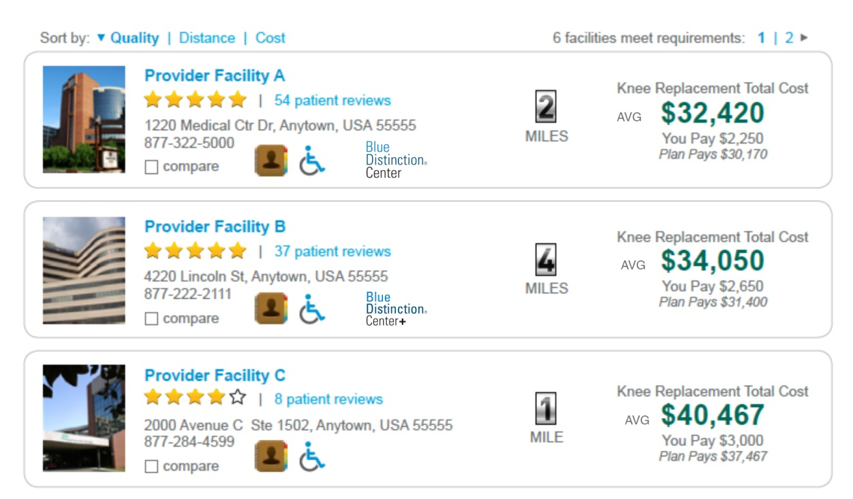
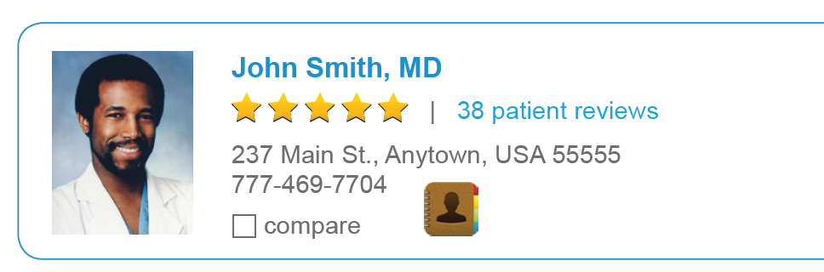

Robust Transparency Tools Drive Informed Decisions
Leveraging BCBS information and resources to power user-friendly transparency tools that ensure member access to meaningful cost and quality information
Cost estimator tools enable members in most major markets to view and compare cost estimates for common treatments and procedures
Member out-of-pocket tools allow members of participating BCBS Plans to obtain estimates of the amount of money they may have to pay for healthcare services
Physician quality measurement and recognition programs allow members to view consistent measurements of BCBS network providers to help engage members in their healthcare decision-making
Note: Functionality views are illustrative.

Slide 10
The Health of America Report
A collaboration between the Blue Cross Blue Shield Association and Blue Health Intelligence
Aims to mine market-leading claims information to uncover key trends and provide insight into healthcare dynamics
Support improved quality and affordability for Americans
This is the first report

Slide 11
Hip and Knee Replacement Cost Variation Study
Sophisticated methodology to measure provider cost
Includes nationwide payment information over 36 months
  Evaluated typical episode costs for Hip and Knee Replacements across 64 MSAs
    Selected MSAs required at least two facilities with at least six procedures performed
Longitudinal evaluation - episodic costs include the first physician appointments, the hospital stay, the device and follow up visits to the doctor

Slide 12
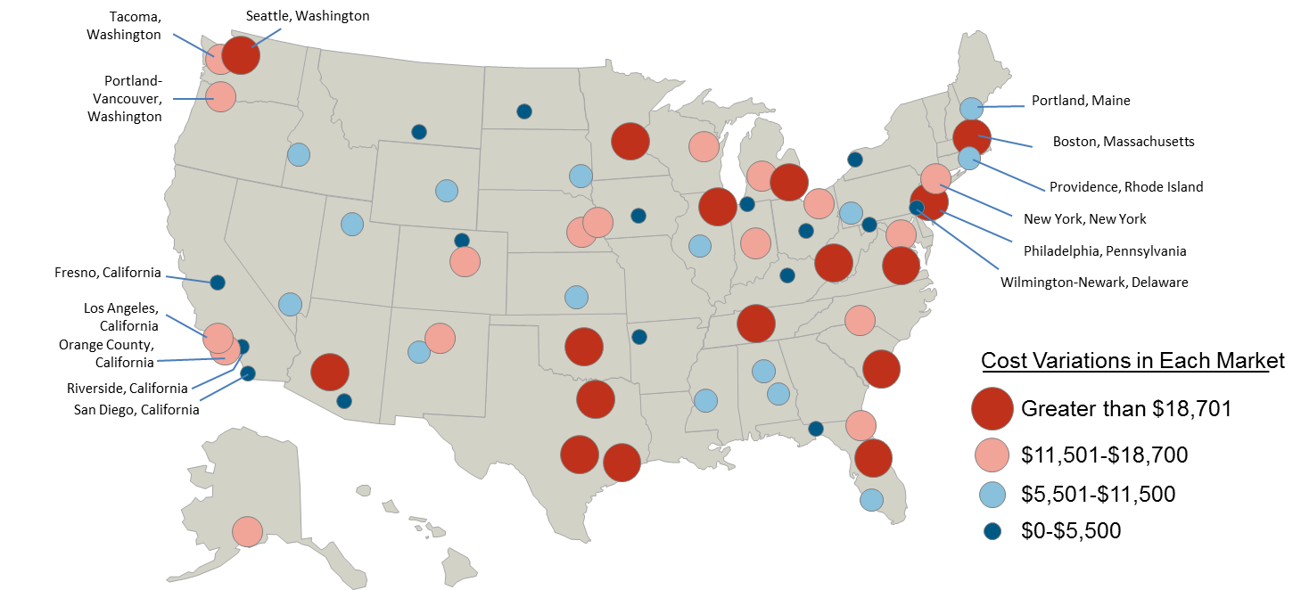
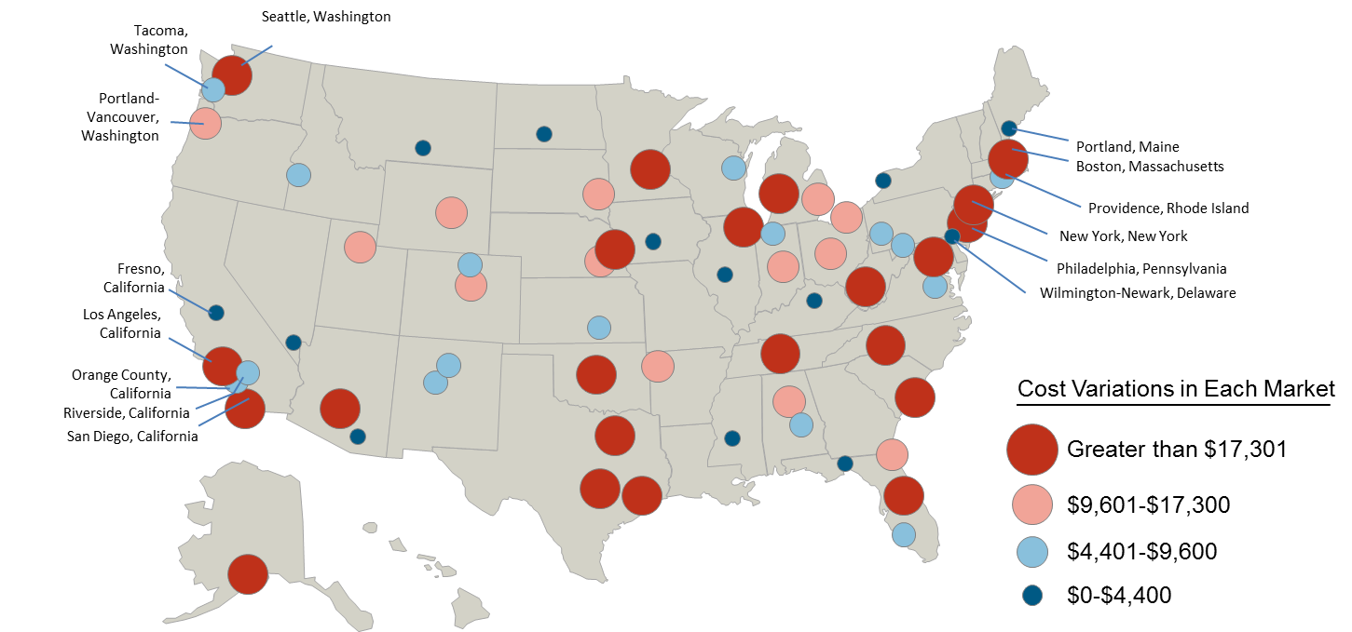
BCBSA Study Reveals Extreme Cost Variations for Knee and Hip Replacement Surgeries
The two maps below highlight cost variation within 64 markets across the country, based on average episodic costs for typical knee and hip replacement procedures.
This confirms generally accepted industry findings that significant cost variation exists across the country.
Figure 1: Cost Variation for Knee Replacement Procedures Across the Country
Figure 2: Cost Variation for Hip Replacement Procedures Across the Country

Slide 13
Key Finding
Some hospitals charge tens of thousands of dollars more than others for the same medical procedures, even within the same metropolitan MSA
Cost can vary by as much as 313 percent, depending on where the surgeries are performed

Slide 14
Additional Analyses
BHI can also consider variation of quality based on BHI’s Adverse Outcome Index (AOI)
  Adjusts for potentially avoidable complications
    Indexes the facility’s rate of complications per episode and the costs associated with complications
  Adjusts for readmissions
    Indexes the facility’s rate of readmissions and the costs associated with readmissions
Information can be used to ensure networks include high performing facilities based on a combined cost and quality index

Slide 15
Summing it up….
Partnerships with high performing providers via networks is the most effective lever insurers employ to ensure quality and lower cost to members
Anything that interferes with this lever will negatively impact insurer effectiveness in managing healthcare cost and quality on behalf of consumers
  Restrictive, one size fits all quantitative standards; proscribed contract requirements
  Any willing provider and like legislation that creates incentives for providers NOT to contract
Dynamic environment; flexibility necessary to ensure evolution that is mutually beneficial

