Slide 1
Effects of Cross-Market Combinations: Theory and Evidence from Hospital Markets Leemore Dafny FTC Healthcare Workshop February 25, 2015

Slide 2
Motivation
Standard horizontal merger theory is about combinations of rivals competing for the same end user of a given product or service, i.e. same market mergers
Enforcement has therefore focused on these
Many combinations span different geographic or product markets, i.e. cross-market mergers
Cross-geographic market combinations
Hospitals: Baylor and Scott & White; Community Health and Health Management Associates
Cross-provider (and geographic) market combinations
Post-acute care: Kindred (LTAC/rehab) and Gentiva (home health/hospice)
Chronic disease: DaVita (dialysis) and Healthcare Partners (MDs)

Slide 3
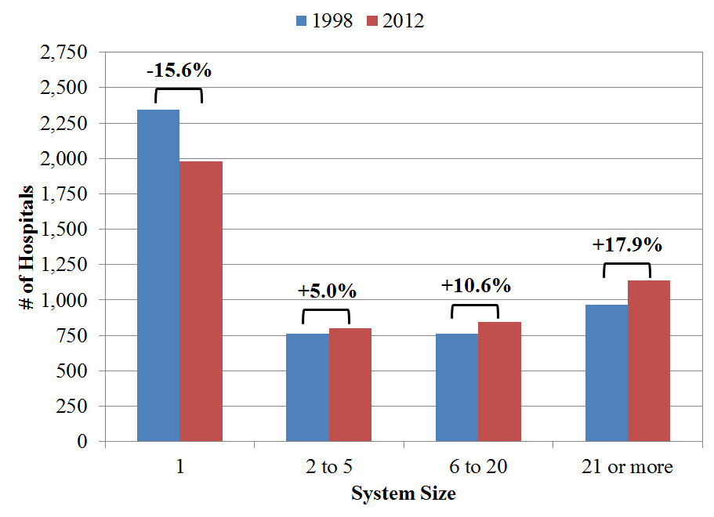
Hospitals have been consolidating into larger systems
Source: Dafny, Ho, Lee (2015); data from Irving Levin Associates and American Hosp Assoc

Slide 4
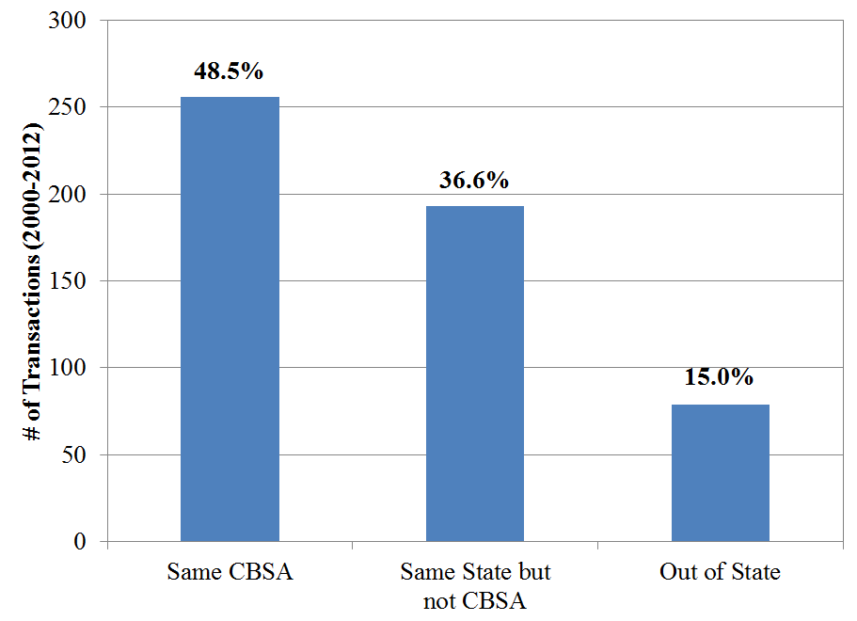
Many hospital mergers do not have any traditional horizontal overlap
Notes: Counties outside a CBSA are treated as their own CBSA in the above. Dafny, Ho, Lee (2015)

Slide 5
Recent evidence suggests cross-market mergers tend to lead to higher hospital prices
Anecdotal
Community Tracking Study of 12 metro areas (Berenson et al 2012)
“Numerous participants in contract negotiations between health plans and hospitals noted that provider leverage depends on how big the hospital or hospital system is and how much of an insurer’s patient volume it generates.”
Systematic
Hospitals joining systems with a member in same broad metro area increase price 4-7 percent (Cuellar and Gertler 2005)
Acquisition by a system leads to higher prices even when other members are outside broad metro area (Lewis & Pflum (2014, 2015)

Slide 6
How might cross-market mergers lead to price increases?
Many possibilities:
Imperfect adjustment for service and patient mix
Improvements in quality
Changes in bargaining skill or ability to bear risk
“Common customer” and “common insurer” effects (focus today)
Some are more compatible than others with standard antitrust law
Section 7 of Clayton Act forbids acquisitions whose effect “may be substantially to lessen competition, or to tend to create a monopoly”

Slide 7
Providers in different markets may have common customers and/or common insurers
Factor | Effect on competition | Effect on price
Common customers | If same customers value both providers, their combination can lessen competition for inclusion in insurance plans
Common insurers | If same insurers negotiate with both providers, their combination can change the bargaining problem they are solving | ?

Slide 8
Deep dive: “Common Customer Effect”
Focus to date: competition among hospitals for the same service
Under standard model only a merger of hospitals that compete for the same patients affects joint bargaining position and therefore the negotiated price with insurers
Reality: customers purchase option to use a bundle of provider services from insurers
If same customer values both providers, the providers are substitutes vis a vis inclusion in the bundle
E.g. employer with employees in both relevant geo markets
E.g. families who value both adult and pediatric hospitals
This common customer effect should be stronger for mergers in close proximity

Slide 9
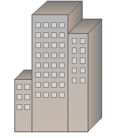
Deep dive: “Common Insurer Effect”
Town A Town B
Insurer ----- Hospital A Insurer ------ Hospital B
Suppose premium elasticity is higher in A. Combined industry profits would be larger if Hospitals A and B merge, and Hospital A lowers price and Hospital B raises price. Weighted average price effect is ambiguous
Additional mechanism: political constraints in Town A yield
$p_{A}^{∗}$
$$p_{B}^{∗}$$
$${premium}_{A}^{∗}(p_{A}^{∗})$$
${premium}_{B}^{∗}(p_{B}^{∗}$)
${p_{A}^{}< p}_{A}^{∗}$

Slide 10
What is net effect on price? An empirical study of cross-market hospital mergers
Challenge: Mergers/acquisitions are not random
Approach: Study hospitals that are “bystanders” to mergers. Compare merger effects for hospitals with strong vs. weak common customer/insurer effects
Two groups of mergers
FTC sample: investigated and consummated mergers Investigation → market with horizontal overlap
Throw out the horizontal overlap
Study merger effect on affiliated hospitals
Broad sample: culled from Irving Levin reports
Drop “crown jewels” and any merging hospitals within 30 min’ drive time
Source: Dafny, Ho, Lee (2015) working paper

Slide 11
Empirical Approach: Overview
Consider two different types of “treatment hospitals”
Merger of System A and System B
C
A B
A
A
B
B
A
B
B
D
Adjacent treatments
Non-adjacent treatments
Notes: Each rectangle is a state; wavy lines signify within-state geo markets

Slide 12
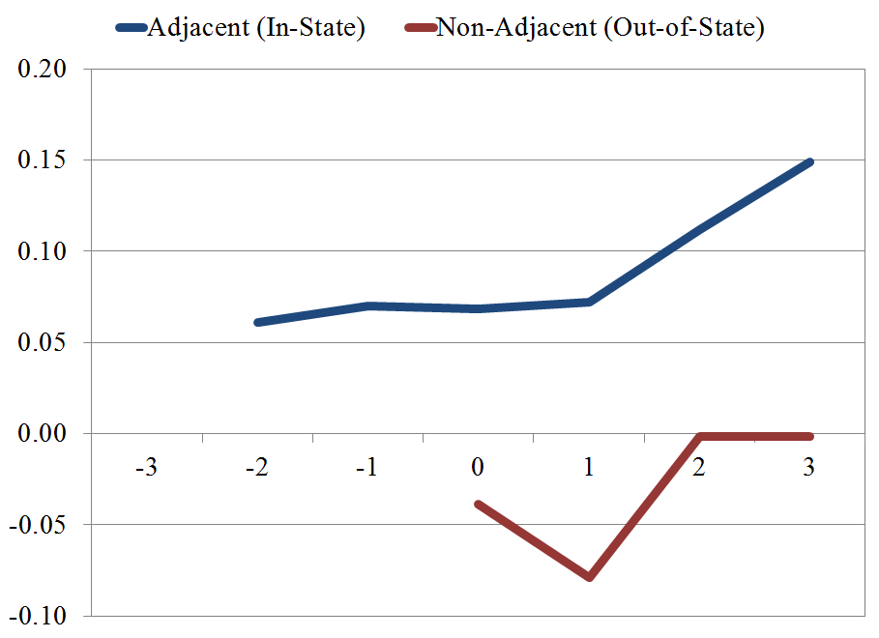
Results: FTC Sample
Post-merger price increase of 5 percent for adjacent hospitals
No increase for non-adjacent hospitals
All estimates are relative to control hospitals unaffected by mergers
Notes: Graph of coefficients from regression model of same-hospital price growth, controlling for year, case mix, beds, % Medicaid, and for-profit status

Slide 13
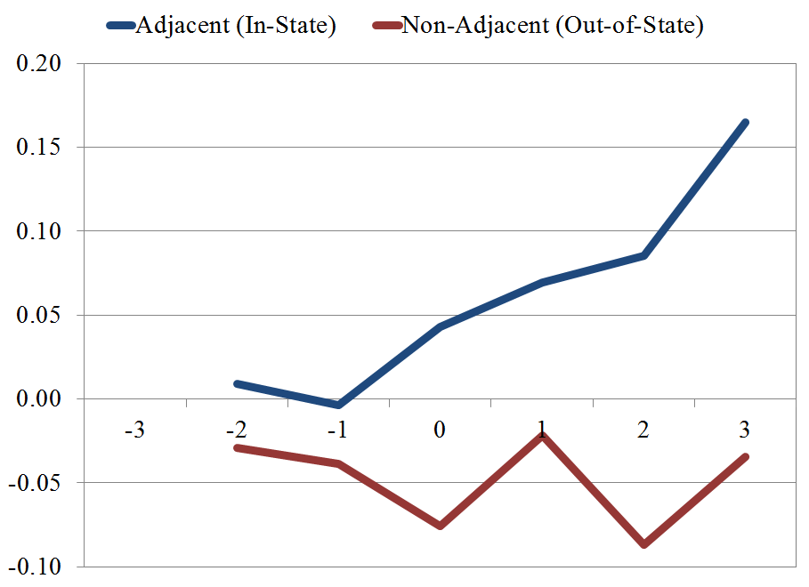
Results: Broad Sample
Post-merger price increase of 10 percent for adjacent hospitals
No increase for non-adjacent hospitals
All estimates are relative to control hospitals unaffected by mergers
Notes: Graph of coefficients from regression model of same-hospital price growth, controlling for year, case mix, beds, % Medicaid, and for-profit status

Slide 14
Preliminary Conclusions and Implications
Adding adjacent system member → P ↑ 5 - 10%
Adding non-adjacent system member → no P change
Common customer effect + common insurer effect are largest for adjacent additions
Suggests hospitals in different, nearby, markets can constrain one another’s pricing because contracting occurs at broader geographic units
We are currently working to disentangle common customer and common insurer effects
Enforcers may need to broaden criteria for deal investigations
But there must also be a limiting principle

