Slide 1
Early Observations Regarding Health Insurance Exchanges
Marketplace Competition, Enrollment, and Pricing in 2014 and 2015
Cynthia Cox, Kaiser Family Foundation
February 24, 2015

Slide 2
Before the ACA, most states’ individual insurance markets were highly concentrated
Kaiser Family Foundation analysis of Mark Farrah AssociatesTM data

Slide 3
Background on health insurance exchanges
Pre-ACA individual market
Highly concentrated
Medical underwriting hampered competition
Exchanges were created to:
Expand access
Encourage insurers to participate
Promote competition

Slide 4
Who is buying on the exchanges?
2014
About 8 million signed up by end of open enrollment
28% of potential market
Most received financial assistance (85%)
Most picked silver (65%) and bronze (20%)
2015
6.7 million still enrolled at beginning of open enrollment
Approx. 11.4 million signed up by end of open enrollment
Vast majority receive financial assistance
Kaiser Family Foundation State Health Facts http://kff.org/state-category/health-reform/

Slide 5
2015 Marketplace signups in states using HealthCare.gov
Percentage of potential market signed up varies by state
Kaiser Family Foundation State Health Facts http://kff.org/state-category/health-reform/

Slide 6
Insurer participation has increased in most state Marketplaces
Kaiser Family Foundation State Health Facts http://kff.org/state-category/health-reform/

Slide 7
Market Share of Insurers in California’s Individual Market (2012) and Exchange (as of Feb. 28, 2014)
Source: Kaiser Family Foundation, “Sizing Up Exchange Market Competition” March 1, 2014

Slide 8
Market Share of Insurers in New York’s Individual Market (2012) and Exchange (as of Dec. 30, 2013)
Source: Kaiser Family Foundation, “Sizing Up Exchange Market Competition” March 1, 2014

Slide 9
Market Share of Insurers in Minnesota’s Individual Market (2012) and Exchange (as of Feb. 19, 2014)
Source: Kaiser Family Foundation, “Sizing Up Exchange Market Competition” March 1, 2014

Slide 10
Market Share of Insurers in Connecticut’s Individual Market (2012) and Exchange (as of Feb. 18, 2014)
Source: Kaiser Family Foundation, “Sizing Up Exchange Market Competition” March 1, 2014

Slide 11
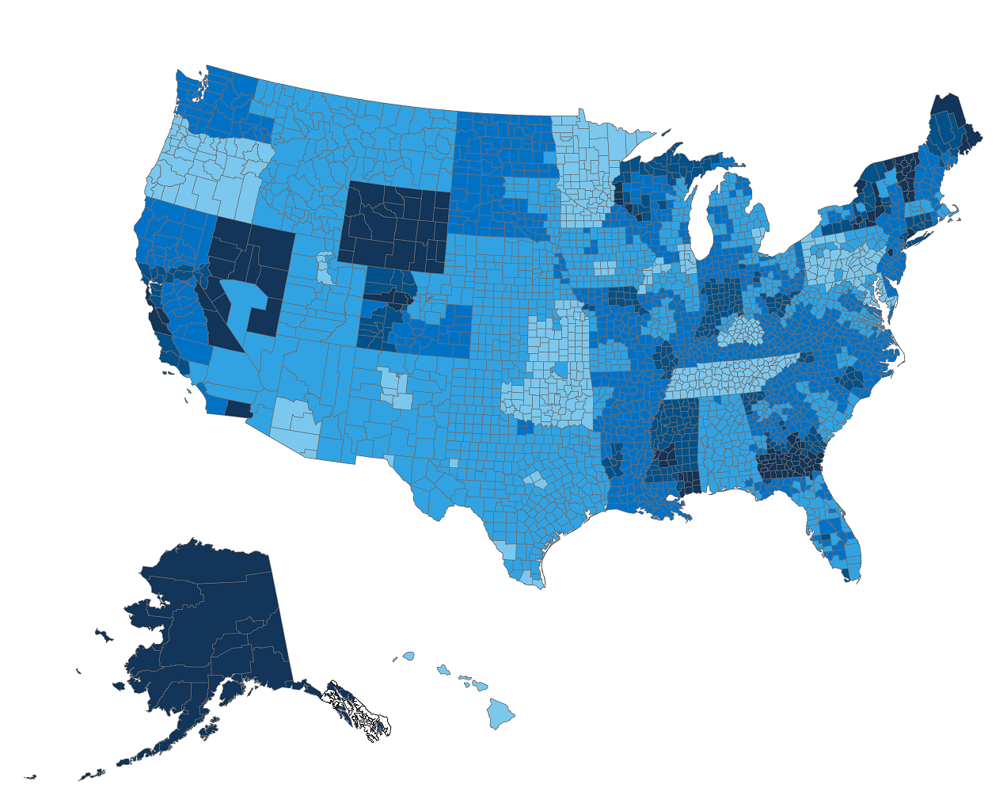
What Americans paid for the second-lowest cost silver plan in 2014, before tax credits
Monthly Premium
Notes: Premiums indicate the amount a 40-year-old would need to spend on the second-lowest cost silver plan in a given county or region.
Source: Premiums for state-based exchanges were obtained through a Kaiser Family Foundation review of insurer rate filings to state regulators. Premiums for federally-facilitated and partnership exchanges were obtained from data published by HealthCare.gov, as of January 22, 2014, available at https://www.healthcare.gov/health-plan-information/.

Slide 12
The difference in premiums Americans pay for the second-lowest cost silver plan from 2014 to 2015, before tax credits
Notes: The premium changes shown are for the second-lowest cost silver (“benchmark”) plan available to a 40-year-old in a given county or region.
Source: Kaiser Family Foundation analysis of insurer rate filings to state regulators and premium data published by HealthCare.gov, available at https://www.healthcare.gov/health-plan-information-2015/

Slide 13
Trends & Lessons from first 2 years
Individual market highly concentrated 2010 - 2013
Marketplace insurer participation increased 2014 - 2015
Some marketplaces are more competitive than pre-ACA, but no guarantee of early success
Trends in the future:
Narrow networks
Migration to self-insurance among small employers
Private exchanges

