Slide 1
Payer-Provider Consolidation
Lawton Robert Burns, Ph.D., MBA
The James Joo-Jin Kim Professor
Dept of Health Care Management
The Wharton School
burnsL@wharton.upenn.edu
Presentation to FTC/DOJ Competition Workshop
Washington D.C.
February 25 2015

Slide 2
Vertical Integration
Payers & Providers
HMOs
PPOs
Buyers
Hospitals
Physicians
Suppliers
2

Slide 3
History of Payer-Provider Integration
1930s & 1940s: Group/staff model HMOs (e.g., Kaiser, GHC, etc.)
1970s - 1980s: IPA model HMOs (e.g., Hill Physicians)
1970s – 1980s: Rural-based IDNs develop health plans (Geisinger, Carle, Scott & White, etc.)
1980s: insurers acquire primary care groups, investor-owned hospitals acquire insurers
1990s: insurers sell off primary care groups to PPMs
1990s: nonprofit hospitals get into insurer business in anticipation of capitated care partly stimulated by BBA ‘97 (Provider-Sponsored Organizations)

Slide 4
Hospital Sponsored Health Plans
First wave interest peaked in mid-1990s
Products rarely achieved substantial scale (failure to reach MES ~ 100K lives)
Host of problems (Burns & Thorpe, 2000):
Under-capitalization
Inability to sufficiently grow & compete
Substantial financial losses in early years
Huge medical loss ratios
No actuarial or marketing expertise
Conflicting capital needs with rest of system
Internal conflicts : cost minimization v. revenue maximization
Viable in selected markets where a large plan dominates market (e.g. Lansing, Indianapolis)
Exclusive affiliations with plans obviate value of plan sponsorship
Provider plans die off in late 1990s and early-mid 2000s as market transitions to open-access

Slide 5
Provider-led Integration with Payors: Rationale
Position themselves to manage risk-based contracts
Position themselves to become ACOs
Position themselves for population health management
Gain some leverage over payers
Never-ending effort to dis-intermediate payers
Never-ending effort to manage care continuum and triple aim

Slide 6
Hospital Sponsored Health Plans: Research Evidence
IDN investment in hospitals/MDs/health plans negatively associated with operating margin
Hospital diversification into other business lines like health plans associated with higher debt-to-capitalization ratios
Health plan investments to link with providers to serve the Medicare Advantage population linked to higher premiums
Sources: Burns, Gimm, & Nicholson (2005), Frakt, Pizer, & Feldman (2013)

Slide 7

Report released
Feb 25, 2015

Slide 8
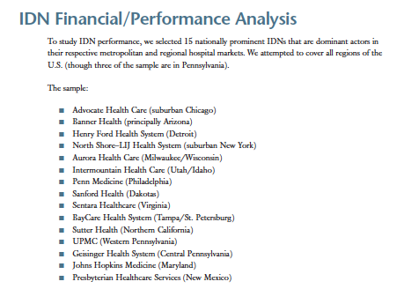

Slide 9
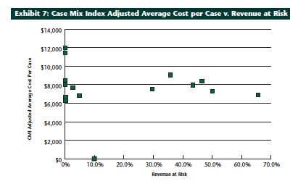
No relationship of IDN revenue at risk and IDN
CMI-adjusted cost of care

Slide 10
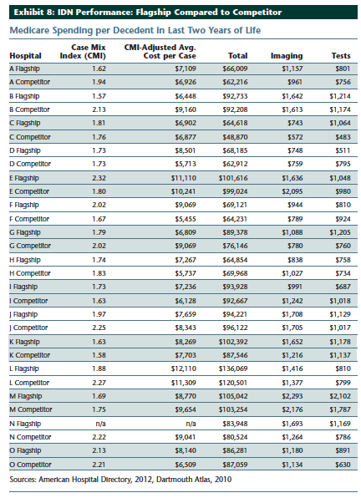
Comparison of IDN flagship hospital and main in-market competitor on Medicare spend in last 2 years of life:
IDN flagship hospital with no revenue at risk was 6.8% less expensive than in-market competitor
IDN flagship hospital with some revenue at risk was 20% more expensive than in-market competitor
No apparent cost of care advantage conferred on IDN hospitals that operate their own health plan

Slide 11
Additional Findings
No meaningful differences in clinical quality or safety scores between IDN flagship hospital and in-market competitor
readmissions
infection rates
complication rates
No meaningful differences in patient satisfaction scores or Leapfrog Group hospital safety ratings between IDN flagship hospital and in-market competitor
In 10 of 14 sites, IDN flagship hospital had higher avg. cost per case
NOT CLEAR that IDNs can coordinate care, lower costs, and deliver value

Slide 12
Study Conclusions
These 15 IDNs are big revenue generators ($73B
They are also inscrutable institutions
public information on hospital performance not aggregated at IDN level
hard to tell what each of their business lines contribute to operating revenues
cannot tell whether they have used their market power to grow their earnings
cannot tell how the insurance vehicle is used by the IDN

Slide 13
Recent Payer-Provider Deals in Vertical Integration
Insurers Buying Physician Groups
WellPoint acquires CareMore (26 clinics in Calif)
Humana acquires:
Concentra - occupational medicine chain Concentra (2010)
SeniorBridge - home health provider and 1,500 care managers (2011)
NextCare - urgent care center chain (2011)
UnitedHealth/Optum acquires:
Monarch medical group (2011)
network of 425 “affiliated” (e.g. employed)
network of 4,500 “contracted” physicians,
300 nurse practitioners and physician assistants in 90 primary care and urgent care clinics

Slide 14
Payer-led Integration with Providers: Rationale
Position for increased Medicare Advantage enrollment, which has been surging and will increase substantially with the retirement of the baby boomers, as well as for increased Medicaid enrollment following PPACA implementation in 2014.
Develop networks to help manage the care of the sickest patients - - such as the chronically ill, the dual eligibles, and those with pre-existing conditions - - which are the target of several initiatives in the PPACA.
Belief that the only way to manage risk contracts and satisfy the dictates of value-based contracting is by owning the front end of (ambulatory) care and incentivizing their employed physicians to treat enrollees cost-effectively
Threat posed by hospital efforts to develop captive physician networks and ACOs which might have as their real goal limiting insurer contracting options and increasing the prices charged them. Insurers may be vertically integrating back into the physician market to develop countervailing power and/or avoid being locked out

Slide 15
Thank you for listening

