Slide 1
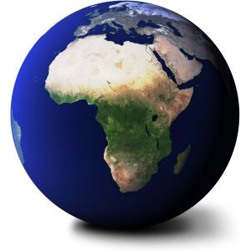

The Sixth Annual
African Consumer Protection Dialolgue Conference
Deon Woods Bell
Lilongwe, Malawi
6-8 September 2014

Slide 2
Overview
Consumer Complaint Databases
  Econsumer.gov
  Consumer Sentinel Network
Consumer Complaints as Enforcement Tools
New Developments in Consumer Complaint Sharing
African Consumer Complaint Data

Slide 3
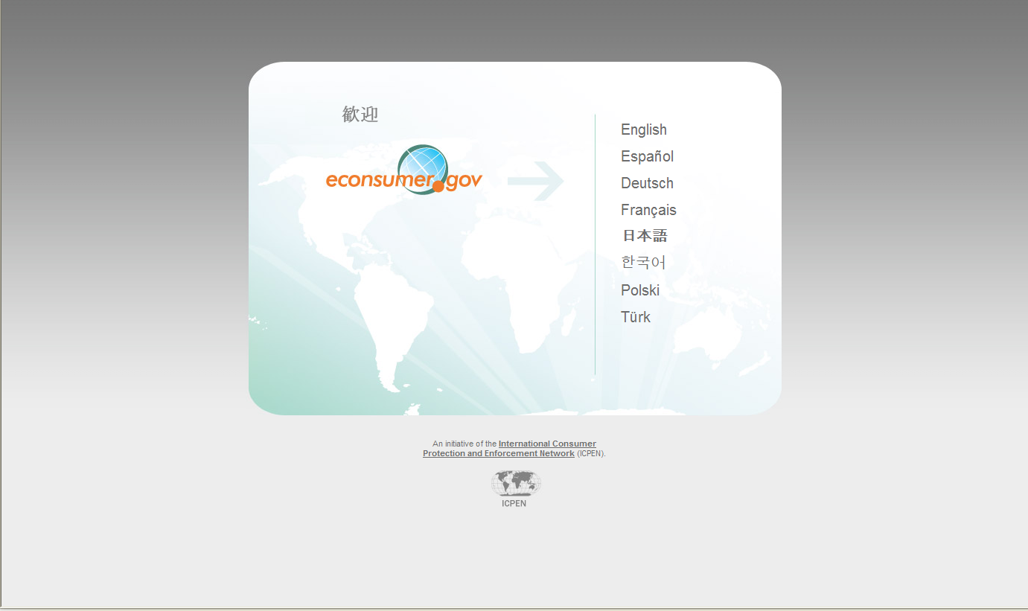
Notes:
consumer protection agencies in 30 countries participate in this initiative.
Certified Foreign Agencies – from 12 countries
Australia,
NSW Fair Trading , Department of Services, Technology and Administration
Australian Communications and Media Authority
Australian Competition and Consumer Commission
Belgium,
Bulgaria
Directorate-General Enforcement and Mediation (Econsumer.gov)
Canada, Canadian Radio-Television Telecommunications Commission, Compliance and Enforcement Sector
Canada, Competition Bureau Canada Canada, Office de la Protection du Consommateur
Canada, Ontario Ministry of Government and Consumer Services, Consumer Protection Branch
Canada, Royal Canadian Mounted Police, Commercial Crimes Branch
Canada, Royal Canadian Mounted Police, D Division, Border Integrity
Canada, Saskatchewan Financial Services Commission, Consumer Protection Division
Canada, Saskatoon Police Service, Fraud Section Canada, Service Alberta Consumer Services Division
Chile, Servicio Nacional del Consumidor (Econsumer.gov)
Egyptian Consumer Protection Agency (Econsumer.gov)
Finland, Kuluttajavirasto (Finnish Consumer Agency) (Econsumer.gov)
Korea Consumer Agency (Econsumer.gov)
Mexico, Procuraduria Federal Del Consumidor (Econsumer.gov)
Netherlands Consumer Authority (Econsumer.gov)
Spain, National Institute for Consumption (Econsumer.gov)
Switzerland, State Secretariat for Economic Affairs (Econsumer.gov)
United Kingdom, Office of Fair Trading (Econsumer.gov)
United States

Slide 4
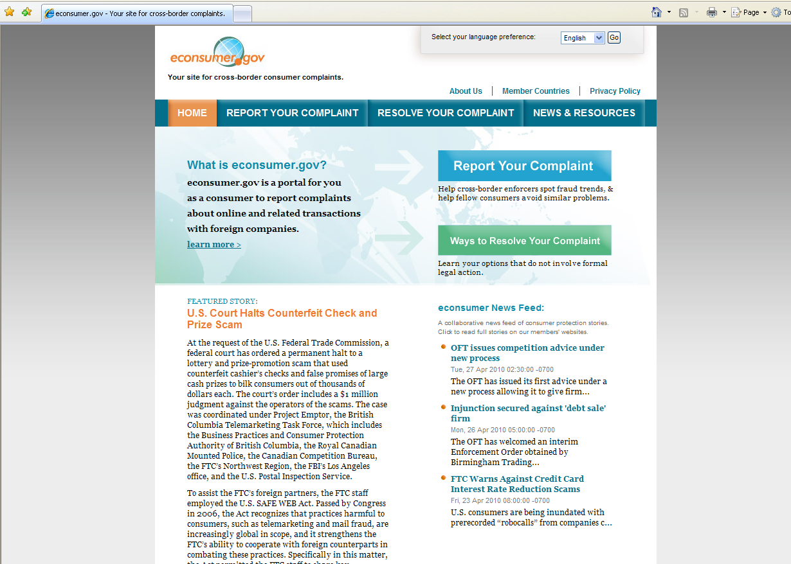

Slide 5

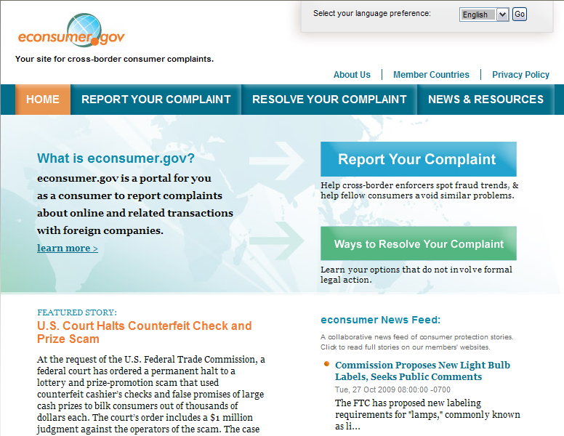
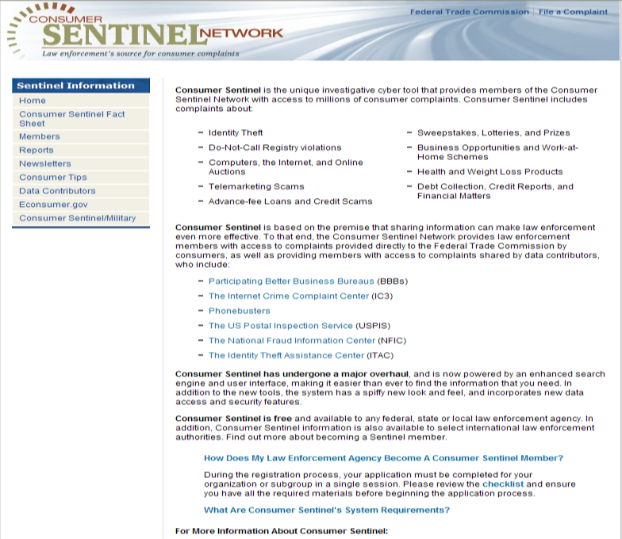
What is econsumer.gov ?
econsumer.gov certified government law
enforcement and regulatory agencies in
ICPEN member countries may access
the complaints to investigate, uncover new
scams, and spot trends in fraud.
Participation by agencies from 30 countries.
Notes:
New Members since last ICPEN Meeting:
Bulgaria – Commission for Consumer Protection
Nigeria – Consumer Protection Council

Slide 6
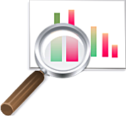
Consumer Complaints As An Enforcement Tool
Econsumer.gov/Consumer Sentinel database helps us identify:
  Patterns and trends in consumer fraud and identity theft
  The issues and actors causing the greatest harm to consumers
The complaint collection process also helps the FTC assist consumers by providing them with educational materials
Notes:
The ability to identify trends helps the FTC to be responsive to consumer problems.
Information about the practices of specific businesses helps the FTC and its law enforcement partners select cases and carry out investigations and prosecutions.

Slide 7

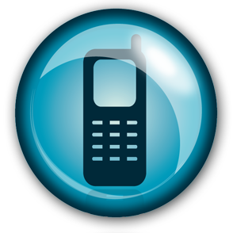
How members Use
Complaint Information
Staff who are investigating a business can search the appropriate complaint databases
In some instances, staff calls a complaining consumer for more information about the business
Consumers voluntarily provide us with this information – none of it is mandatory (e.g., they can submit anonymous complaints)
In some instances, the FTC asks consumers who have filed complaints with the FTC to serve as witnesses in the cases we file in federal court

Slide 8


New Developments in Consumer Complaint Sharing
The Consumer Sentinel Network (CSN) is a database of consumer complaint data and other investigative information operated by the U.S. Federal Trade Commission), the incoming complaints are shared with participating consumer protection law enforcers.
There are several subsets of complaints within the CSN
  econsumer.gov complaints Certified econsumer.gov
  General consumer complaints, including complaints about cross-border fraud
  Spam messages forwarded by consumers

Slide 9


New Developments in Consumer Complaint Sharing
  Current certified econsumer.gov members only have access to econsumer.gov complaints, alerts, and the spam database in the CSN.
  We are working to expand access to more parts of the database to include cross-border fraud consumer complaints that includes complaints from consumers and data contributors
  This means a larger pool of complaints to use for investigations, and to spot complaint trends and practices.

Slide 10
Complaint Data

Slide 11
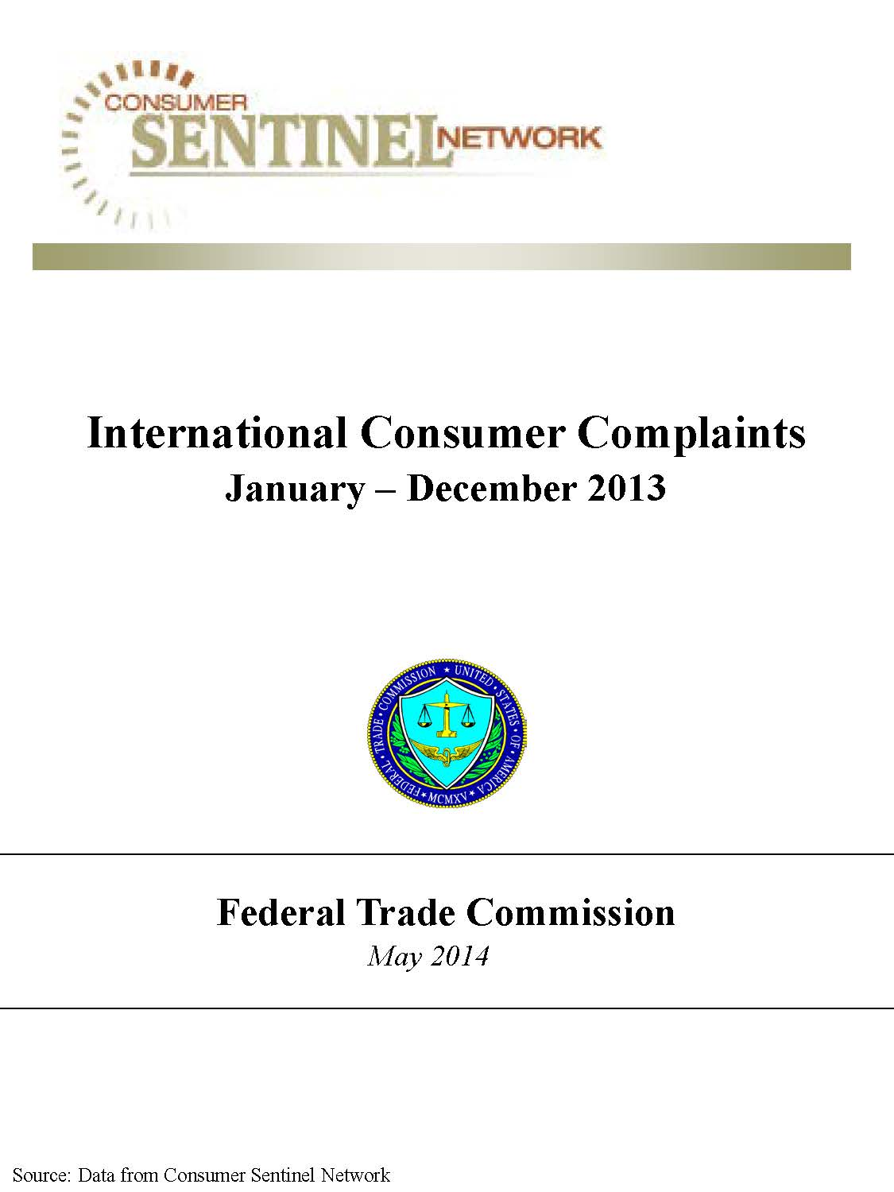

Slide 12

Fraud Complaints Reported Against
Top 100 Non-U.S. Company Locations
January 1 – December 31, 2013
Note: Company country names appear as reported by consumers and may not reflect where the company is actually located.
Federal Trade Commission Released August 2014

Slide 13
Top Products or Services for Fraud Complaints Reported
Against the Top Company Locations in Africa^{1,2}
January 1 – December 31, 2013
¹Complaints may be coded under multiple product service codes.
²“Africa” includes complaints where consumers reported the company country location as Algeria, Angola, Ascension and Tristan Da Cunha, Benin, Botswana, Burkina Faso, Burundi, Cameroon, Cabo Verde, Central African Republic, Chad, Comoros, the Democratic Republic of Congo, the Republic of Congo, Cote D’Ivoire, Djibouti, Egypt, Equatorial Guinea, Eritrea, Ethiopia, Gabon, Gambia, Ghana, Guinea, Guinea-Bissau, Kenya, Lesotho, Liberia, Libya, Madagascar, Malawi, Mali, Mauritania, Mauritius, Mayotte, Morocco, Mozambique, Namibia, Niger, Nigeria, Rwanda, Saint Helena, Sao Tome and Principe, Senegal, Seychelles, Sierra Leone, Somalia, South Africa, South Sudan, Sudan, Swaziland, Tanzania, Togo, Tunisia, Uganda, Western Sahara, Zambia or Zimbabwe. Note it is possible that not all countries have complaints in the system for the period the report covers.
Note: Company country locations appear as reported by consumers and may not reflect where the company is actually located.
Federal Trade Commission Released August 2014

Slide 14
Fraud Complaints Reported For
Top 100 Non-U.S. Consumer Locations
January 1 – December 31, 2013
Note: Consumer country names appear as reported by consumers.
Federal Trade Commission Released August 2014

Slide 15
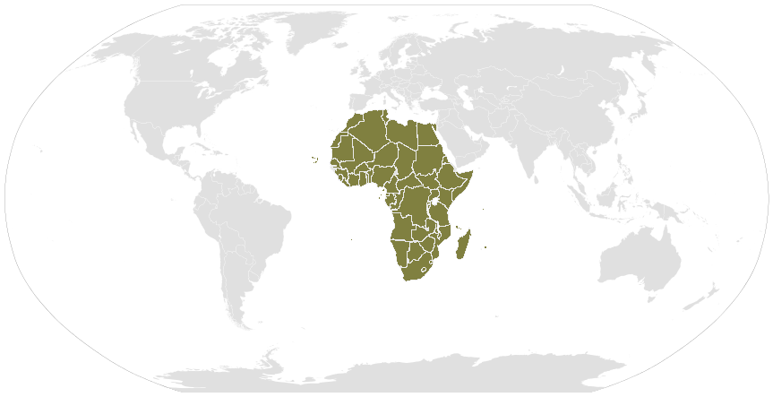
Top Products or Services in All Complaints
Reported Against Companies Located in Africa¹
January 1 – December 31, 2013
¹“Africa” includes complaints where consumers reported the company country location as Algeria, Angola, Ascension and Tristan Da Cunha, Benin, Botswana, Burkina Faso, Burundi, Cameroon, Cabo Verde, Central African Republic, Chad, Comoros, the Democratic Republic of Congo, the Republic of Congo, Cote D’Ivoire, Djibouti, Egypt, Equatorial Guinea, Eritrea, Ethiopia, Gabon, Gambia, Ghana, Guinea, Guinea-Bissau, Kenya, Lesotho, Liberia, Libya, Madagascar, Malawi, Mali, Mauritania, Mauritius, Mayotte, Morocco, Mozambique, Namibia, Niger, Nigeria, Rwanda, Saint Helena, Sao Tome and Principe, Senegal, Seychelles, Sierra Leone, Somalia, South Africa, South Sudan, Sudan, Swaziland, Tanzania, Togo, Tunisia, Uganda, Western Sahara, Zambia or Zimbabwe. Note it is possible that not all countries have complaints in the system for the period the report covers.
Note: Company country locations appear as reported by consumers and may not reflect where the company is actually located.
Federal Trade Commission Released August 2014

Slide 16
Top Products or Services in All Complaints
Reported Against Companies Located in Africa¹
January 1 – June 30, 2014
¹“Africa” includes complaints where consumers reported the company country location as Algeria, Angola, Ascension and Tristan Da Cunha, Benin, Botswana, Burkina Faso, Burundi, Cameroon, Cabo Verde, Central African Republic, Chad, Comoros, the Democratic Republic of Congo, the Republic of Congo, Cote D’Ivoire, Djibouti, Egypt, Equatorial Guinea, Eritrea, Ethiopia, Gabon, Gambia, Ghana, Guinea, Guinea-Bissau, Kenya, Lesotho, Liberia, Libya, Madagascar, Malawi, Mali, Mauritania, Mauritius, Mayotte, Morocco, Mozambique, Namibia, Niger, Nigeria, Rwanda, Saint Helena, Sao Tome and Principe, Senegal, Seychelles, Sierra Leone, Somalia, South Africa, South Sudan, Sudan, Swaziland, Tanzania, Togo, Tunisia, Uganda, Western Sahara, Zambia or Zimbabwe. Note it is possible that not all countries have complaints in the system for the period the report covers.
Note: Company country locations appear as reported by consumers and may not reflect where the company is actually located.
Federal Trade Commission Released August 2014

Slide 17
Consumer Age in All Complaints
Reported Against Companies Located in Africa¹
January 1, 2013 – June 30, 2014
¹“Africa” includes complaints where consumers reported the company country location as Algeria, Angola, Ascension and Tristan Da Cunha, Benin, Botswana, Burkina Faso, Burundi, Cameroon, Cabo Verde, Central African Republic, Chad, Comoros, the Democratic Republic of Congo, the Republic of Congo, Cote D’Ivoire, Djibouti, Egypt, Equatorial Guinea, Eritrea, Ethiopia, Gabon, Gambia, Ghana, Guinea, Guinea-Bissau, Kenya, Lesotho, Liberia, Libya, Madagascar, Malawi, Mali, Mauritania, Mauritius, Mayotte, Morocco, Mozambique, Namibia, Niger, Nigeria, Rwanda, Saint Helena, Sao Tome and Principe, Senegal, Seychelles, Sierra Leone, Somalia, South Africa, South Sudan, Sudan, Swaziland, Tanzania, Togo, Tunisia, Uganda, Western Sahara, Zambia or Zimbabwe. Note it is possible that not all countries have complaints in the system for the period the report covers.
²Percentages are based on the total number of consumers reporting their age: CY-2013 = 8,964 and January-June 2014 = 3,930. Of the total number of complaints reported against companies located in Africa, 41% of consumers reported their age during January-June 2014, and 47% reported their age for CY-2013.
Note: Company country locations appear as reported by consumers and may not reflect where the company is actually located.
Federal Trade Commission Released August 2014

Slide 18
Top Consumer Countries in All Complaints
Reported Against Companies Located in Africa¹
January 1, 2013 – June 30, 2014
¹“Africa” includes complaints where consumers reported the company country location as Algeria, Angola, Ascension and Tristan Da Cunha, Benin, Botswana, Burkina Faso, Burundi, Cameroon, Cabo Verde, Central African Republic, Chad, Comoros, the Democratic Republic of Congo, the Republic of Congo, Cote D’Ivoire, Djibouti, Egypt, Equatorial Guinea, Eritrea, Ethiopia, Gabon, Gambia, Ghana, Guinea, Guinea-Bissau, Kenya, Lesotho, Liberia, Libya, Madagascar, Malawi, Mali, Mauritania, Mauritius, Mayotte, Morocco, Mozambique, Namibia, Niger, Nigeria, Rwanda, Saint Helena, Sao Tome and Principe, Senegal, Seychelles, Sierra Leone, Somalia, South Africa, South Sudan, Sudan, Swaziland, Tanzania, Togo, Tunisia, Uganda, Western Sahara, Zambia or Zimbabwe. Note it is possible that not all countries have complaints in the system for the period the report covers.
²Percentages are based on the total number of consumers reporting their country: CY-2013 = 18,263 and January-June 2014 = 8,876. Of the total number of complaints reported against companies located in Africa, 93% of consumers reported their country during January-June 2014, and 95% reported their country for CY-2013.
Note: Company country locations appear as reported by consumers and may not reflect where the company is actually located.
Federal Trade Commission Released August 2014

Slide 19
Company’s Method of Contacting Consumers in All Complaints
Reported Against Companies Located in Africa¹
January 1, 2013 – June 30, 2014
¹“Africa” includes complaints where consumers reported the company country location as Algeria, Angola, Ascension and Tristan Da Cunha, Benin, Botswana, Burkina Faso, Burundi, Cameroon, Cabo Verde, Central African Republic, Chad, Comoros, the Democratic Republic of Congo, the Republic of Congo, Cote D’Ivoire, Djibouti, Egypt, Equatorial Guinea, Eritrea, Ethiopia, Gabon, Gambia, Ghana, Guinea, Guinea-Bissau, Kenya, Lesotho, Liberia, Libya, Madagascar, Malawi, Mali, Mauritania, Mauritius, Mayotte, Morocco, Mozambique, Namibia, Niger, Nigeria, Rwanda, Saint Helena, Sao Tome and Principe, Senegal, Seychelles, Sierra Leone, Somalia, South Africa, South Sudan, Sudan, Swaziland, Tanzania, Togo, Tunisia, Uganda, Western Sahara, Zambia or Zimbabwe. Note it is possible that not all countries have complaints in the system for the period the report covers.
²Percentages are based on the total number of consumers reporting the company’s method of initial contact: CY-2013 = 7,771 and January-June 2014 = 3,291. Of the total number of complaints reported against companies located in Africa, 33% of consumers reported this information during January-June 2014 and 40% in CY-2013.
Note: Company country locations are as reported by consumers and may not reflect where the company is actually located.
Federal Trade Commission Released August 2014

Slide 20
Method of Consumer Payment in All Complaints
Reported Against Companies Located in Africa¹
January 1, 2013 – June 30, 2014
¹“Africa” includes complaints where consumers reported the company country location as Algeria, Angola, Ascension and Tristan Da Cunha, Benin, Botswana, Burkina Faso, Burundi, Cameroon, Cabo Verde, Central African Republic, Chad, Comoros, the Democratic Republic of Congo, the Republic of Congo, Cote D’Ivoire, Djibouti, Egypt, Equatorial Guinea, Eritrea, Ethiopia, Gabon, Gambia, Ghana, Guinea, Guinea-Bissau, Kenya, Lesotho, Liberia, Libya, Madagascar, Malawi, Mali, Mauritania, Mauritius, Mayotte, Morocco, Mozambique, Namibia, Niger, Nigeria, Rwanda, Saint Helena, Sao Tome and Principe, Senegal, Seychelles, Sierra Leone, Somalia, South Africa, South Sudan, Sudan, Swaziland, Tanzania, Togo, Tunisia, Uganda, Western Sahara, Zambia or Zimbabwe. Note it is possible that not all countries have complaints in the system for the period the report covers.
²Percentages are based on the total number of consumers reporting method of payment: CY-2013 = 14,673 and January-June 2014 = 8,033. Of the total number of complaints reported against companies located in Africa, 81% of consumers reported this information during January-June 2014 and 76% in CY-2013.
³Wire Transfer figures include a significant number of complaints from data contributors MoneyGram International and Western Union Money Transfer. This may affect the distribution of the reported methods of payment.
Note: Company country locations are as reported by consumers and may not reflect where the company is actually located.
Federal Trade Commission Released August 2014

