Slide 1
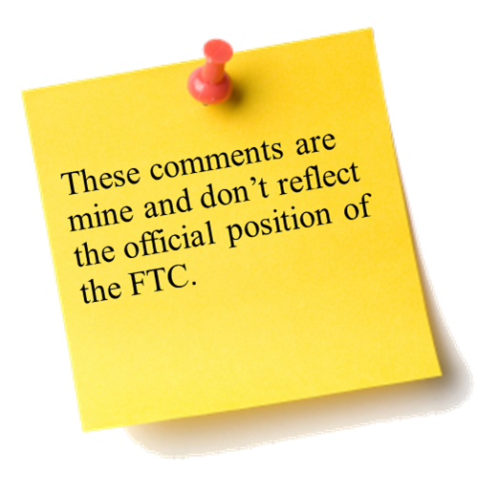
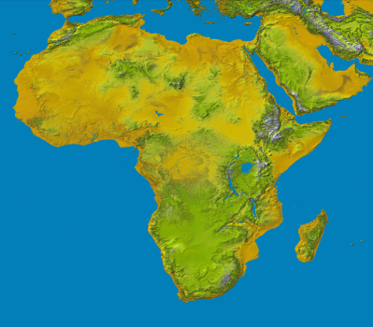
The Sixth Annual African Dialogue Consumer Protection Conference
Energy and Environmental Competition Case Study
Lilongwe, Malawi
8-12 September 2014

Slide 2
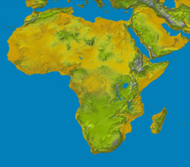
Recharging Batteries Facts 1/3
Autoex (Pty) Ltd is a global supplier of automotive and industrial technology, consumer goods and building technology based in Accra, Ghana. Autoex intends to acquire Taguro (Pty) Ltd, a diversified global supplier of highly engineered products for industries including power and energy, food and beverage, vehicle and transit, and infrastructure processes.
Taguro is headquartered in Bolgatanga, Ghana but operates a plant in Tema where it supplies automotive tools, equipment, and services for aftermarket repair shops.
The only product overlap results from both parties’ assemblage of a specific automotive tool, a vehicle battery recycling, recovery and recharge (BRRR) device.
In a previous acquisition in 2010, Autoex purchased an automotive equipment manufacturer located in Lome, Togo called LRB Technologies Ltd, which primarily produced BRRR devices. Soon after the deal closed, Autoex began selling BRRR under both the LRB and Autoex brands.

Slide 3
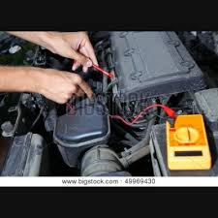
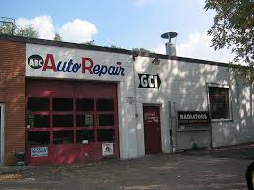
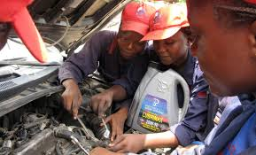
Recharging Batteries Exhibit A

Slide 4
Recharging Batteries Facts 2/3
Taguro’s brand is the leading supplier of BRRRs in Ghana.
Autoex’s brands are the second largest suppliers.
There are four other BRRR suppliers in Ghana, but each company has a very small presence.
Autoex has notified the competition authority that it has entered into an asset purchase agreement with Taguro.

Slide 5
Developing An Investigation Plan Interview Questions for the Merging Parties
Learn each party’s view on antitrust issues
What is the rationale for the conduct
Have the parties’ business people educate you
Talk to the marketing people or the person that can tell you how prices are set or negotiated
Ask the target to back it up. Obtain key ordinary course of business document such as –
Strategic and business plans
Studies
Board presentations on conduct, particularly those describing any synergies
Pricing plans
Test competitive concerns by disclosing them to the target
The disclosure will help you to learn the evidence and arguments that you will need to overcome in any challenge

Slide 6
Recharging Batteries Facts 3/3
The documents and information submitted by the parties in their merger notification filings provided the rationale for the transaction and market share calculations:
Rationale
Autoex recognizes the environmental benefits of the BRRR device as an essential tool in repair shops by helping to extend the life of batteries and prevents disastrous leaks.
Autoex projects substantial turnover will result from becoming the larger supplier of BRRRs.
Market Share
Taguro 80%
Autoex 10%
LRB 7%
Autoex 3%
Evergreen 4%
Pace 3%
Wyzt 2%
Optxs 1%

Slide 7
Developing An Investigation Plan Interview Questions for Competitors
Learn from competitors
Product offerings and overlaps
How companies compete on price on services?
What new innovation have emerged?
Competitive conditions
What is the current market structure?
What is the draw/service area size?
What are the technological trends and historical events?
What are the market shares?
Entry
What are the entry conditions, i.e., investment costs, government approvals and licensing regulations, marketing expenses, etc.?

Slide 8
Developing An Investigation Plan Interview Questions for Customers
Learn from customers
The number and strength of competitors
Are the parties’ services viewed as close substitutes?
What substitutes are available?
Do they have any concerns?
Are there anecdotes of past competition issues?

Slide 9
Developing An Investigation Plan Questions for Discussion
Using information from interviews and obtained from the parties, determine whether the available information suggest there are issues that pose a potential competitive problem:
What is the relevant product market?
The relevant line of commerce is the manufacture and sale of BRRRs used for the repair of motor vehicle batteries.
What is the relevant geographic market?
The relevant market is the country of Ghana.

Slide 10
Developing An Investigation Plan Questions for Discussion
Using information from interviews and obtained from the parties, determine whether the available information suggest there are issues that pose a potential competitive problem:
Identify which companies compete with the parties to provide the same services to the same customers.
Four companies can manufacture BRRRs but not at the same speed and with same nationwide distribution as the parties.
Is there any information that rules out a potential for a competitive problem, such as a low barriers to entry?
Barriers to entry into BRRRs production are high because a license is required to manufacture the patented device. Taguro possesses all the patents.

Slide 11
Managing the Investigation and Evidence
Organize the Information
Develop an investigation plan that organizes case information (by product or by issue)
Consider how technology may help you be more efficient
Maintain Communications
Keep an Open Dialogue with Merging Parties
– commit to regular opportunities to discuss progress
Initiate a Dialogue with Third Parties
– can provide crucial fact information and perspectives on the merger
Keep decision makers informed
Discuss impasses with the parties
Discuss possible remedies

Slide 12
Managing the Investigation and Evidence
Organizing Information
Set out a summary description of the transaction
Autoex, a global supplier of automotive and industrial technology and producer of BRRR devices, intends to purchase Taguro, a global supplier of highly engineered products for the automotive industry and the largest supplier of BRRRs in Ghana.
Distil the reason(s) to investigate further
Merger would combine the two largest suppliers of BRRR devices in Ghana.
Develop a working theory of harm (and, if appropriate, remedies to be sought)
Merged firm could charge higher prices to BRRR customers in Ghana if the parties are particularly close competitors, and could control an overwhelming share of the narrow market for BRRR devices, and if price increases would not be defeated by entry and/or expansion into that market.
Possible Remedies
Divestiture of the LRB brand of BRRR devices

Slide 13
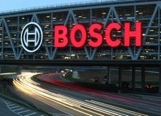
FTC Settled With Bosch GmbH
Robert Bosch GmbH and SPX Services Solutions produce air conditioning recycling, recovery, and recharge (ACRRR) devices in the United States.
FTC required Bosch GmbH to sell one of its ACRRR brands before it could acquire SPX’s brand which held 80% of the market.

