Slide 1
Empowering and Educating Consumers

Slide 2
Introduction
Consumers are not always aware of the factors that affect their buying behavior. However, education helps to address the gap and make them aware of their rights
It helps consumers understand their rights and become active participants in the buying process
An informed consumer is able to dissect the information about the product or service to make a wise buying decision after exploring his options and making accurate product comparisons.

Slide 3
Mandate
The Department of Trade and Consumer Affairs is mandated by the Consumer Protection Act of 1998, to disseminate information to enable consumers to acquire knowledge of basic consumer rights and the skills needed to make informed choices of goods and services
The Act is currently undergoing review.
It is envisaged that the Act will be administered by the Competition Authority in the near future

Slide 4
Objectives
To improve consumer awareness on unfair business practices
To disseminate information to enable consumers to acquire knowledge of basic consumer rights and obligations
To formulate and implement consumer education programmes

Slide 5
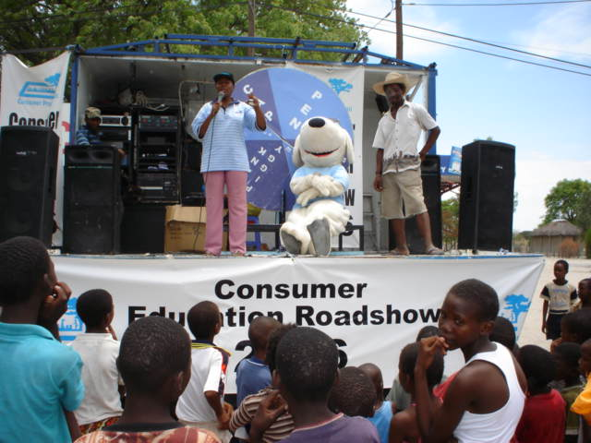
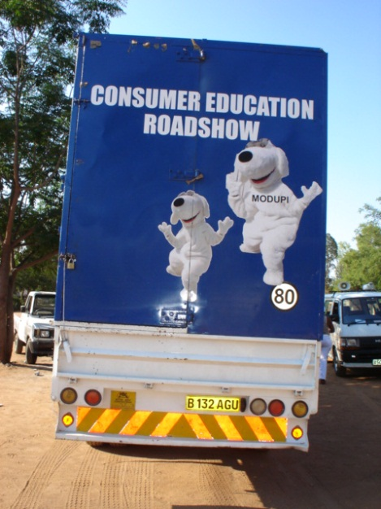
Innovative projects
Formation of Consumer Groups
Taking services to the people
Door-to-door campaigns
Road shows
Edutainment-Drama
Itshireletse Show-Collaboration with Botswana Police (Television)
Weekly Newspaper Articles
Radio Jingles

Slide 6
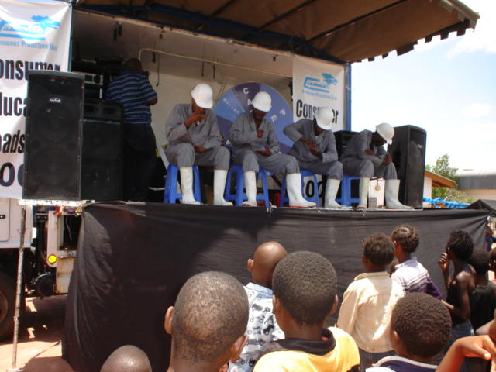
Consumer education programs
Breakfast seminars
Fairs and Exhibitions
Kgotla and school addresses
NGO’s AND Association Addresses
Workshops
Open air campaigns
Radio call-in programme in collaboration with relevant stakeholders
TV adverts
Television Shows/Presentation

Slide 7
Challenges
Lack of sustainable funding for consumer education and empowerment
Reluctance of consumer groups to work as consumer watchdogs ( are they reluctant or is it because of their capacity)

Slide 8
Achievements
Permanent slot in the Daily news paper
Permanent slot in the National Radio(RB1)
A live television show on the 2014 WCRD theme
Revival of 3 consumer groups
Media Interviews
Price survey publication is in the Daily Newspaper on monthly basis
Strengthened partnership with relevant stakeholders (amongst others,BCCARO,BOCRA,Competition Competition Authority, NBFIRA, BOBS & GOVT MEDIA)

Slide 9
THANK YOU!!!!!!!!!!!

