Slide 1
Framing the issues: AI and Consumer Protection
Deirdre K. Mulligan
Federal Trade Commission
FinTech Forum
March 9, 2017

Slide 2

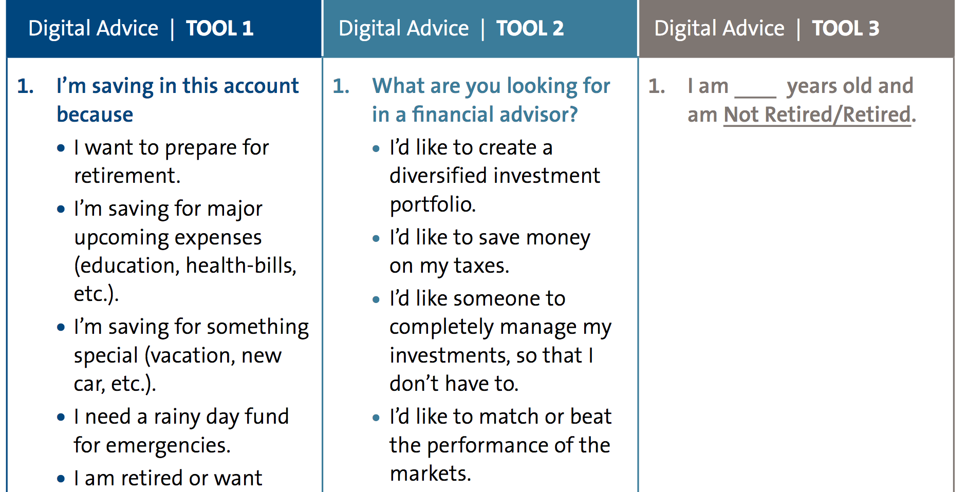
Functional Fidelity

Slide 3



Values: system
Intentional bias
Bias through process, values of designer
Complexity
Tumitu Design

Slide 4
Values: In Financial Advising Systems
Intentional bias
  incentive structure for the financial professional
  Incentive structure of firm
  Portfolio of funds
Designers’ values as source of bias
  Intake process how to assess risk—self assessment, scenarios, hypotheticals
  Presentation of options (framing, ordering, etc.)
Complexity
  data, algorithms, interactions, personalization
  machine learning
  Multiple parties

Slide 5
Values: data used in financial advising systems
Data considered relevant
What data to request and use about clients
What data about funds
Accuracy and quality
information about funds—limited or gaps in data; asymmetry in access cf. other players
clients input—sources, accuracy, incentives to update
cleaning
Sampling bias
who is poorly represented in training data from which models are built?

Slide 6
Values at risk
Privacy
lots of personal information to feed systems
Autonomy
nudging (Dream Forward “emotional advisor)
output of model taken as “objective” b/c its math or machine
Fairness
investor profiles (what characteristics; non-distributive group profiles)
impact on portfolio offered, defaults
estimated value of clients—trapped by past behavior (group or ind)
Responsibility
responsibility for outputs/outcomes as tasks are reallocated

Slide 7
Handoffs require attention to
Functional requirements—What properties must a system have to support function? translation work is critical!
Socio-technical systems—people and algorithms as organizations: how do they shift power, responsibility, resituate domain expertise? how do the constraints of code and law interact? How do we assure assumptions and limits are correct, understood and shared?
Managing values and risk—not solve for them once and for all. It’s a dynamic ecosystem. Can be very volatile due to velocity, volume, variety; and actors with different motives.
Social input into the guts of the machine and data—backend transparency is insufficient—need methods of participation and interpretation.

Slide 8
Consumer Protection Challenges
    Do consumers understand the product and how it works?
    Interpretability:
      processes—what the algorithm does
      how it does it—rules
      who controls algorithm (sources of bias)
      what data feeds it (sources, kinds)
      Biases (does it favor certain funds, and why)

Slide 9
Consumer Protection Challenges
    Can consumers and financial professionals interact with the systems safely?
    Exposing the assumptions and limitations of the model embedded in the algorithmic system
    handoffs between algorithm and humans (oob actions)
    Need for tools to foster understanding
    Simulations and other ways of educating consumers about services (playing with system)
    Access to their data, and how they are profiled

Slide 10
Thanks
Research supported by National Science Foundation under "INSPIRE: Value-Function Handoffs in Human-Machine Compositions” NSF Award number SES 1650589 (Helen Nissenbaum & Deirdre K. Mulligan)

