Slide 1
BLOCKCHAIN
A briefing from Coin Center
Peter Van Valkenburgh

Slide 2
The word
“Blockchain”
is like the word
“Vehicle”

Slide 3
No one says,
“how do you feel about vehicle?”

Slide 4
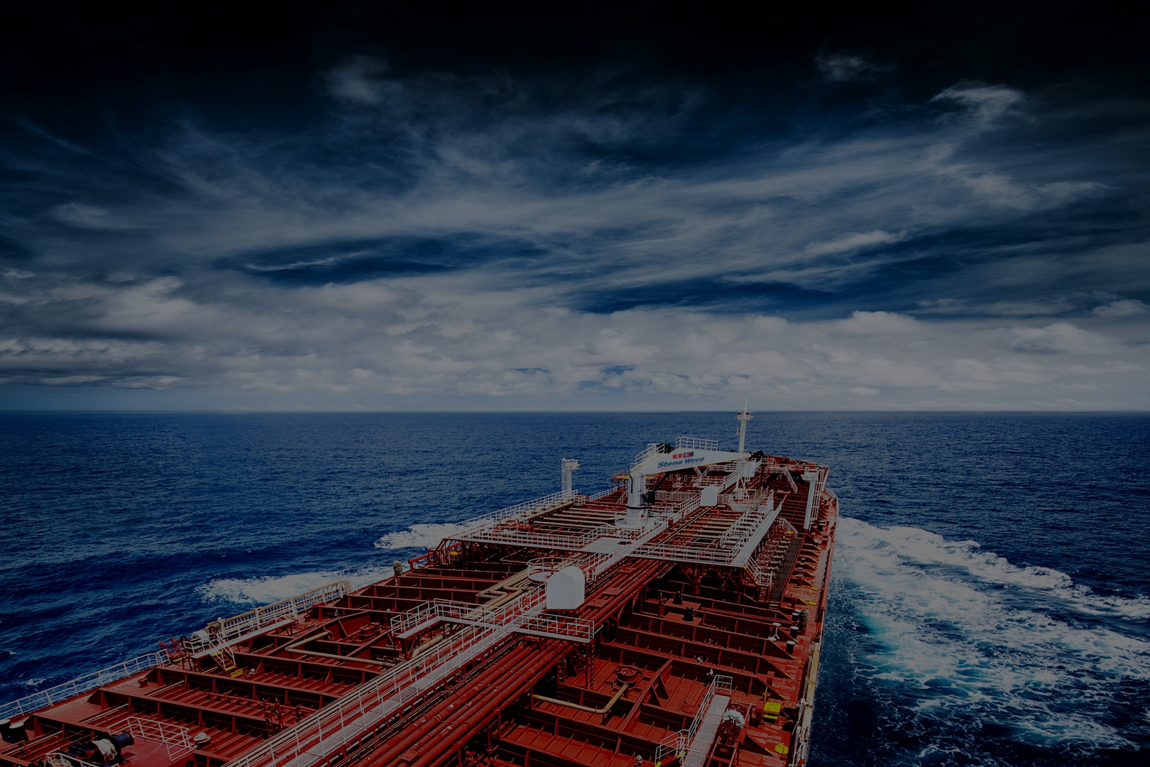
Or,
“We can fix this problem with vehicle!”

Slide 5
We might talk about “vehicle technology”
but even that is strangely abstract.

Slide 6
And “blockchain”
is the same...

Slide 7
There is no “the blockchain”
Any more than there is “the vehicle”

Slide 8
and “Blockchain Technology”
is a broad category.

Slide 9
Blockchain technology.

Slide 10
Blockchain technology?

Slide 11
All blockchain technologies have three essential components:

Slide 12
Connected computers...
...reach agreement over...
...shared data.

Slide 13
Blockchain technology.

Slide 14
Blockchain technology.

Slide 15
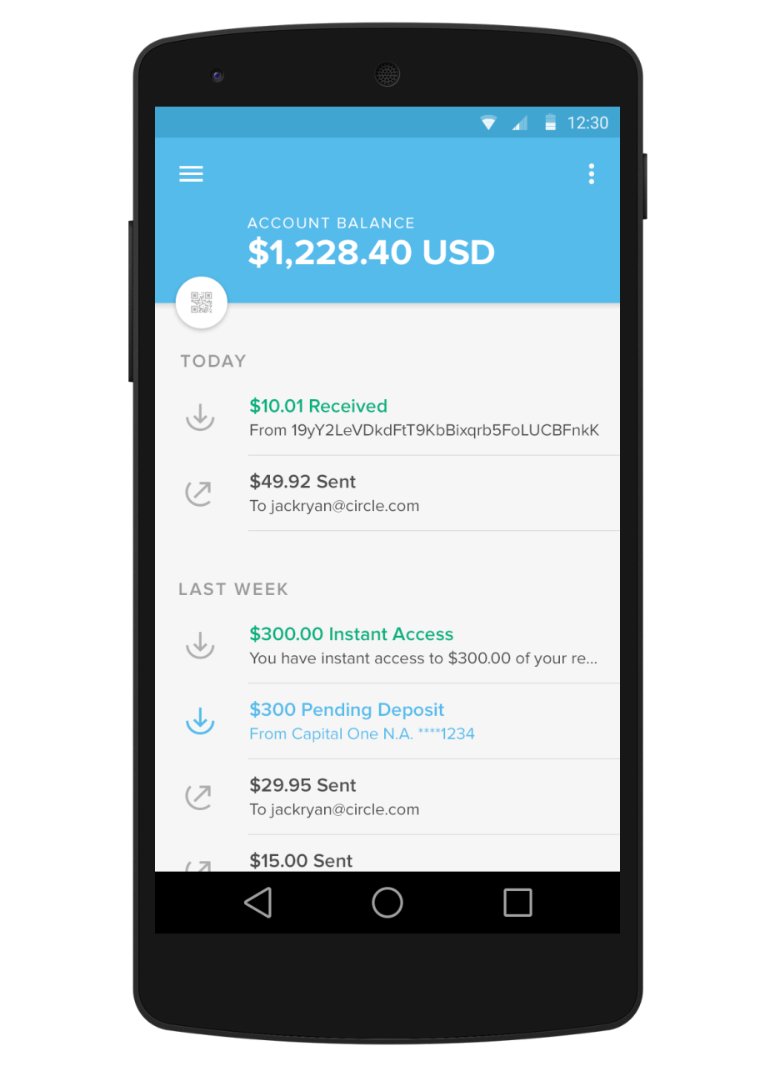
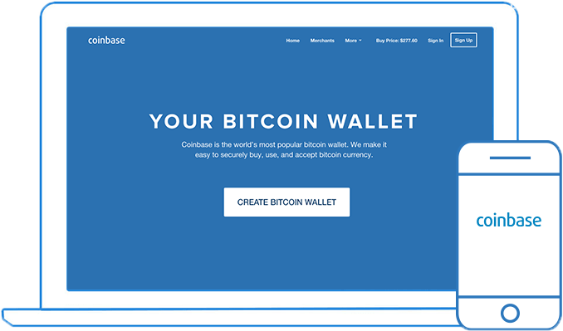
Connected computers reach agreement over shared data.

Slide 16
Connected computers reach agreement over shared data.
Rules for Agreement:
Nobody can send bitcoins that they have not first received from someone else.
Every 10 minutes or so one of the connected computers will be selected to choose the order of valid transactions for that period.

Slide 17
Connected computers reach agreement over shared data.
Shared Data:
TX 230: Mark sent Reuben 1 Bitcoin
TX 229: Mark sent Robin 1 Bitcoin
TX 228: Peter sent Mark 2 Bitcoin
TX 227: Robin sent Peter 2 Bitcoin

Slide 18
What about other blockchain technologies?

Slide 19
Connected computers...
...reach agreement over...
...shared data.

Slide 20
What data?
Identity Credentials
Votes
IOT (permissions to open smart locks / turn on smart bulbs)
Records of Securities Transactions
Property Records
Interbank Settlement Records
Provision of digital goods (cloud storage, network infrastructure)

Slide 21
What rules and design choices?
Open network (like Internet) or closed (like a company intranet)?

Slide 22
What rules and design choices?
Data privacy or data transparency / auditability?

Slide 23
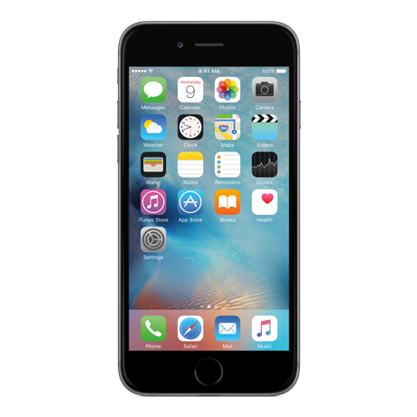
What rules and design choices?
Security at the edge (immutable) or security at the center (mutable)?

Slide 24
Connected computers...
...reach agreement over...
...shared data.

