Slide 1




sponsored by the Federal Trade Commission in cooperation with the
Office of the Georgia Attorney General
State Bar of Georgia Antitrust Law Section
Better Business Bureau Serving Metro Atlanta
The speakers’ comments are their own and don’t reflect the official position of the sponsoring organizations.
August 15, 2019

Slide 2
Daniel Kaufman
Deputy Director
Bureau of Consumer Protection
Federal Trade Commission

Slide 3
Honorable Christopher M. Carr
Attorney General
State of Georgia

Slide 4
THE TRUTH ABOUT FALSE ADVERTISING
5 questions to ask before you run that ad
Lesley Fair Attorney, Bureau of Consumer Protection
Federal Trade Commission
Melissa Devine Assistant Attorney General, Consumer Protection Division
Office of the Georgia Attorney General

Slide 5
5
QUESTIONS TO ASK
BEFORE YOU RUN THAT AD
1
What consumer protection laws apply?
What claims does the ad convey to consumers?
Do we have proof to support those claims?
Have we clearly disclosed material information?
Do our claims raise any compliance red flags?
2
3
4
5

Slide 6

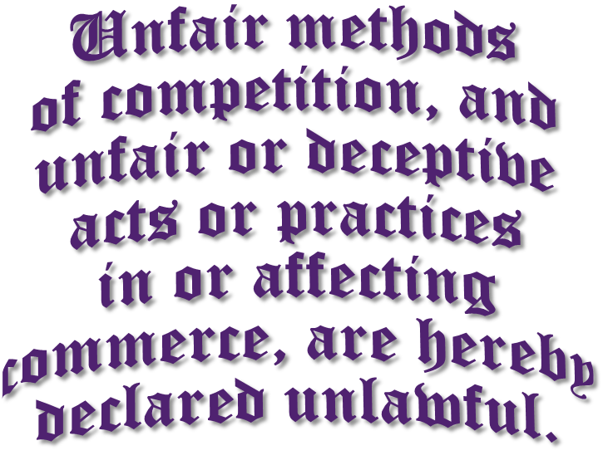


Slide 7
Under FTC law, an act or practice is DECEPTIVE if:
it contains a misrepresentation or omission of information
likely to mislead consumers acting reasonably under the circumstances
and it would be material
– important –
to their decision
to buy the product

Slide 8
Under FTC law, an act or practice is UNFAIR if:
it causes substantial injury – physical, financial, or otherwise
not reasonably avoidable by consumers themselves
and not outweighed by benefits to consumers or competition

Slide 9

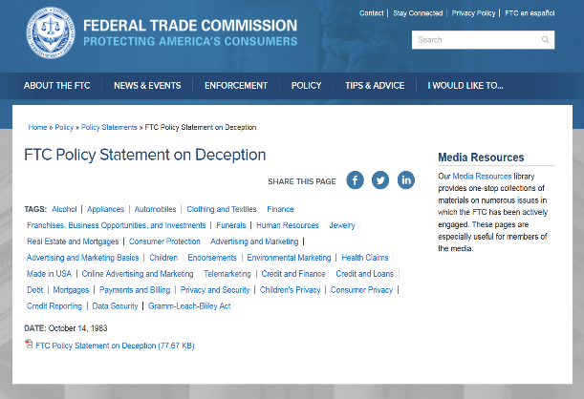
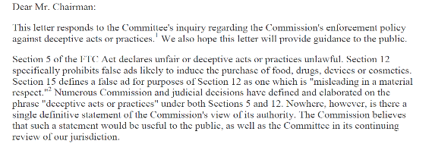
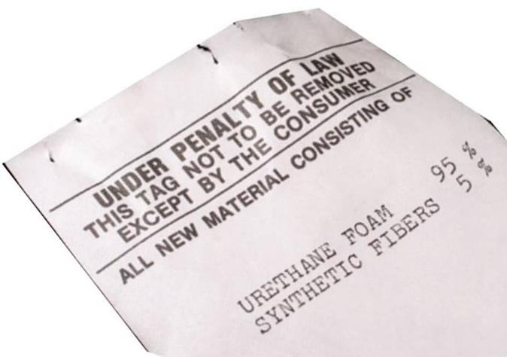
Other sources of FTC law and guidance
FTC POLICY
STATEMENTS
SOME LAWS AND RULES ENFORCED BY THE FTC
Fair Debt Collection Practices Act
Fair Credit Reporting Act
Children’s Online Privacy Protection Rule
CAN-SPAM Rule
Funeral Rule
Textile Rules

Slide 10
Fair Business Practices Act
O.C.G.A. § 10-1-391 et seq.
“Unfair or deceptive acts or practices in the conduct of consumer transactions and consumer acts or practices in trade or commerce are declared unlawful.”
NOTE: Section 393(a) applies to “consumer transactions and consumer acts or practices.” However, B2B deception can also be an FBPA violation pursuant to O.C.G.A. § 10-1-393.1 (“office supply” transactions – BROAD)

Slide 11
Fair Business Practices Act
O.C.G.A. § 10-1-393(b)
By way of illustration only, the following practices are declared unlawful:
Passing off goods or services as those of another;
Causing actual confusion or actual misunderstanding as to the source, sponsorship, approval, or certification of goods or services;
Causing actual confusion or actual misunderstanding as to affiliation, connection, or association with or certification by another;
Using deceptive representations or designations of geographic origin in connection with goods or services … ;
Representing that goods or services have sponsorship, approval, characteristics, ingredients, uses, benefits, or quantities that they do not have or that a person has a sponsorship, approval, status, affiliation, or connection that he or she does not have;
Representing that goods or services are of a particular standard, quality, or grade or that goods are of a particular style or model, if they are of another;
Disparaging goods, services, or business of another by false or misleading representation;
Advertising goods or services with intent not to sell them as advertised;
Advertising goods or services with intent not to supply reasonably expectable public demand, unless the advertisement discloses a limitation of quantity;
Making false or misleading statements concerning the reasons for, existence of, or amounts of price reductions;
Deceptive promotions and prizes;
Conducting a going-out-of-business sale for more than 90 days.

Slide 12
Fair Business Practices Act
O.C.G.A. § 10-1-391(b)
The FBPA must “be interpreted and construed consistently with interpretations given by the Federal Trade Commission in the federal courts pursuant to Section 5(a)(1) of the Federal Trade Commission Act ….”
REMEMBER: You cannot contract around the FBPA! O.C.G.A. § 10-1-393(c)

Slide 13




Before running an ad, be mindful of federal and state consumer protection law.
The scope of “advertising” is broad – TV, radio, print, direct mail, online, social media, etc.
Depending on the facts, the scope of liability for violations of consumer protection laws can be broad – companies, ad agencies, PR firms, individual corporate officers, etc.

Slide 14
5
QUESTIONS TO ASK
BEFORE YOU RUN THAT AD
1
What consumer protection laws apply?
What claims does the ad convey to consumers?
2

Slide 15
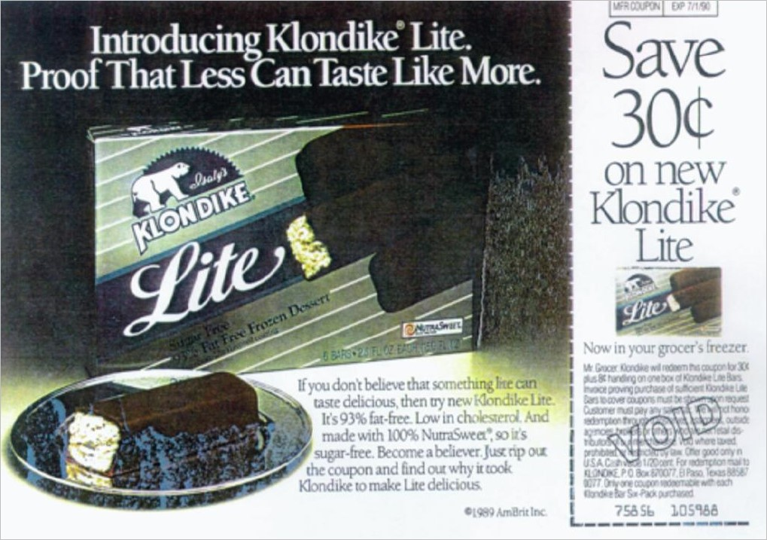
Consumer perception
If you don’t believe that something lite can taste delicious, then try new Klondike Lite. It’s 93% fat-free.
Isaly Klondike (consent order)

Slide 16

Consumer perception
Nissan North America and TBWA Worldwide (consent orders)

Slide 17
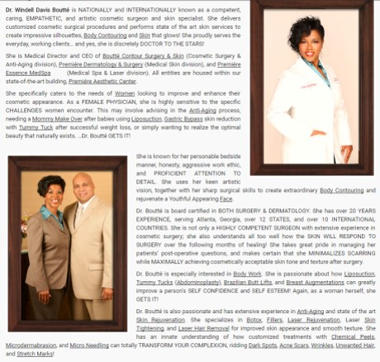
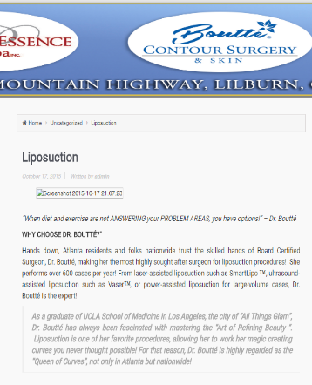
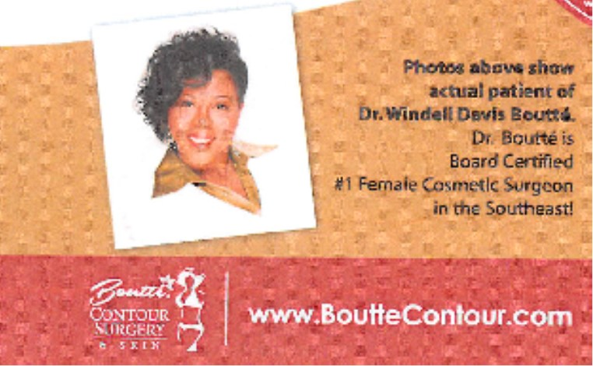
Consumer perception
Dr. Boutté is
Board Certified
#1 Female Cosmetic Surgeon
In the Southeast!
Premiere Dermatology (consent judgment)

Slide 18

Consumer perception
State of Georgia ex rel. Chris Carr v. Marvelay, LLC (judgment entered against company, action against individuals still pending)

Slide 19

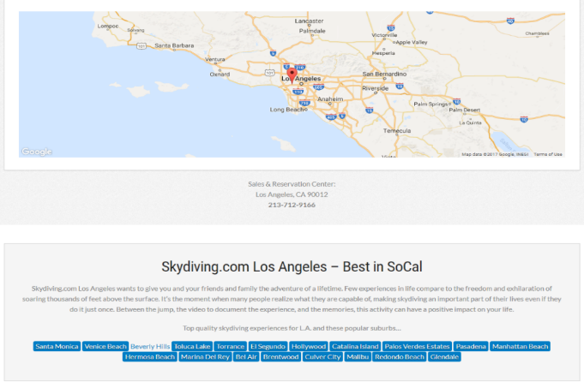
Consumer perception
State of Georgia ex rel. Chris Carr v. Marvelay, LLC (judgment entered against company, action against individuals still pending)

Slide 20
The FTC and the AG’s Office look at ads from the point of view of consumers.
Consider all claims – express and implied – your ads convey to consumers.
Ads can convey multiple claims to reasonable consumers.
Advertisers can convey claims by words, images, and even omissions of information.
Ads can be literally truthful, and yet still deceptive to consumers.

Slide 21
5
QUESTIONS TO ASK
BEFORE YOU RUN THAT AD
1
What consumer protection laws apply?
What claims does the ad convey to consumers?
Do we have proof to support those claims?
2
3

Slide 22
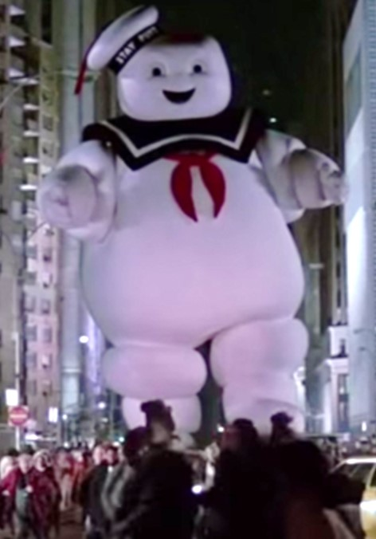
Substantiation
Objective product claims convey the implied representation that the advertiser has proof.
NARROW EXCEPTION: Puffery
At minimum, advertisers must have the proof they claim to have – “Doctors recommend,” “A university study shows,” “Test prove,” etc.
But what if the advertiser doesn’t state or imply a level of substantiation?

Slide 23
OBJECTIVE PRODUCT CLAIMS
HEALTH, SAFETY OR EFFICACY CLAIMS
MOST
DISEASE-RELATED
CLAIMS
competent and reliable evidence
competent and reliable scientific evidence
randomized clinical testing

Slide 24
Competent and reliable scientific evidence
WHAT IT IS
WHAT IT ISN’T
Methodologically sound tests, studies, scientific research
Based on expertise of professionals in field
Objectively conducted by qualified people
Using procedures accepted as accurate
Yielding statistically significant results
Considered in light of the entire body of relevant and reliable scientific evidence
Endorsements from people who use the product
Popular press articles
Sales materials from manufacturer
Low return rate
Money-back guarantee

Slide 25

Substantiation
POM Wonderful LLC v. FTC, 777 F.3d 478 (D.C. Cir. 2015)

Slide 26

Substantiation
i-Health, Inc. and Martek Biosciences (consent order)

Slide 27
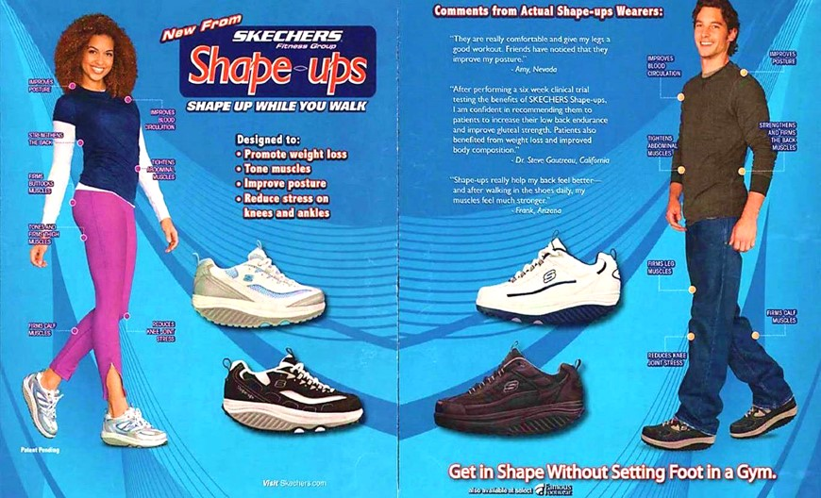
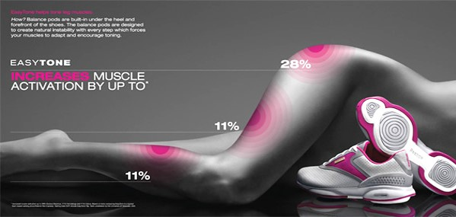
Substantiation
Skechers U.S.A., Inc. and Reebok International, Ltd. (stipulated orders)

Slide 28



Substantiation
Mars Petcare U.S, Inc. (consent order)

Slide 29
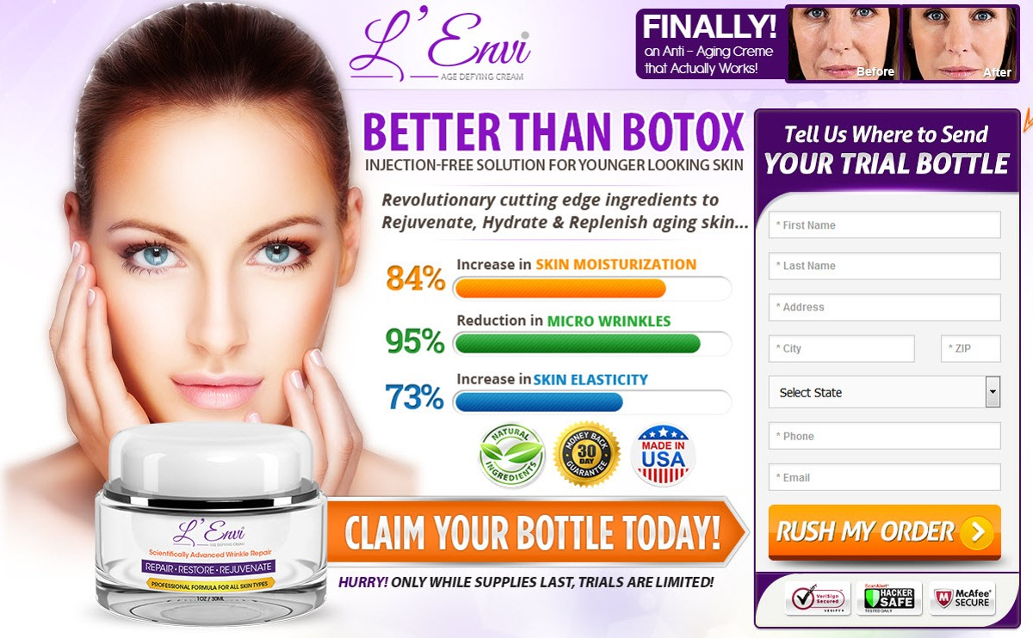

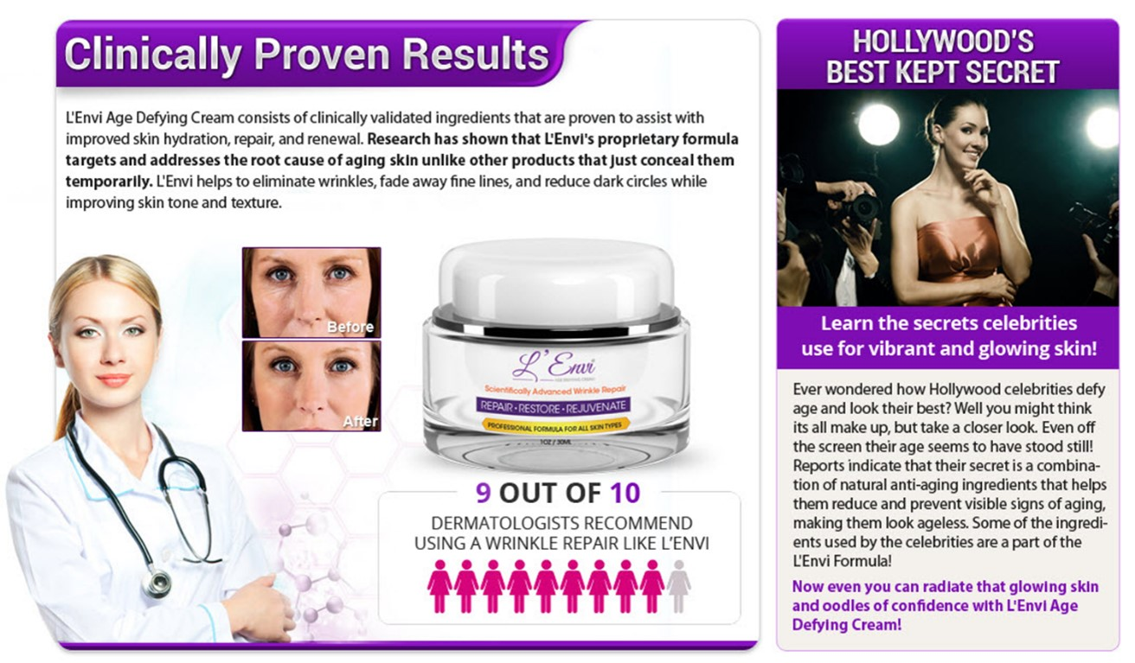
Substantiation
L’Envi (assurance of voluntary compliance)

Slide 30

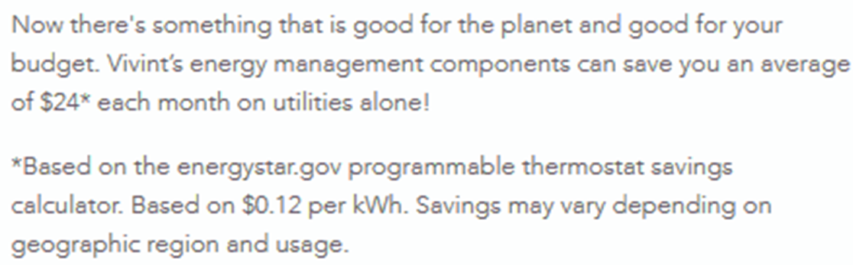
Substantiation
Vivint, Inc. (assurance of voluntary compliance)

Slide 31
Advertisers must have proof in hand before they run the ad.
At minimum, advertisers must have the level of proof they claim they have.
The FTC and the AG evaluate health and safety claims with particular care.
Scientific evidence must be methodologically sound based on experts in the field.

Slide 32
5
QUESTIONS TO ASK
BEFORE YOU RUN THAT AD
1
What consumer protection laws apply?
What claims does the ad convey to consumers?
Do we have proof to support those claims?
Have we clearly disclosed material information?
2
3
4

Slide 33
If the disclosure of information
is necessary to prevent deception,
the disclosure must be
CLEAR AND CONSPICUOUS

Slide 34
PROMINENCE
Is it big enough for consumers to notice and read?
PRESENTATION
Is it worded in a way that’s easy for consumers to understand?
PLACEMENT
Is it where consumers will see it and at a time that gives a meaningful choice?
PROXIMITY
Is it close to the claim it explains?

Slide 35
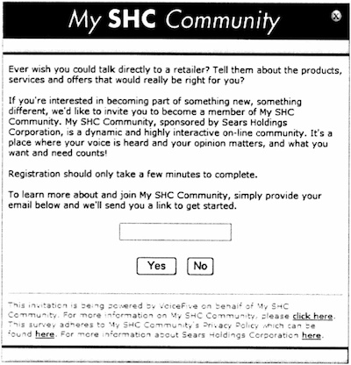
Disclosures
Ever wish you could talk directly to a retailer? Tell them about the products, services, and offers that would be right for you? . . . We’d like to invite you to become a member of My SHC Community
Sears Holdings Management Corp. (consent order)

Slide 36
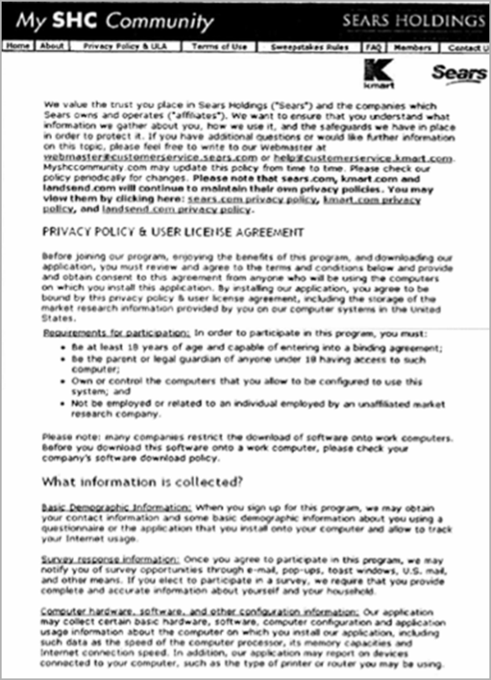
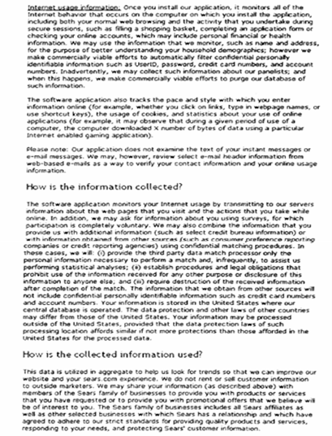
Disclosures

Slide 37
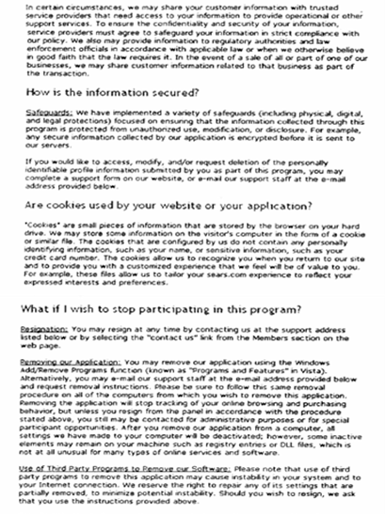
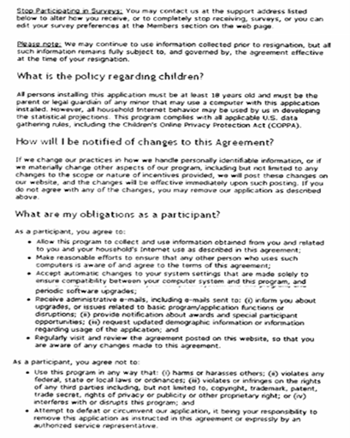
Disclosures

Slide 38
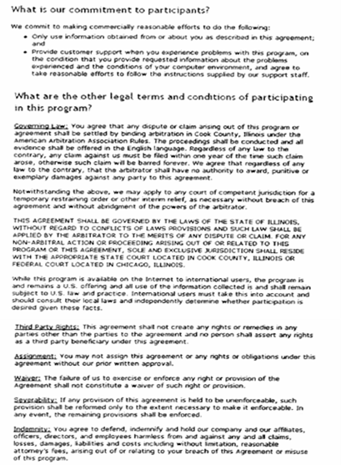
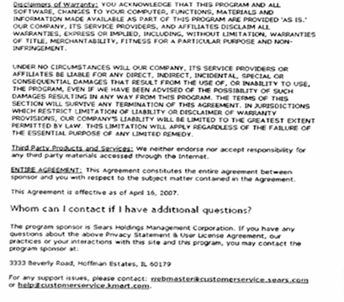
Disclosures
Beginning on the 75th line
Once you install our application, it monitors all of the Internet behavior that occurs on the computer on which you install the application, including both your normal web browsing and the activity that you undertake during secure sessions.

Slide 39































Disclosures

Slide 40


Disclosures
hat the
headline giveth
the fine print cannot taketh away.

Slide 41

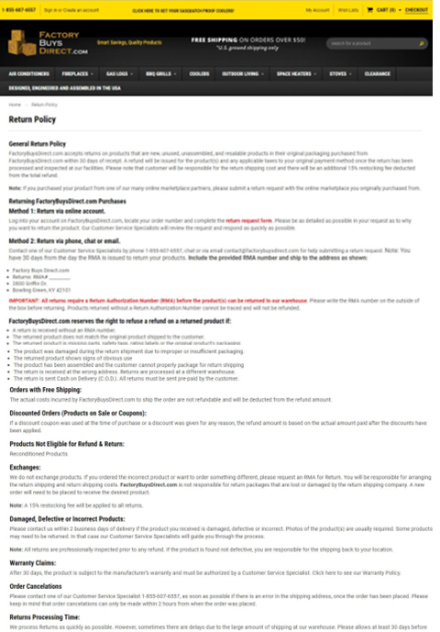
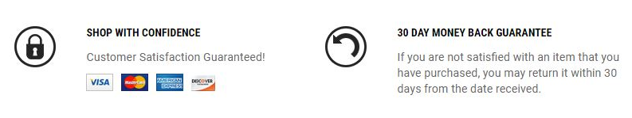
Disclosures
(15 C.F.R. Part 239)
Factory Buys Direct.com, Inc. (assurance of voluntary compliance)

Slide 42
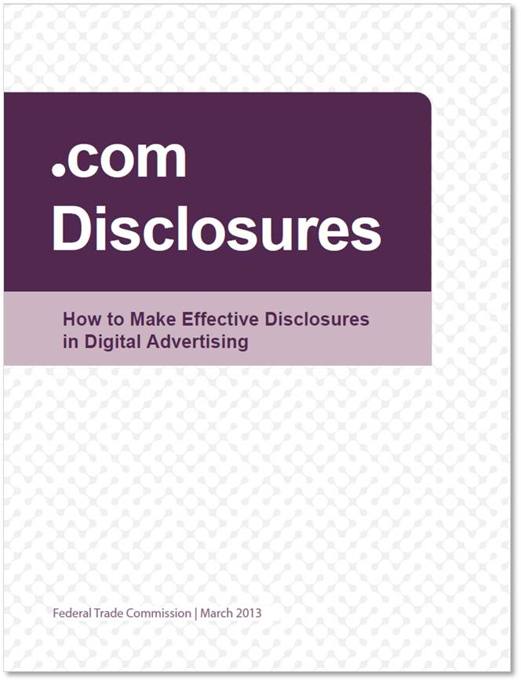
Disclosures

Slide 43
“Clear and conspicuous” is a performance standard, not a font size.
The test isn’t “Is it readable?” The test is “Is it read – and understood – by consumers?”
Consider the same tools you use when you want to catch a customer’s eye – color, size, sound, graphics, etc.
FTC cases establish that fine print, dense blocks of text, fleeting superscripts, footnotes, and obscure hyperlinks don’t meet the “clear and conspicuous” standard.

Slide 44
5
QUESTIONS TO ASK
BEFORE YOU RUN THAT AD
1
What consumer protection laws apply?
What claims does the ad convey to consumers?
Do we have proof to support those claims?
Have we clearly disclosed material information?
Do our claims raise any compliance red flags?
2
3
4
5

Slide 45
Deceptive pricing
Price Comparisons/Discounts, 16 CFR Part 233
Bait Advertising, 16 CFR Part 238
The Use of the Word “Free” and Similar Representations, 16 CFR Part 251

Slide 46
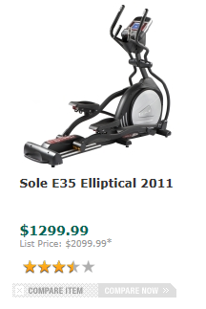
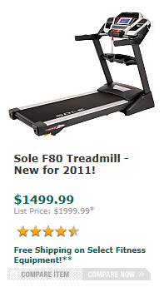
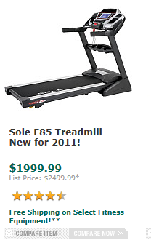
Deceptive pricing
Deceptive Pricing: Comparative Pricing, 16 CFR Part 233
Former price must be an actual, bona fide price
List price must be the price at which at which a substantial number of sales are made
Dick’s Sporting Goods (assurance of voluntary compliance)

Slide 47
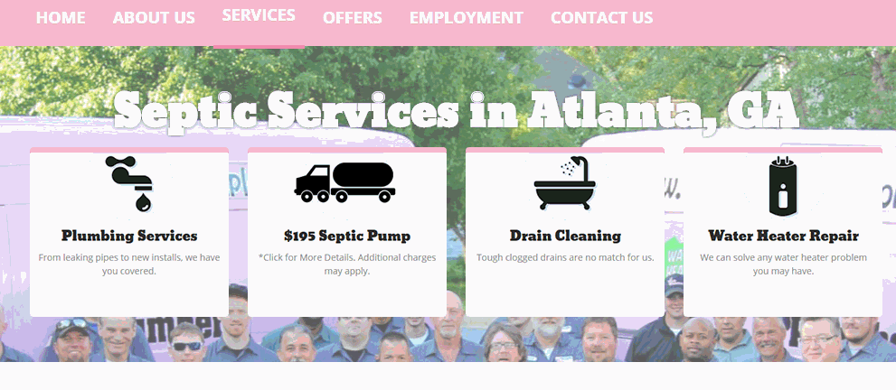
Deceptive pricing
Bait Advertising, 16 CFR Part 238
An alluring but insincere offer to sell a product/service which the advertiser in truth does not intend or want to sell. Its purpose is to switch consumers from buying the advertised merchandise, in order to sell something else, usually at a higher price.
The offer must be a bona fide effort to sell the advertised product!
Aames Heating and Plumbing, Inc. d/b/a The Pink Plumber (assurance of voluntary compliance)

Slide 48

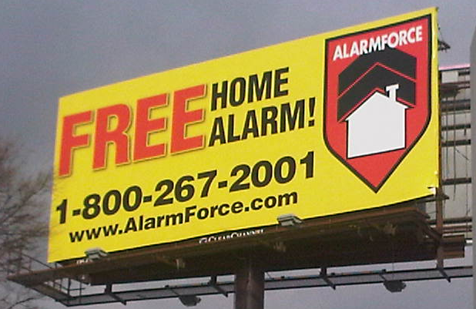

Deceptive pricing
Free and similar representations
Conditions and obligations on which receipt and retention of “free” item should be set forth clearly and conspicuously at the outset of the offer
Merchant not directly or immediately recover, in whole or in part, the cost of the “free” product/service by marking up the price of the other product/service, by the substitution of inferior merchandise, or otherwise.
Alarm Force Industries, Inc. (assurance of voluntary compliance)

Slide 49
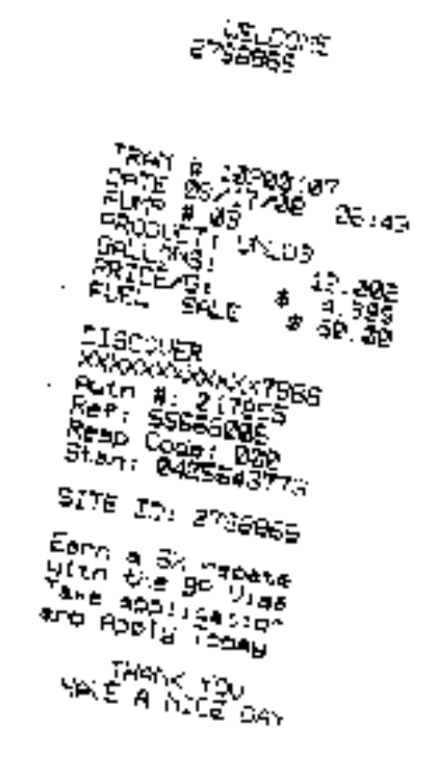
Price Gouging, O.C.G.A. § 10-1-393.4
If the Georgia governor declares that a state of emergency exists in a certain location, a business may not sell or offer for sale in that location goods or services declared by the governor to be “necessary to preserve, protect, or sustain the life, health, or safety of persons or their property” at a price higher than the price at which such goods were sold or offered for sale immediately prior to the governor’s declaration.
$4.999 PER GALLON
BP gas station
Tropical Storm Fay 2008
(assurance of voluntary compliance)

Slide 50
Mail Order Rule
IT IS AN UNFAIR OR DECEPTIVE TRADE PRACTICE:
To solicit any order for the sale of merchandise to be ordered by the buyer through the mail, via the Internet, or by telephone unless, at the time of the solicitation, the seller had a reasonable basis to expect that it will be able to ship any ordered merchandise to the buyer within a time clearly and conspicuously stated in the solicitation or within 30 days. Ga. Comp. R. & Regs. 60-2-2-.01 and 16 C.F.R. § 435.2(a)(1)
To, if a seller is unable to ship merchandise within the applicable time (CAC disclosed time or 30 days), fail to offer the buyer, clearly and conspicuously and without prior demand, the option either to consent to a delay in shipping or to cancel the order and receive a prompt refund. Ga. Comp. R. & Regs. 60-2-2-.01 and 16 C.F.R. § 435.2(b)(1)

Slide 51
Miscellaneous in Georgia
Violations of consumer-facing statutes are unfair/deceptive practices, for example:
  Credit repair services are generally ILLEGAL in GA (O.C.G.A. § 16-9-59)
  Payday loans are generally ILLEGAL in GA (O.C.G.A. § 16-17-1 et seq.)
  Gambling and raffles are generally ILLEGAL in GA (O.C.G.A. § 16-12-20 et seq.)
  Fair Debt Collection Practices Act (15 U.S.C. § 1692 et seq.)
  Debt Adjustment Act (O.C.G.A. § 18-5-1 et seq.)
A business may not publicly post or display consumer SSNs (O.C.G.A. § 10-1-393.8), and must destroy records containing consumer PII (O.C.G.A. § 10-15-2)
Prohibited uses of consumers’ credit card information (O.C.G.A. § 10-1-393.3)
Prohibited fraud or deceit using telemarketing, internet activities, or home repair (O.C.G.A. § 393.5)
Health spas (O.C.G.A. § 10-1-393.2)
Add’l penalties for violations against the elderly or disabled (O.C.G.A. § 10-1-850 et seq.

Slide 52
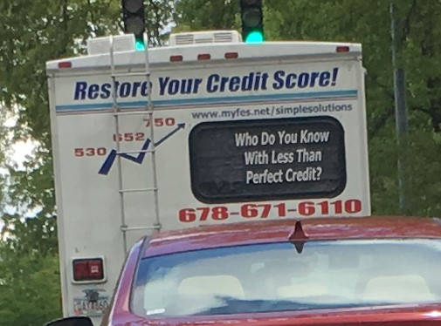
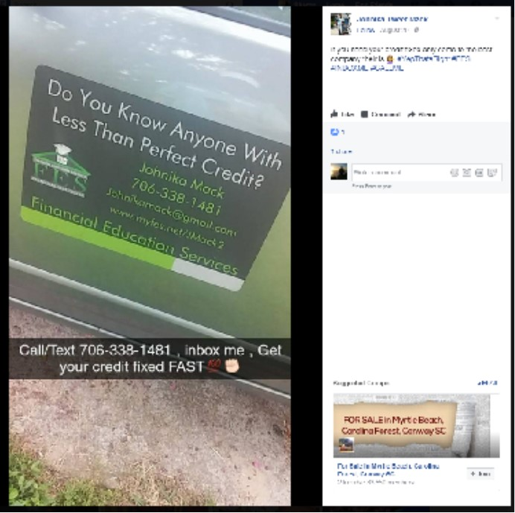
Credit Repair
Financial Education Services, Inc. (consent judgment)

Slide 53

Debt Adjustment
Student Loan Solutions (assurance of voluntary compliance)

Slide 54
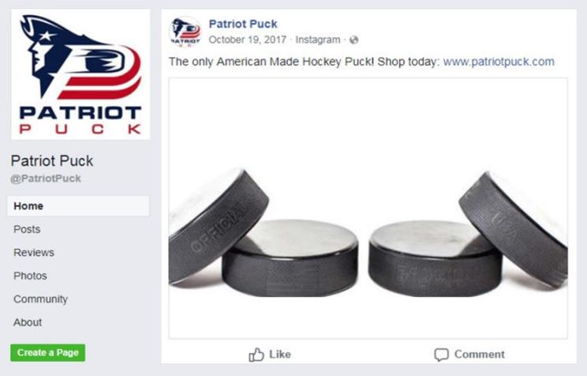
Made in USA claims
Patriot Puck (consent order)

Slide 55
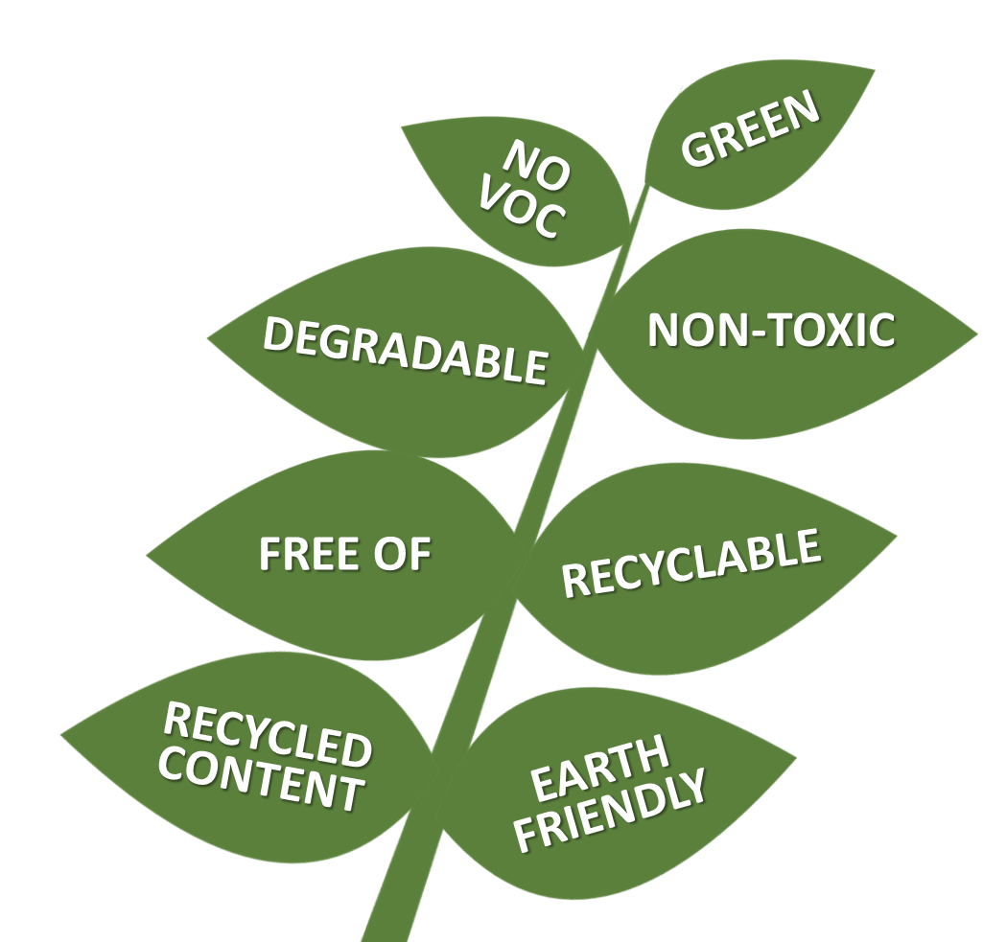

Environmental marketing claims

Slide 56
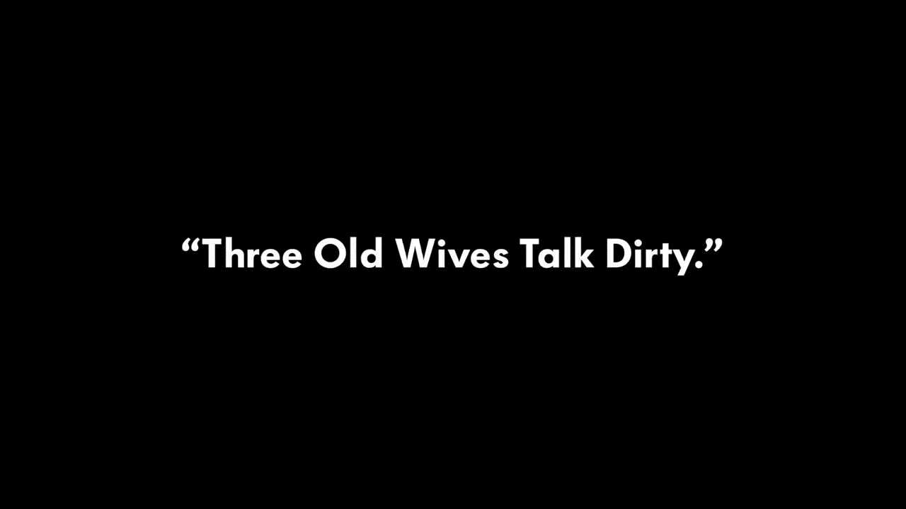
Environmental marketing claims
FTC v. Volkswagen Group of America (stipulated order)

Slide 57
Price comparisons must be based on bona fide former or reference prices. An advertised offer must be a bona fide effort to sell.
Don’t make promises about shipping dates that you cannot fulfill, and offer a refund if you can’t keep your promise.
The violation of a consumer-facing statute can also be an unfair or deceptive practice.
To make a Made in USA claim – without explanation or limitations – companies must meet the “all or virtually all” standard.
Consult the FTC’s Green Guides before making environmental claims.

Slide 58
LESLEY FAIR
MELISSA DEVINE
Federal Trade Commission
lfair@ftc.gov
(202) 326-3081
Office of the Attorney General
mdevine@law.ga.gov
(404) 656-3795
business.ftc.gov
ftc.gov/subscribe

