Slide 1
CTIA Monitoring Program
Overview
WMC Global proprietary and confidential • Do not distribute
© 2011 Wireless Media Consulting, Inc.

Slide 2
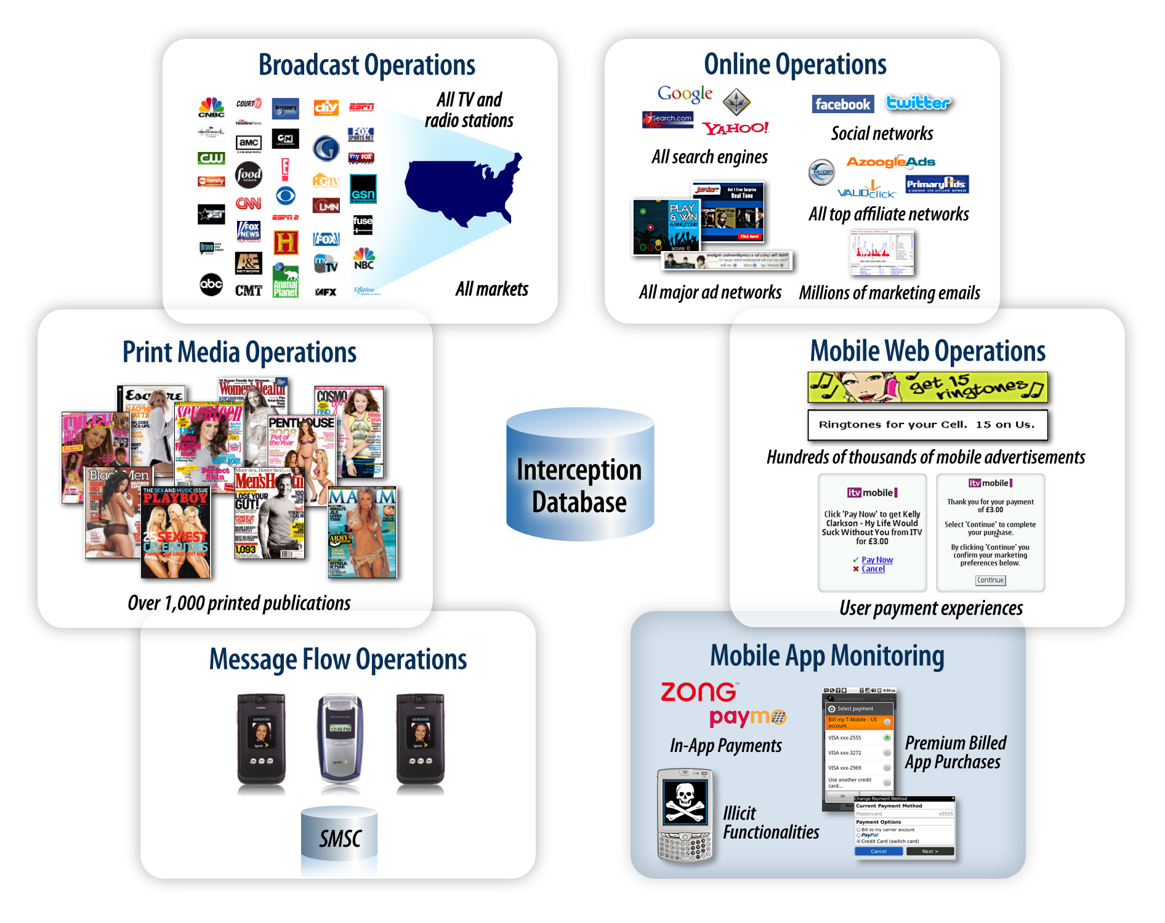
CTIA Monitoring Program
We conduct extensive U.S. operations to intercept premium rate services as the customer experiences them
Our reach and capabilities include:
All U.S. TV channels and more than 1,000 print publications in national and local markets
Hundreds of thousands of targeted Internet properties
Mobile Internet sites, accessed via all carriers
Message flow monitoring across all carriers

Slide 3
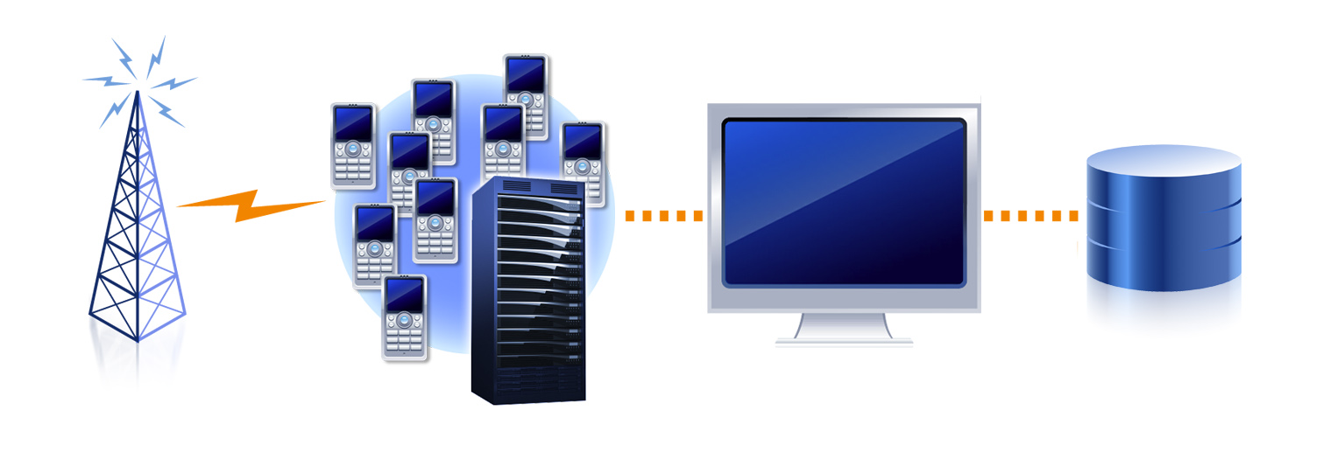
Interception Operations
We perform message flow monitoring using M2M technology, allowing us to:
Remain subscribed to programs, capturing and auditing subscription reminder messages and looking for unexpected messages received after opt-out
Intercept and monitor content providers’ repeat marketing, looking for ongoing abuse of customer details and spam

Slide 4
In-Market Monitoring Process
Advertising Interception
Compliance Audit
Verification of CSCA Data
Quality Assurance
Report Production
Final Quality Assurance
Message Flow Interception
Advertising and message flow interception
Interception involves the advertising and the message flows triggered by responding to advertising
Ongoing interception captures marketing messages and subscription reminder messages
Compliance audit
An experienced team of media analysts audits all interceptions
Each interception is reviewed individually
CSCA data verification
CSCA data is compared with the program found in market
Additional violations might be raised if the data is inaccurate
Quality assurance
Quality assurance professionals verify every compliance audit
Further quality assurance checks are performed following report production, before any information is released to the carriers, aggregators, or others in the industry

