Slide 1
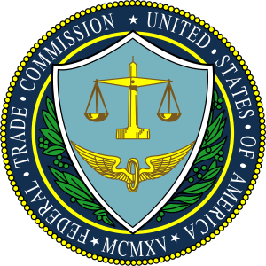
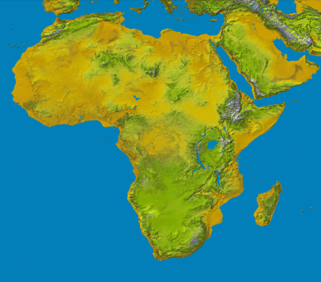
The Fifth Annual African Dialogue Consumer Protection Conference
Mobile and Cyber Threat Issues
Livingstone, Zambia
10-12 September 2013

Slide 2
ZIMBABWE COMPETITION AND TARIFF COMMISSION
Presented by Tausha Isaac
The views and opinions expressed herein are those of the author and do not necessarily reflect the views or opinions of the Zimbabwe Competition and Tariff Commission or any government agency of the Republic of Zimbabwe.

Slide 3
The Zimbabwean Mobile Market
Zimbabwean’s mobile market has 12.553682 million subscribers as at March 2013.
4.250 930 million are on mobile internet.
2.2 million currently use them to make mobile payments
According to POTRAZ mobile payments subscription is exponentially growing such that in a very short space of time it would have covered the mainstream payment system.
Zimbabwe’s internet charges are believed to be the most expensive in the region.
Few mobile devices have antivirus protection
The current mobile payment systems are believed to be secure for now on the part of the service provider.
Security on the part of the consumer depends on how one keeps his or her pass word.
the use of mobile payment is more safe and convenient to the consumer relative to credit card.

Slide 4
Mobile Payments
SMS Payments
Is currently one of the most popular method used in Zimbabwe by the Banks and MNOs.
It entails using mobile phones to pay for goods or services, or even for person-to-person payments.
All the MNOs and Banks uses it is the most dominant in this platforms.
WAP Payments
Is the one that use the Wireless Application Protocol (WAP) facility on the Smart phone to connect to the internet and then using an online payment method such as PayPal, Google Wallet or Yahoo Wallet or simply entering your credit card details into the payment box on a company’s website.
This is not a popular method of mobile payment in Zimbabwe.

Slide 5
Protection and Security of Mobile Payments
Mobile payments market is a very young market in Zimbabwe
Consumer Bill
Ensures the upholding of consumers’ rights
Cyber Security Act
Protection on online transactions
Data Protection
Protection of consumers’ personal data given on opening of credit accounts.
Electronic Transaction Act
Protect consumers’ private information i.e. PIN Account number, credit card number,

Slide 6
Consumer Bodies Initiatives
Embark on consumer awareness campaigns
Lobby for consumer rights
Address consumer complaints through referring cases of internet fraud to the relevant organisations like Interpol for investigations.

Slide 7
Cyber threats
The mobile threat landscape is ever-evolving, and thus presenting institutions and consumers to high risks.
Among today's growing concerns:
Mobile Malware - Trojans, viruses and rootkits migrating from traditional online banking and designed specifically for the mobile marketplace. Researchers see an increase in mobile malware development - in pace with market growth.
Third-Party Apps - Consumers often download mobile devises applications, some which come mainly from third parties with questionable security practices. Or worse, the apps are created by fraudsters and loaded with malware.
Unsecured Wi-Fi - The unsecured wireless network is a toll-free highway for fraudsters to gain access to mobile devices, either to seize control of or gain access to account information.
User Behavior - Consumers are prone to download third-party apps, use unsecured wireless networks, open and click links in SMS text messages and e-mails, and lose their mobile devices and in some cases account information.

Slide 8
Countermeasures
Anti-virus software
Firewalls
Intrusion detection systems
Authentication systems
Encryption
Consumer education on the use of Wi Fi and downloading of mobile devices applications.

Slide 9
End !!
THANK YOU

