Slide 1
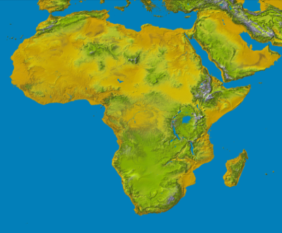
Consumer Protection and Competition Highlights
The Fifth Annual African Dialogue Consumer Protection Conference
Livingstone, Zambia
10-12 September 2013

Slide 2
ZIMBABWE COMPETITION AND TARIFF COMMISSION
Presented by Tausha Isaac
The views and opinions expressed herein are those of the author and do not necessarily reflect the views or opinions of the Zimbabwe Competition and Tariff Commission or any government agency of the Republic of Zimbabwe.

Slide 3
FUNCTIONS
to encourage and promote competition in all sectors of the economy;
to reduce barriers to entry into any sector of the economy ;
to investigate, discourage and prevent restrictive practices;
to study trends towards increased economic concentration, with a view to the investigation of monopoly situations and the prevention of such situations, where they are contrary to the public interest; and
to monitor prices, costs, and profits in any industry or business that the Minister directs the Commission to monitor, and to report its findings to the Minister.

Slide 4
Application of the Act
The Act applies to all economic activities within or having an effect within the Zimbabwe. The Act recognize intellectual property rights to the extent that such rights are not used for the purposes of enhancing or maintaining prices or restrictive practices.
With certain exceptions the Act binds the state to the extent that it is involved in commercial activities and it also applies to the activities of parastatals and public enterprises

Slide 5
Main Elements of Zimbabwe Competition Law
Prevention and Control of Restrictive Practices (section 2(1))
Regulation of Mergers and Acquisitions

Slide 6
Consumer Protection
While the Act does not have a particular Part or section that is specifically devoted to consumer protection it has a number of consumer protection provisions.
Five out of the nine unfair business practices that are specified in the First Schedule of the Act are directly related to consumer protection. These are (i) misleading advertising; (ii) false bargains; (iii) distribution of commodities or services above advertised price; (iv) resale price maintenance; and (v) exclusive dealing

Slide 7
Case Studies
Case of Misleading Advertising
The Act prohibits ‘misleading advertising’
Grinding Mills Case 2007 – 2010
Taxi Case

Slide 8
Hot Issues in the Country
Electricity Supply and Billing issues (ZESA Case)
Municipality Service Provision (Harare and Bulawayo City Councils Cases)

Slide 9
Collaboration with Regional and international partners
Since the Act has no extra-territorial jurisdiction, and the Commission cannot investigate firms from other countries.
Consequently Zimbabwe relies on collaboration with other competition authorities in the region on the investigation of cross border competition cases that have effects in Zimbabwe.

Slide 10
Regional Cooperation
Cross border collaboration on competition cases between the Commission and other competition authorities in the region is both;
Informal bilateral level, and
The cooperation mainly was on bilateral bases where information was exchanged on agency experiences on handling competition cases, involving both mergers and restrictive business practices.
More recently at Formal regional level.
SADC
COMESA
ACF

Slide 11
International Cooperation
Participates in the African Dialogue;
A member of ICN and participate at its conferences.

Slide 12
End!!
Thank Yu

