Slide 1
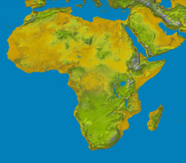
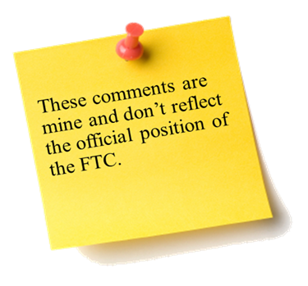
Planning and Conducting An Investigation
The Fifth Annual African Dialogue
Consumer Protection Conference
Deon Woods Bell
U.S. Federal Trade Commission
Livingstone, Zambia
10-12 September 2013

Slide 2
A complaint arrives on your desk…
What do you do now?

Slide 3
Steps in Conducting an Investigation
1. Develop a theory of the case
2. Identify sources of information
3. Interview witnesses
4. Requests documents and data
5. Organize and assess the evidence
6. Determine whether there is a violation of the law

Slide 4
What is an Investigation Plan?
A plan that outlines the various parts of the investigation
No set format, but usually a detailed outline or narrative document that is updated as the investigation proceeds

Slide 5
Includes 3 Primary Areas
Legal theories – identifying the laws that may have been violated
Evidence – identifying sources of evidence and pertinent facts to help evaluate the law violations
Tasks – specifying investigation tasks and assignments and identifying the time and personnel required

Slide 6
Benefits of an Investigation Plan
Provides an organized roadmap for staff to follow in developing a case and presenting it to the decision makers
Allows managers to better understand and oversee the investigation
Provides continuity when adding and removing staff members from investigation team and efficiency

Slide 7
Elements of an Investigation Plan - Legal Theories -
Theory of the case
a short summary of the conduct being investigated and how it might violate the law
Theory of harm
highlights the harm consumers have suffered as a result of the trader’s conduct
Defenses and arguments against the case
Consider potential defenses that the target of the investigation may make and what evidence may support the trader’s case
Remedies
what remedy will address the harm, what information is needed to determine the appropriate remedy, and what evidence is required to support the remedy?

Slide 8
Elements of an Investigation Plan - Evidence-
Elements of the offense
Evidence
What information is needed to satisfy the legal elements, and what might suggest that the case should be closed?
Where can the information be found? (documents, witnesses, etc.)
How can it be obtained? (voluntary versus compulsory)
Evidentiary standards
What are the evidentiary standards required by the decision maker?
Will the information gathered satisfy those evidentiary standards?

Slide 9
Evidence Matrix
Elements | Evidence Obtained | Evidence Needed | Source of Evidence | Evidence Gathering (how to obtain, by whom, when)

Slide 10
Elements of an Investigation Plan - Tasks -
Timing and Administrative Tasks
Identify specific tasks, assign responsibilities and set deadlines
Resource Considerations
Staffing
Office resources
Expert requirements and costs
Legal requirements and costs
Travel requirements and costs
Timing requirements and any internal or external deadlines
Communications

Slide 11
Investigation Agenda (non-exhaustive, work in progress)
TASK | ACTION | RESPONSIBILITY | TARGET DATE | STATUS
1. Administrative Tasks
2. Interviews | Prepare list of interviewees | Dave | Jan. 8 | Done
 | Prepare questionnaires | Melissa | Jan. 9 | Done
 | Conduct interviews | Team | Jan. 30 | Done
 | Follow-up with in-person mtg |  |  | Ongoing
 | Review/summarize info | Team
3. Written Evidence
Voluntary information | Follow-up with merging parties
Compulsory information | Prepare orders
 | Issue orders
 | Receive responses
 | Input in litigation support database

Slide 12
Coordination with Others
Criminal Authorities
Foreign Agencies
Cooperating with other CPAs
Consulting with international networks
Foreign Criminal Cooperation

Slide 13
The Investigative Plan Using the Investigational Plan
1. Roadmap for the staff
Focuses on important/priority issues
Organizes the investigation and evidence
Living document – evolves as the case develops
Framework for preparing recommendation document for decision makers
Allows colleagues to provide feedback
2. Oversight of the investigation
Allows investigation to be effectively supervised and reviewed
Right issues identified, investigated and discussed
Resources not wasted on superfluous issues
Reasoned decision can be made to close or go forward
Aids in staffing and other budgetary decisions

Slide 14
The Investigative Plan Using the Investigational Plan
3. Helps present the case to the decision maker
Organizational tool
Facts not just “dumped”
Explains the law, facts, and economics
Identifies the strengths and weaknesses of the case; good and bad witnesses; good and bad facts
Allows colleagues to provide feedback
Risks of going forward

Slide 15
Sequencing for Gathering Information
Complainant
Develop a Theory
Documents
Analyze the Evidence
Identify Sources
Interviews
Target
Request Documents
Interview Witnesses

Slide 16
Thank you! Questions? For all questions, please contact Deon Woods Bell dwoodsbell@ftc.gov +1-202-326-3307

