Slide 1
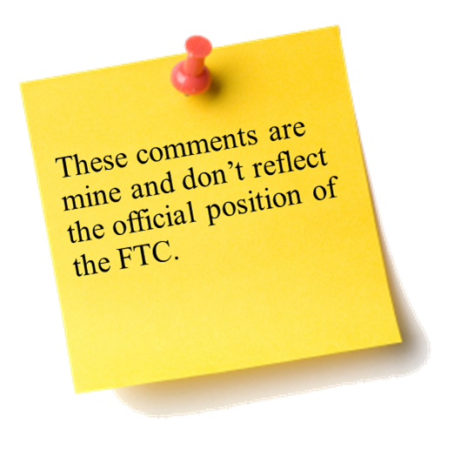
2013 FTC Consumer Protection and Competition Highlights Deon Woods Bell Office of International Affairs
The Fifth Annual African Dialogue Consumer Protection Conference
Livingstone, Zambia
10-12 September 2013

Slide 2
FTC’s Mission and Legal Framework
Mission:
To prevent business practices that are anticompetitive, deceptive, or unfair to consumers
Consumer Protection:
The Federal Trade Commission Act provides that “unfair or deceptive acts or practices in or affecting commerce…are…declared unlawful.” (15 U.S.C. Sec. 45(a)(1))
Competition:
The FTC Act also prohibits “unfair methods of competition.” (15 U.S.C. Sec. 45(a))
Including any conduct that violates the Sherman Antitrust Act or the Clayton Act

Slide 3
Protecting Consumers in a Recovering Economy
Even as the economy recovers, some consumers continue to face financial challenges. The FTC takes effective actions to ensure that consumers are protected from abusive credit practices and get the information they need to make informed financial choices.
Law Enforcement:
Rumson Bolling
Luebke Baker
Goldman Schwartz
American Debt Crunchers
Innovative Wealth Builders
Broadway Global Master
Studies:
Debt Buyer Study
Outreach:
Deceptive Mortgage Ads
Stop Calls and Letters From Debt Collectors
Fake Debt Collectors

Slide 4
Challenging Deceptive Advertising and Marketing
Consumers should get what they pay for. The FTC works to ensure that national advertisers can back up the claims they make for their products, especially health and safety claims.
Law Enforcement:
POM Wonderful
Skechers & Reebok Settlements
Your Baby Can Read!
Ab Circle Pro
Operation False Promises (Business Opportunity sweep)
John Beck ($478 million judgment in a “get rich quick” scam)
Winfixer ($163 million judgment in scareware case)
Led international crackdown against tech support scams involving removal of non-existent spyware

Slide 5
Protecting Consumer Privacy
As the nation’s top cop on the consumer privacy beat, the FTC’s goals are to protect consumer privacy in an evolving market for consumer information, make sure companies keep their privacy promises to consumers, and ensure that consumers have confidence to take advantage of the benefits that a dynamic marketplace offers.
Law Enforcement:
Google
Wyndham Worldwide Corp.
Cbr, Inc.
DesignerWare, LLC
Equifax, HireRight & Spokeo, Inc. (FCRA)
Enforcing the Do Not Call Registry
Studies:
FTC Study Of The U.S. Credit Reporting Industry
Mobile Privacy Disclosure Report
Outreach:
Privacy Choices for Your Personal Financial Information
Employment Background Checks
Video: Sharing Information: A Day in Your Life
Mobile App Developers: Start with Security

Slide 6
Safeguarding Children
The Children’s Online Privacy Protection Act (COPPA) and the FTC’s COPPA Rule protect children’s privacy when they’re online by putting their parents in charge of who gets to collect personal information about their preteen kids. The FTC enforces COPPA by ensuring that parents have the tools they need to protect their children’s privacy.
Outreach:
Child Identity Theft
Infographic: Keeping Up with Kids’ Apps
Marketing Your Mobile App: Get it Right form the Start
Audio: Protecting Your Child’s Personal Information
Law Enforcement:
The Children’s Online Privacy Protection Act (COPPA Rule)
Artists Arena ($1 million)
Path
Studies:
Second Staff Report examining privacy disclosures and practices of apps offered to children
Follow-up study of food and beverage industry advertisements and marketing to children and teens

Slide 7
Fostering Competition in the Tech Industry
The Commission takes a balanced approach when applying antitrust principles to fast-paced technology markets, focusing on the facts as they develop in real time to assess what competition is likely to look like in the future.
Law Enforcement:
Integrated Device Technology, Inc.
Google
Motorola Mobility LLC
Corning Incorporated

Slide 8
Fostering Competition in the Health Industry
The cost of health care is a real problem for most Americans and our national economy. Accordingly, the Commission devotes significant resources to ensure that competition will enable market participants to deliver cost-containment, excellence, and innovation.
Law Enforcement:
Rockford Health System
Universal Health Services
Renown Health
Watson Pharmaceuticals Inc.
Cooperativa de Farmacias Puertorriquenas
St. Luke’s Health System, Ltd.
Studies:
Drug Firm Agreements Delaying Development of Generics

Slide 9
Fostering Competition in the Energy & Environmental Products Industries
Consumers continue to value efficient energy markets and environmentally-friendly products. The Commission devotes significant resources to ensure that competition to produce these items remains robust.
Law Enforcement:
Kinder Morgan, Inc.
Robert Bosch GmbH
Studies:
Staff Report: U.S. Ethanol Markets Remain Unconcentrated
Outreach:
Audio: Saving Money on Heating and Cooling Your Home

Slide 10
Collaborating with International Partners
The FTC continues to lead efforts to promote convergence toward sound and effective consumer protection and antitrust enforcement internationally.
International Competition and Consumer Protection Technical Assistance Program
38 missions in 19 countries
International Fellows and Interns Program
FTC hosted consumer protection and competition officials from 12 countries
US SAFE WEB Act
Enables the FTC to share information with foreign law enforcement agencies and to obtain information on their behalf

