Slide 1
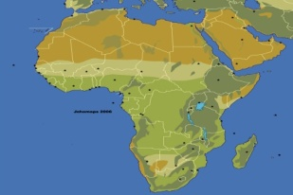
CONSUMER PROTECTION COUNCIL,NIGERIA (CPC)
MOBILE TECHNOLOGY AND CYBER THREATS ISSUES
(The Nigerian Situation)
Fifth Annual African Dialogue Consumer Protection Conference
Livingstone Zambia 10-12 September 2013
Presented by
Mrs Dupe Atoki
Director General
Consumer Protection Council (CPC)

Slide 2
THE NIGERIAN MOBILE MARKET
INTRODUCTION: THE NIGERIAN MOBILE MARKET
West Africa has about 188m mobile subscribers being 30% of Africa’s total mobile market share, with Nigeria holding 95m subscribers.
There is an influx of internet enabled smart phones and mobile internet use is fast gaining ground.
Cyber security threat is said to be on a marginal decrease in Nigeria which moved from 59th in 2011 to 69th in 2012 world statistics for malicious cyber activities. (Symantec Corporation).
The positioning still shows a prevalence of cyber threats particularly for a country with approximately 160 million people and high use of mobile technology.

Slide 3
Factors responsible for mobile and cyber threats
FACTORS RESPONSIBLE FOR MOBILE AND CYBER THREATS
Nigeria’s explosive ICT growth and the wide spread adoption and use of modern gadgets and applications like smart phones has increased the growth and penetration of ICT in the country.
This has come with a commensurate growth in cyber threat. As the country’s appetite for mobile devices grows, so does the threat of cyber crimes.
Even though there is a proliferation of smart phones and other gadgets, mobile technology is still quite novel and most consumers are unaware of its intricacies.
Many consumers do not realise the damage that the loss of their mobile devices may cause in regard information stored for mobile transactions. Their transactions may be available for the thief to utilise.

Slide 4
Factors responsible for mobile and cyber threats
FACTORS RESPONSIBLE FOR MOBILE AND CYBER THREATS
c. The influx of web based transactions has increased the
risk of cyber threats. On-line commerce is easily available.
Also, the aggressive pursuance of the cash-less policy of
the Central Bank of Nigeria has increased the ability and
appetite for web based transactions via the internet or
mobile devices.
d. Importation of substandard devices also means that there
are fewer or no safeguards for the mobile transactions.
Sadly, the cheaper brands tend to be popular purchases for
consumers who do not realise the compromises being
made.
e. Lack of national approach to tackling cyber threat e.g no
legislation yet on cyber crime.

Slide 5
Nature of mobile technology/cyber threats
NATURE OF MOBILE TECHNOLOGY/CYBER THREATS
There is a fair level of hacking into devices and retrieving
personal information used for internet or mobile transactions.
Legal sites are hacked and utilised by fraudsters to divert victims to unsafe sites. A number of government sites had previously been hacked.
Those of telecommunication companies are also hacked or cloned with fake messages of winnings communicated to consumers who are deceived into parting with funds.
Fraudsters hack into devices and email and retrieve information that would enable them gain control of the victim’s identity. The hackers then send mail to the contacts of the victim saying that the victim is stranded in some foreign country and wants his/her friend to send funds to a specified account. Some have been taken in by this thinking they are helping a friend.

Slide 6
Nature of mobile technology/cyber threats
NATURE OF MOBILE TECHNOLOGY/CYBER THREATS
b) Malware and virus attacks are becoming more prevalent by
the day. Consumers are more interested in protecting themselves from tangible threats such as loss of the mobile device, debit cards etc. However, there is little awareness of malware or hacking.
Not all users of the internet consider an anti virus or vital
updates crucial for their computers. Fewer consider it
necessary for their smart phones.
Not many use encryption or security software.
c) Consumers visit unsecure sites regularly and this is partly
due to ineffective or non existent anti-virus protection and
consumer ignorance of need for security.
Most do not know that it is safer to type out a website
address and not follow a link.
Many also connect to unknown wireless networks which
could compromise security of their mobile devices.

Slide 7
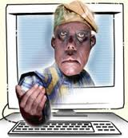
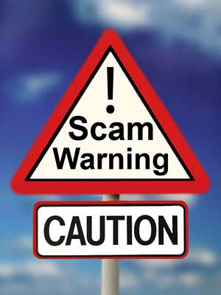
Nature of mobile technology and Cyber threats
NATURE OF MOBILE TECHNOLOGY AND CYBER THREATS
d. Phishing scams: Consumers fall prey quite easily to these. A lot of this is prevalent in the banking industry.
You get a message supposedly from your bank asking you to update your banking details or you will not be able to utilise the account anymore. It then tells you to log on the pin to your debit card etc. These scams are very widespread, easily recognised by the computer savvy but a potential trap for others. Falling for this scam results in accounts being hijacked and cleared of funds.

Slide 8
ACTUAL SAMPLE SCAM
ACTUAL SAMPLE SCAM
This is an automatic message by the New Zenith Bank Security System to protect
our customers from unauthorized users.
Our system detected your account been (sic) compromised and we had no
choice than to temporarily suspend your account.
In order for your account to start working normally without interruption, you
have to confirm your account information within 24 hours.
Your account has been temporarily suspended in order to protect you.
Your account will continue to work normal and the limit will be lifted after few
verification process. Once you have updated your account records, your information will be
confirmed and your account will start to work as normal once again.
This will help protect you in the future. The process does not take more than 5
minutes. To proceed to confirm your account information please click on the link below
and follow the instructions that will be required.
Click Here To Verfiy Your Account info
We Are Here For You
Zenith Bank Plc©.

Slide 9
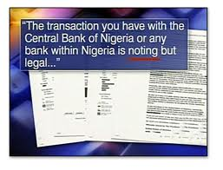
ACTUAL SAMPLE SCAM
ACTUAL SAMPLE SCAM
ACTUAL SAMPLE SCAM
Sample scams
Dear customer, Important New Security UPDATE! Validate Your Account. LOGIN Please if this message is found in your spam folder, move message to inbox to enable you click on the login above Privacy Department. 2013 First Bank Nigeria plc
---------------------------------------------------------------------
Dear Customer,
Your Zenith Bank Online security is still not active.
Please Login below to activate your Online Banking security.
Please complete your online verification Privacy Department. © 2013 Zenith Bank
-------------------------------------------------------------
If you look carefully, you will find that there are spelling mistakes and use of language not likely for banks. The construction of the messages as well, would be a sign that this is a scam, but many who are educationally or technically challenged could easily fall prey.

Slide 10
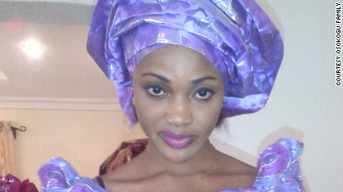
CYBER THREATS
CYBER THREATS
CYNTHIA OSOKOGU: VICTIM OF CYBER BASED CRIME
e) A new scam targets people who are looking for work. The scammer clones a website, often that of a govt agency and requests for applications for employment, asking for a processing fee. The victim pays the money only to find out that the agency was not recruiting and did not post any vacancies on its real website!
f) Other scams are perpetuated on social media such as Facebook where unsuspecting victims are sometimes lured to their death or physical harm by scammers promising business opportunities.

Slide 11
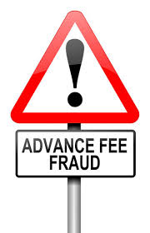
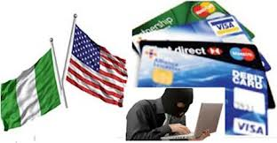
REGULATORY INITIATIVES
REGULATORY INITIATIVES
REGULATORY INITIATIVES
g) Advance fee fraud is another well known cyber fraud through the use of mobile devices. While Nigeria is sometimes referred to in these scams, there are statistics to show that they also originate in other nations including the western world.
It is however normal practice when the Council receives alerts or complaints on Cybercrime related issues, it liaises with the relevant agencies charged with the responsibility of tackling these issues. Such agencies are Economic & Financial Crimes Commission and Special Fraud Unit of the Nigerian Police.
There is an ongoing initiative between the Consumer Protection Council, Economic & Financial Crimes Commission of Nigeria and the Federal Trade Commission of USA ,to work together to combat various cross border frauds, including this type.

Slide 12
REGULATORY INITIATIVES. CYBER CRIME BILL
REGULATORY INITIATIVES. CYBER CRIME BILL
A bill to provide an effective, unified and comprehensive legal
framework for the prohibition, prevention, detection,
prosecution and punishment of cybercrime in Nigeria has been
proposed by the office of the National Security Adviser to fill
the vacuum of legislation in this area. Highlights of the bill are:
To enhance Cyber security and the protection of computer
systems and networks, electronic communications, intellectual
property and privacy rights.
To criminalize specific computer and computer–related offences, which include: Unlawful access to a computer; Unauthorized disclosure of access code; Data forgery; Computer fraud; System interference; Misuse of devices; Denial of service; Identity theft and impersonation; Child Pornography; Records Retention and Preservation; Unlawful Interception; Cyber squatting; Cyber-terrorism; Failure of Service Providers to Perform certain Duties; Racist and xenophobic Offences; Attempt, conspiracy and abetment; and Corporate Liability.

Slide 13
OTHER Regulatory INITIATIVES
OTHER REGULATORY INITIATIVES
THE DRAFT CONSUMER PROTECTION AMENDMENT BILL
The Draft Consumer Protection Council Amendment Bill currently before the National Assembly also addresses transactions bordering on electronic commerce.
In addition, CPC is also working on a regulation to guide on-line transactions and protect consumers thereby.
Furthermore, cyber and mobile assisted fraud has compelled the Nigerian Communications Commission to create and enforce a policy that SIM cards must be registered with biometric data of owners, in order to reduce the fraud committed or assisted with the use of mobile devices. Prior to this, a scammer may purchase an inexpensive mobile phone and a pre-paid SIM card without submitting any subscriber information. If the scammers believed they were being traced, they would simply discard their SIM cards and purchase new ones.

Slide 14
OTHER REGULATORY INITIATIVES
OTHER REGULATORY INITIATIVES
NATIONAL INFORMATION TECHNOLOGY DEVELOPMENT AGENCY (NITDA) ACT 2007
The NITDA is a government agency whose mandate is to bring government and its services closer to the people through Information Technology. Its major function among others is to develop guidelines for electronic governance and monitor the use of electronic data interchange and other forms of electronic communication transactions as an alternative to paper based methods in government, commerce, education, the private and public sectors, labor, and other fields, where the use of electronic communication may improve the exchange of data and information. It is entrusted with the implementation of the national IT policy.
The need for cyber security is not lost on the nation. Nigeria is set to host the 2013 World Cyber Security Conference at which Nigeria’s First Lady will be unveiled as the champion for child on-line protection to give it the publicity and sensitization needed by the populace. The main focus of the conference is to address individual security in cyber space.

Slide 15
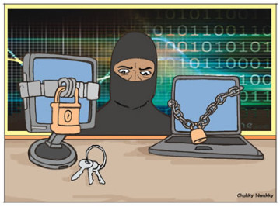
CONCLUSION
CONCLUSION
PREVENTION IS THE KEY
A national policy on cyber threats and the cyber crime bill currently being pursued will hopefully address the earlier stated threats.
While that is being pursued, CPC will continue to sensitise consumers and come up with regulations to make the providers more responsible for protecting the consumer.
The education of consumers in security in the virtual world is a task that is also beginning to be understood by different regulatory authorities as something that must be tackled by all.
All hands are pretty much getting on deck.

Slide 16
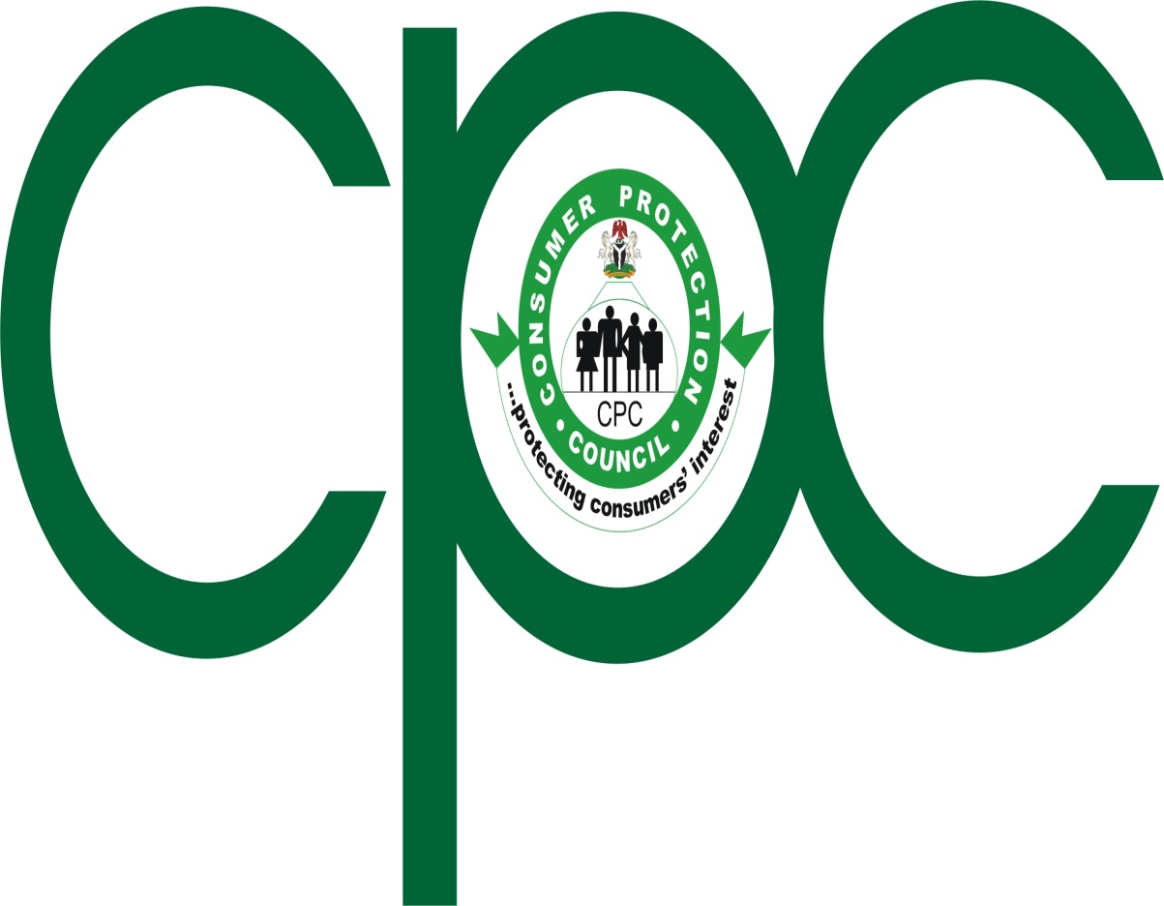
APPRECIATION
THANK YOU FOR YOUR KIND ATTENTION

