Slide 1


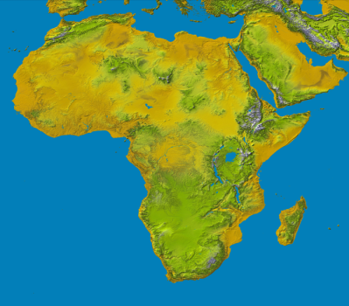
The Fifth Annual African Dialogue
Consumer Protection Conference
Brief overview of Consumer protection and Competition highlights in Namibia
Livingstone, Zambia
10-12 September 2013

Slide 2
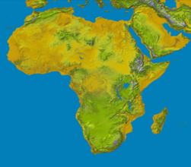

Presentation outline
Introduction
Overview of Consumer protection in Namibia
Motivation for a consumer protection legislation in Namibia
Namibian Competition law
Namibian Competition Commission
Way forward

Slide 3
Introduction
Consumer protection is a form of government regulation which aim to protect the rights of consumers
consists of laws and organizations designed to ensure the rights of consumers, fair trade competition and the free flow of truthful information in the marketplace
prevent businesses from engaging in fraudulent or unfair practices in an attempt to gain advantage over competitors at a disadvantage to consumers
Consumers are individuals who acquires goods or services for direct use or ownership rather than for resale
UN Guidelines for Consumer Protection 1985, 8 fundamental consumer rights
  Satisfaction of basic needs
  Safety
  Information
  Choice
  Representation
  Redress
  Consumer education
  A healthy environment

Slide 4
Overview of Consumer protection in Namibia
Namibia has no law and policy on Consumer Protection
Country is dominated by foreign firms mainly SA firms mostly in
Banking, Retail, Insurance, etc
Namibian Consumers often faced with unfair trade practices from SA and other trading partners
South African Consumer Protection Act does not extend to consumers of SA goods & services purchased outside SA although produced in SA or supplied by SA firms
Namibian Competition Act has some provisions on consumer protection
provide consumers with competitive prices and product choices
Consumer protection lobby groups
Need for a Consumer protection legislation

Slide 5
Motivation for a CPL in Namibia
Inherent exploitative trade practices by businesses local and foreign
  i.e. Voetstoots clause
Lack of redress mechanisms for aggrieved consumer, high cost of litigation
Existence of CP in countries around the region making Namibia an easy target for substandard goods and exploitative practices

Slide 6
Namibia Competition landscape
Since 1990, Namibian economy is highly developmental and faces challenges on high unemployment, skewed income inequality, and a enclaved economic structure which is primary commodity driven (base metals and minerals) and highly concentrated on few sectors such as agriculture, retail, mining and fishing.
Since 1996, the Ministry of Trade and Industry (MTI) under which NaCC resorts started developing a competition policy and law.
The Namibian Competition, Act No. 2 of 2003 was enacted in 2003; to enhance the promotion and safeguarding of competition in Namibia in order to:
provide consumers with competitive prices and product choices;
promote employment and advance the social and economic welfare of Namibians;
expand opportunities for Namibian participation in world markets while recognizing the role of foreign competition in Namibia;
ensure that small undertakings have an equitable opportunity to participate in the Namibian economy; and
promote a greater spread of ownership, in particular to increase ownership stakes of historically disadvantaged persons.
Commencement of the Competition Act (the Rules) passed in 2008.

Slide 7
Enforcement of the Competition law
NaCC established in 2009; big role in promoting and safeguarding fair competition in the Namibian economy
Through the regulation of mergers and acquisitions, public advocacy and regulating business activities to ensure that businesses do not engage in anti competitive conducts
Has successfully dealt with over 200 cases in Mergers and Acquisitions
Most cases are from wholesale and retail trade repair, Real estate and business services, mining, financial intermediation, hotel and restaurant and communication
Over 20 cases in Restrictive Business Practices currently under investigation
over 20 cases in public advisory
The Commission finalised thresholds study on mergers and abuse of dominance. The legal notices are to be gazetted soon

Slide 8
Enforcement of the Competition law conti...
Commission has developed its research programme through its Economic and Sector Research Division
-- prioritising sectors for market studies
-- competition impact assessments
-- advocacy and awareness of competition policy and law
Concluded MoUs with some sector regulators (Namport, BON, CRAN, ECB, ACC etc)
Explorations with regulators of Non Banking Financial Supervision, and Tender board.

Slide 9
Way forward
Need for CP has been established
Need for coordinated of existing efforts towards the development of Consumer Protection Law and Policy
Govt is busy drawing up the CP framework through Division of Consumer protection in MTI
Benchmarking completed last year and report was produced ( Australia, RSA, Zambia)
National policy (Consultants to be appointed)
Institutionalisation (Stand alone CP commission or intergraded in the NaCC (economic interest)
Review of the Namibian Competition Act advocate to have some CP provisions
Establishment of steering Group on Consumer Protection
  Approach
  Coverage
  Institutionalisation
  Jurisdiction...

Slide 10
Thank you for your attention....
Josef Hausiku
Researcher
Namibian Competition Commission
+264 61 224622 tel
+264 61 401900/901 fax
E-mail: josef.hausiku@nacc.com.na
www.nacc.com.na
“Fair competition, prosperous economy.”

