Slide 1
The Fifth Annual African Consumer Protection Dialogue Conference
National Telecom Regulatory Authority
EGYPT Eng. Aly Anis
Livingstone, Zambia
10-12 September 2013

Slide 2
Mobile Technology
It is well known that the conversions of (services, networks, and devices) are the trend now likes: Cloud, VOIP, DSL, Wi-Fi, and IPTV.
Changing media landscape: analogue to digital conversions, height frequency updates, Video on demand (non-linear broadcasting).
Cellular revolution:
1G voice only
2G voice and data capability
3G evolved voice and data
4G new trend LTE (voice, data) with height speeds.

Slide 3
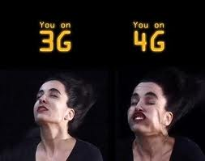
Mobile Technology
* What is the deference between 3G and 4G ?:
for 4G service at 100 (Mbps) for high mobility communication (such as from trains and cars) and 1000 (Mbps) for low mobility communication (such as pedestrians and stationary users.

Slide 4
Mobile Technology
4- Internet development :
Broadband instead of narrow band.
Mobile instead of fixed.
GIFT era :
Google, I-phone, Face book, Twitter.
5- Mobile applications:
Money transfer, location based services, mobile health …etc
6- Static to dynamic environment:
Accessibility to usability
Rights to sharing.
7- Machine to machine :
Internet of things, Vehicle to vehicle & smart grids.

Slide 5
Mobile Technology
Conclusion:
The telecom mega trends now is changed to :
From Fixed to mobile
From Voice to video
From Operators to users
From Human to things.
LTE Overlay vs. HSPA Overlay:
For the traffic levels modeled and the price assumptions provided, the cost
per Mb of an HSPA+ is 11% lower than that for an LTE Overlay deployment
over the period studied as a function of the traffic carried.
However, as a function of the network utilization (for like deployment
spectrum) LTE has a lower cost per Mb than HSPA+ except at very low
utilization
For Overlay deployments, the cost per Mb of LTE can be as low as 25 to 30%
the cost of HSPA+ for high utilization levels.

Slide 6
Mobile Technology
Conclusion:
In general terms, LTE is more efficient in cost per Mb than HSPA+ for high traffic
levels that lead to higher utilization for which the carrying capacity of LTE is a
dominant factor.
Operators considering either or both of the technologies for high data access will:
have to understand well the traffic forecast, take rates, penetration and
network utilization to make the appropriate decisions.
A critical decision point will be the applications that will generate the traffic
carried by either technology.
Applications requiring a more symmetric traffic (VOIP, Gaming …), will be better suited for LTE due to its capacity advantage in the reverse link.

Slide 7
Cyber Security:
Top 4 Most Expensive Data Breaches
Sony - $2B (est.): The Sony data breach, exposed information from over 100 million user accounts-April 2011.
Epsilon - $225 million - $4 billion : In March 2011, hackers stole millions of names and e-mail addresses from the Dallas-based marketing firm. Epsilon handles e-mail lists for major retailers and banks like Best Buy, JPMorgan, TiVo, Walgreen, and Kroger.
TJX – $256 million or more : Cyber criminals took more than 45 million credit and debit card numbers.
Heartland Payment Systems - $140 million: Criminals installed spying software on the company’s computer network and stole the numbers of over 100 million credit and debit cards.
That is why the world build CERT:
Egyptian Computer Emergency Response Team-(EG-CERT) 2009-2013
Source: The Christian Science Monitor - CSMonitor.com – 4 May 2011

Slide 8
EG-CERT
Establish 0n April 2009 (EG-CERT).
Under Egyptian National Telecom Regulatory Authority (NTRA)
July 2009 , 24/7 Monitoring & Incident Response
September 2009 , Forensics Analysis Service
April 2011 , Malware analysis & Reverse Engineering
March 2012 , Full member in FIRST.

Slide 9
1.Reactive services.
EG-CERT Services
Incident (Response –Coordination-support on site)
2.Proactive Services.
Vulnerability Scanning – Penetration testing- Technology watch
3.Forensics Services.
Evidence handling & analysis – Reporting
4.Malware Analysis
Malicious Software Collection.
Malware analysis –Reverse engineering
Notes:
Malicious software collection.
Malware analysis.
Reverse engineering.

Slide 10
EG-CERT Services
EG-CERT - Incident Handling
Incidents From 1/4/2009 to 25/12/2012
Incident Type | No. of Cases
Web Site Defacement | 826
Malware URL | 87
Phishing | 83
Spamdexing | 55
Online Web Shell | 6
DDOS | 28
Authentication Bypass | 15
Sql Injection | 41
Abusive Content | 11
Mass Web site Defacement | 12
Remote File Inclusion (RFI) | 2
Others | 23

Slide 11
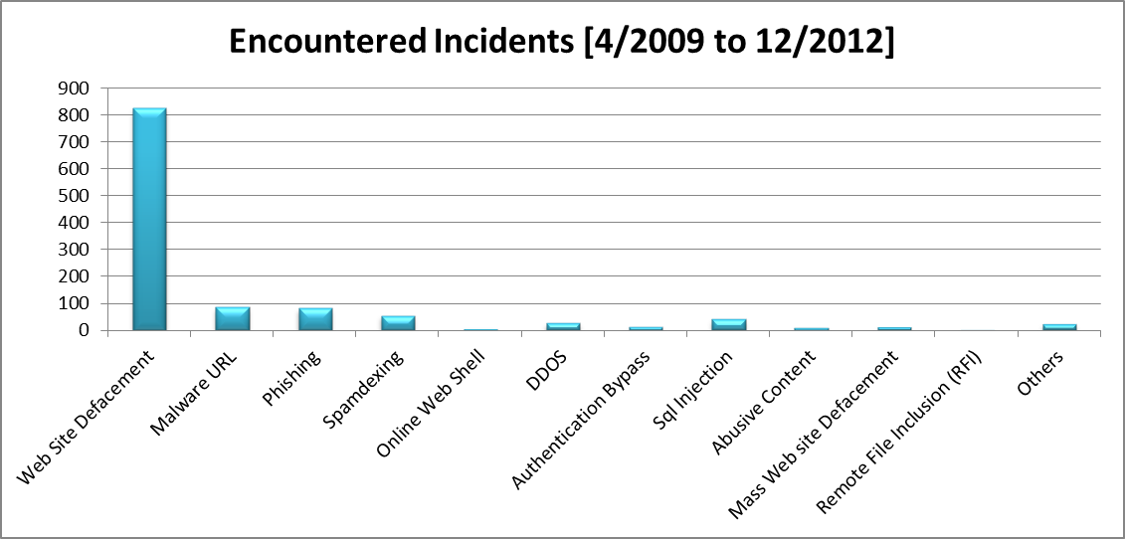
EG-CEG-CERT Services
ERT - Incident Handling

Slide 12
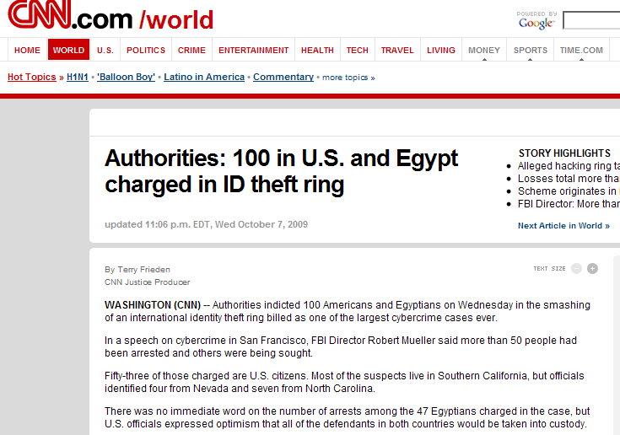
CEG-CERT Services
Forensics
Achievements
EG-CERT has contributed to tone of largest phishing case by providing (forensics analysis; report +400 pages; 1600 working hours by 12 specialists).

Slide 13
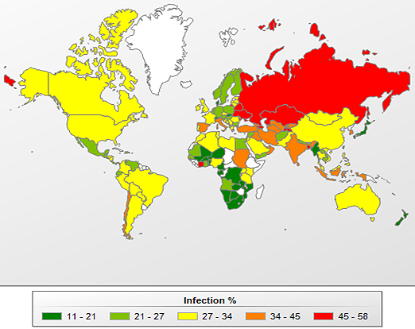
The risk of online infection around the world (Q1 2012)
All of the statistics reported here are based on data collected by the Kaspersky Security Network and its
security modules..
http://www.securelist.com/en/analysis/204792231/IT_Threat_Evolution_Q1_2012#16

Slide 14
EG-CEG-CERT Services
* Building Trust
Signed MOU with :
Malaysian CERT
South Korean CERT
US-CERT
Team cymru
IMPACT.
Letter of intend
Uganda .
Thank You

