Slide 1

Deceptive and Unsubstantiated Health-Related Advertising
Fifth Annual African Consumer Protection Dialogue
Livingstone, Zambia
Charles Harwood
Deputy Director
Bureau of Consumer Protection
Federal Trade Commission

Slide 2


Advertising Law Basics
Advertising must be truthful and not deceptive
Objective claims must be substantiated before they are made

Slide 3
When is a claim deceptive?
A three-part test:
  Was there a representation or omission of information?
  Was the claim likely to mislead a reasonable consumer?
  Was the claim material?
Intent to deceive not required!

Slide 4
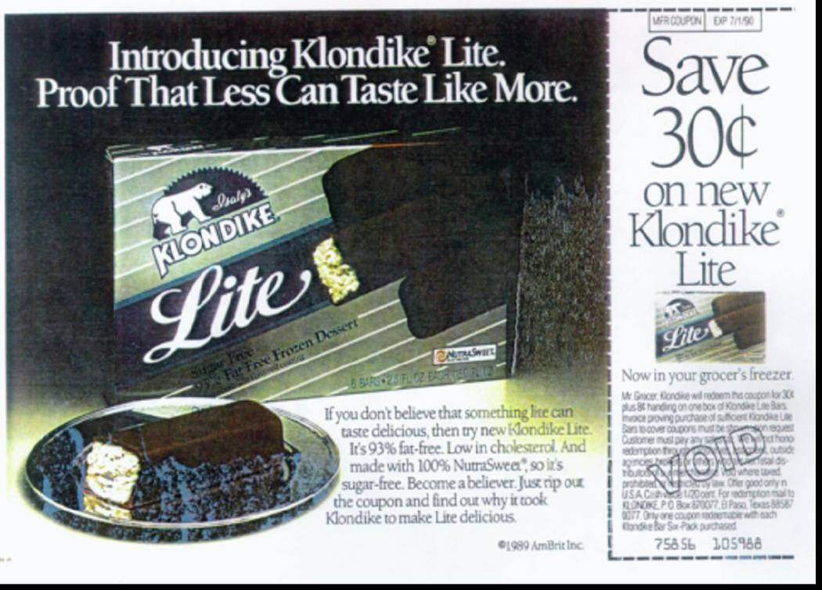
Deceptive Claims
If you don’t believe that something lite can taste delicious, then try new Klondike Lite. It’s 93% fat-free.

Slide 5
Substantiation Doctrine
Advertiser needs “reasonable basis” for express and implied objective claims before ad runs
At least the level claimed in the ad
Depends on nature of claim:
  Type of product
  Type of claim
  Benefits of truthful claim and cost/feasibility of developing substantiation
  Consequences of false claim
  What do experts in the field expect

Slide 6
Miracle Cures

Slide 7

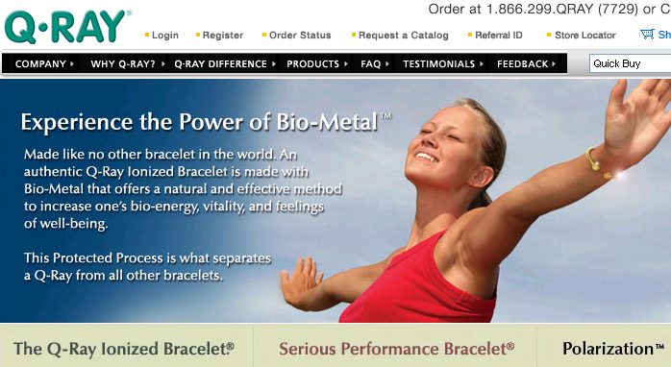
Q-Ray Bracelet
“I’ve had total knee replacements in both of my knees. .. I was on a cane all the time… Imagine what it must feel like to throw away your cane forever.”

Slide 8
Q-Ray Bracelet
“Ionized” bracelet a sham
No well-controlled double-blind studies
Mayo Clinic study found it no more effective than placebo
8,100 “satisfied” customers not evidence of efficacy (>100,000 requested refunds)
$22.5m judgment, (+ up to $87m in consumer refunds -entire net sales)
Notes:
8

Slide 9
Weight Loss Products

Slide 10


Slide 11

Enforma

Slide 12
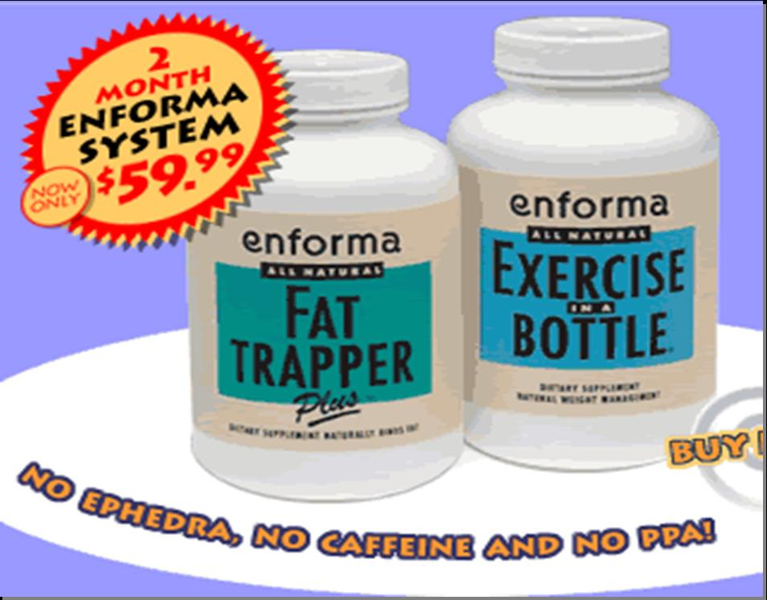
Enforma
Purports to prevent absorption of dietary fat
Chicken and rat “fecal fat” weight loss studies
Human study subjects on very low calorie diets
2 well-conducted studies showed no difference versus placebo
Supposedly increases the body’s capacity to burn fat
Animal studies
Human subjects on 500-1000 calorie diets
Test dosage was 30+ times higher than on bottle
"With Enforma, you can eat what you want and never, ever, ever have to diet again."

Slide 13
Remedy
$10 million in consumer redress
Order requires substantiation for fat-trapping, calorie-burning, and weight loss claims
Order prohibits false establishment claims
Future ads must disclose that dieting and/or exercise are required to lose weight

Slide 14

WOMAN: After 30, your metabolism can slow down, and you know how hard that can make things. Here’s an easy exercise that can help. One-A-Day WeightSmart. Just lift, and twist and bend.
ANNOUNCER: One-A-Day WeightSmart. A complete multivitamin with EGCG, a natural green tea extract, to enhance metabolism.
WOMEN: And lift and twist and bend.
WOMAN: Just once a day. That’s easy.
ANNOUNCER: One-A-Day WeightSmart. The multivitamin with more for your metabolism.

Slide 15

One A Day
Metabolism/weight control claims
Product had only 10% of green tea extract used in cited research studies.
$3.2 million civil penalty for violation of 1991 FTC order

Slide 16
Food

Slide 17

Kelloggs

Slide 18
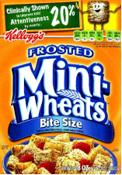
Kelloggs
Claimed Frosted Mini-Wheats was “clinically shown to improve kids’ attentiveness by nearly 20%”
Only half of the kids in the study showed any improvement in attentiveness; only 1 in 7 improved by 18% or more, and only 1 in 9 improved by 20% or more
Kids who ate Frosted Mini-Wheats were compared against kids who only had water.

Slide 19

Nestlé Healthcare Nutrition
Nestlé Boost Kid Essentials drink & probiotic straw for children
Ad claims: prevents upper respiratory infections; protects against cold & flu; reduces duration of acute diarrhea; reduces school absences
Some good evidence but claims went beyond what studies showed

Slide 20

Dannon

Slide 21
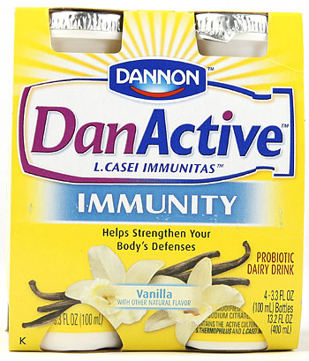

Dannon
Dairy drink and yogurt with probiotics
Ads claims:
  DanActive is clinically proven to reduce the risk of colds and flu
  Activia is clinically proven to relieve temporary irregularity and help with slow intestinal transit time

Slide 22



POM Wonderful
POM Wonderful 100% Pomegranate Juice & POMx supplements
“Clinically proven” claims about treatment and/or prevention of heart disease, prostate cancer, and erectile dysfunction
No blinding or control in prostate cancer study; no benefit beyond placebo in erectile dysfunction study; many studies for heart disease showed no benefit

