Slide 1
Cross-Border Collaboration
Fifth Annual African Consumer Protection Dialogue
Livingstone, Zambia
Charles Harwood
Deputy Director
Bureau of Consumer Protection
U.S. Federal Trade Commission

Slide 2
Why Cooperate Across Borders?
Cases involve foreign parties, foreign-based evidence or reviews in multiple jurisdictions
Essential to effective case management
Helps to reduce costs
Better enforcement outcomes
Increased consumer and business confidence in the marketplace

Slide 3
What Do We Need to Cooperate?
Willing Partners
Robust Communications
Confidentiality Arrangements
Evidence and Intelligence Sharing
Open Investigations

Slide 4
Cross-Border Collaboration
Consumer Protection Investigations

Slide 5
Outline
Partnerships
Information and intelligence sharing
Confidentiality
Investigations and enforcement assistance

Slide 6
International Consumer Protection Partners

Slide 7
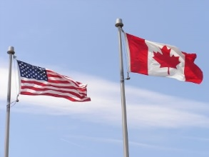
Project Emptor (Vancouver Canada)
RCMP, Vancouver Commercial Crimes Unit
British Columbia Ministry of Public Safety and Solicitor General
Competition Bureau, Industry Canada
Federal Trade Commission
Federal Bureau of Investigation
U.S. Attorney, Los Angeles

Slide 8
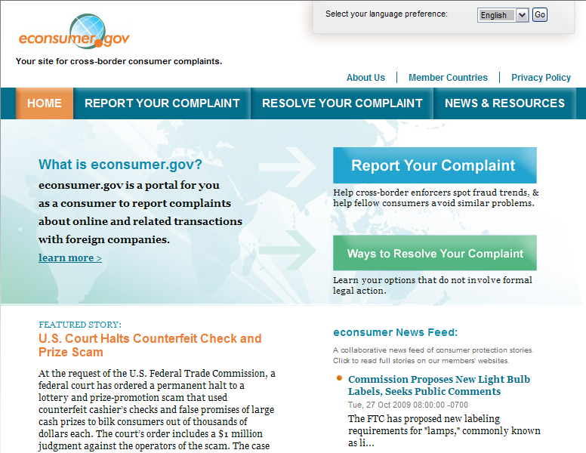
econsumer.gov certified government law
enforcement and regulatory agencies in
ICPEN member countries may access
the complaints to investigate, uncover new
scams, and spot trends in fraud.
Participation by agencies from 30 countries.

Slide 9
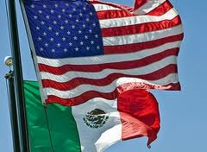
Memorandum of Understanding

Slide 10
The Federal Trade Commission

Slide 11
Overview
Information sharing with foreign law enforcement agencies
Investigative assistance to foreign law enforcement agencies
Pre- and post-judgment enforcement litigation in foreign courts
Enforcement relationships

Slide 12
Information Sharing With Foreign Law Enforcement Agencies
“Foreign law enforcement agency”
vested with law enforcement or investigative authority
in civil, criminal, or administrative matters
Prior agreement, MOU, or written certification that requestor will protect confidentiality of the information and use it for official law enforcement purposes
Materials will be used for investigating or enforcement proceedings related to foreign laws prohibiting
fraudulent or deceptive commercial practices, or
other practices substantially similar to practices prohibited by laws enforced by FTC;
Not applicable to antitrust and there are other exceptions

Slide 13
Investigative Assistance to Foreign Law Enforcement Agencies
Written Request from a Foreign Law Enforcement Agency concerning violations of laws prohibiting fraudulent or deceptive practices (or similar to FTC laws).
Type of Assistance
Investigation to collect information and evidence using all of its investigative powers, e.g., Civil Investigative Demand.
Discovery on behalf of civil authorities, or on behalf of criminal authorities when referred by the Attorney General.
Criteria for Determination
Whether the requester has agreed to provide reciprocal assistance
Whether compliance would prejudice US public interest
Whether the investigated practice involves injury to a significant number of persons

Slide 14
Enforcement Relationships
Permission to negotiate international agreements, which may include
Provide assistance;
Disclose confidential materials; and
Engage in further cooperation and protect the confidentiality of materials
Criminal
When negotiating MOUs and international agreements, the FTC will attempt to ensure that materials obtained from foreign agencies enforcing criminal laws may be used for enforcing criminal laws in the US

Slide 15
FTC Cross Border Collaboration
More than 100 investigations with international components, such as foreign targets, evidence, or assets since 2007
More than 50 cases involving cross-border components since January 2007
Evidence provided in response to 63 information-sharing requests from 17 foreign law enforcement agencies as of mid-2012
52 civil investigative demands (equivalent to administrative subpoenas) issued in 21 investigations on behalf of nine agencies in five countries
In SAFE WEB Act cases, FTC has collected more than $10 million in restitution for injured consumers

Slide 16
Case Study: Best Priced Brands
California Internet marketer that sold cameras, video games, and other electronic goods to thousands of British consumers

Slide 17
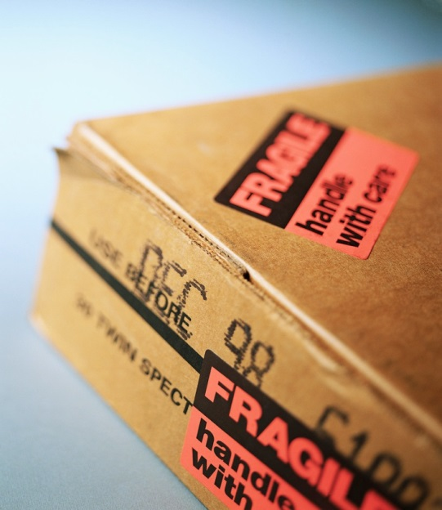
Engaged in Deceptive Practices

Slide 18
Consumer Complaints
Tricked consumers into believing that they were buying products from a company operating in the UK
When consumers received their products they discovered that they:
Had been charged unexpected import duties
Were left with invalid warranties
Would be charged astronomical cancellation and refund fees it they sent back the merchandise

Slide 19
Response
Options to address
For law enforcement to act, what is needed?
Complaints from consumers
Information about company
Information about third-parties associated with company
Who can obtain and how?
How will entities communicate and what can they disclose and share?
Who will address?

Slide 20
Allegations
False and Misleading Representations that Defendants are located in the UK and thus come with manufacturers’ warranties
False and Misleading Representations that the price for goods sold was the total cost delivered
False and Misleading Representations that Defendants were located in the UK and thus give unconditional right to cancel orders and have no restocking fees for returned merchandise

Slide 21
Cross-Border Collaboration
Competition Investigations

Slide 22
Outline
Bilateral agreements & international organizations
Information exchanges
Cooperation and confidentiality rules
Enforcement cooperation

Slide 23
Competition Cooperation Tools
US agencies party to
9 antitrust agreements
3 MOUs
OECD Recommendation – framework for cooperation with 40 jurisdictions.
ICN Framework for Merger Review Cooperation – 51 participant agencies
Waivers of Confidentiality granted by parties and third parties
Notes:
23

Slide 24
Cooperation
Investigative
Timing
Market definition
Theories of competitive harm
Remedies
Merger divestitures that take place or have effects in another country (can only divest a unit to one buyer)
Conduct remedies that will affect competitive behavior abroad

Slide 25
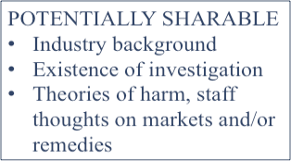
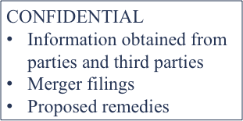
Cooperation: Information Sharing
1. Publicly available or
non-confidential
information
Often sufficient for
cooperation
2. Confidential information
Only pursuant to:
Waivers of Confidentiality
Certain Agreements

Slide 26
Waivers of Confidentiality
In many cases, parties grant waivers of confidentiality to facilitate cooperation
More frequent when parties have incentives to cooperate (mergers), but not only
Parties decide whether to waive
No adverse consequences from failure to waive
ICN mergers Notifications and Procedures working group issued report with model waivers (FTC, DOJ, EC) and model waiver request text

Slide 27
Three Myths about Cooperation
Popular Myths
Reality
Lack of a formal cooperation mechanism prevents effective cooperation
Cooperation requires a formal mechanism to make it work
Cooperation only takes place among developed countries
Effective cooperation happens every day, with and without a formal mechanism
Cooperation requires mutual trust and strong relationships
Cooperation takes place whenever common enforcement interests call for it

Slide 28
Practicalities of Merger Cooperation
Identifying mergers with cross-border implications and the reviewing agencies as soon as possible. E.g. parties or third parties identify voluntarily, sometimes on the pre-merger notification forms; media; contacting counterpart agency liaison officers; formal notifications under cooperation agreements
Seek the parties’ cooperation. In identifying other reviewing jurisdictions, and suggesting timing of filings in manner that maximizes opportunity for inter-agency coordination

Slide 29
Practicalities of Merger Cooperation (cont’d)
Identify the affected product and geographic markets. Staff may find it helpful to share their respective analyses, and learn from one another’s prior expertise in an industry
Identify common enforcement interests, so that cooperative efforts can be focused on overlapping enforcement interests
Seek waivers of confidentiality from the parties, as needed

Slide 30
Practicalities of Merger Cooperation (cont’d)
Share substantive analyses. Usually done orally, over the phone. FTC staff can often share its competitive analysis without a waiver, as long as it does not include any information supplied by the parties or third parties
Identify and, to the extent permitted, share relevant evidence if helpful
Identify potential remedies, and coordinate the timeline. In merger cases, the remedy is typically a divestiture. It is rare for settlement agreements to be reached simultaneously, but coordination is nonetheless extremely helpful

Slide 31
Conclusion

