Slide 1
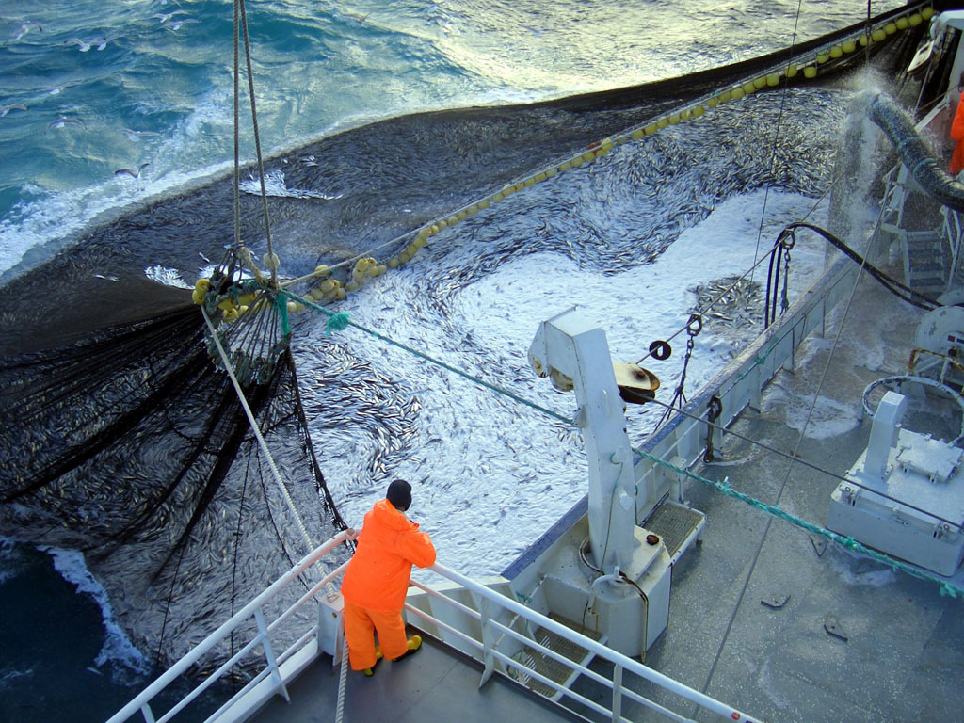
ISEAL Alliance
Making Good Standards Better
29 November 2012
FTC Forum on Cross-Border Enforceable Codes of Conduct
Norma Tregurtha, Senior Policy Manager
Photo © Marine Stewardship Council

Slide 2
ISEAL’s Mission
to define good practices for sustainability standards
distinguish and promote credible standards and tools, and
ensure that people understand the difference.
Photo © Noah Jackson | Rainforest Alliance

Slide 3
ISEAL Alliance Members
Full Members
Associate Members
Applicants

Slide 4
What are Sustainability Standards?
Market-based tools to drive Sustainable Production and Consumption
Social and environmental good practices are defined in standards
At their core, sustainability standards are all about the practices defined in their standard
A good standard is complemented by a certification programme to assure the market of compliance
A label on product then conveys the message to consumers

Slide 5
ISEAL Codes:
Performance: Codification of good practices that lead to improved impact
Legitimacy: Global recognition/benchmark of good practice
ISEAL Codes of Good Practice
Referencing ISEAL Codes
Standard-Setting Code (2004)
Impacts Code (2010)
Assurance Code (2012)
Claims and Labelling (2014)
Notes:
Point out the existing presence ISEAL has within policy and legislation and how we are recognised and supported by a number of governmental, intergovernmental and non-governmental actors.

Slide 6
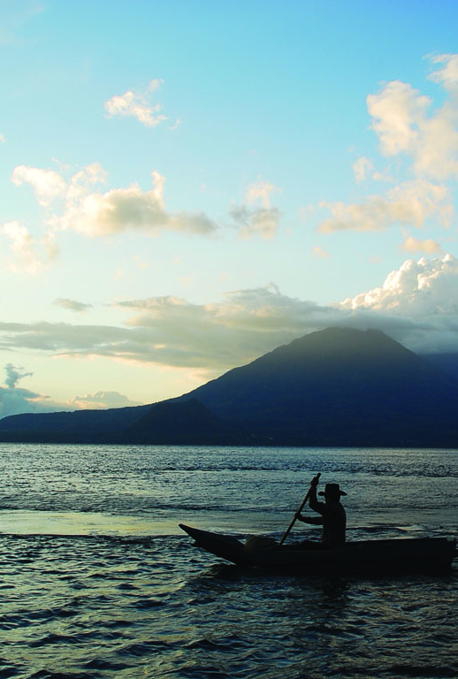
ISEAL Codes….
iii) Transparency: Convening function of code development
iv) Governance: – ISEAL membership requirement
Photo © Charlie Watson| Rainforest Alliance

