Slide 1

Global Food Safety Initiative
Joseph Scimeca, PhD
Vice President, Global Regulatory & Scientific Affairs
Corporate Food Safety & Regulatory Affairs
November 29, 2012
Enforceable Codes of Conduct
Washington, DC
1

Slide 2
GFSI Background
Launched in 2000 following a directive from food business CEOs of The Consumer Goods Forum (known as CIES at the time) following concerns about:
  Food safety crises
  Profileration of individual retailer schemes
  Burden to suppliers and producers due to frequent audits
  Lack of efficiency and high costs in the food supply chain
2
Notes:
Back in 2000, food safety was also top of mind with consumers due to several high-profile recalls, quarantines, and negative publicity about our industry. The retailers and manufacturing CEOs agreed that consumer trust needed to be strengthened and maintained, while making the supply chain safer, through the harmonisation of food safety standards and driving cost efficiency, which is why GFSI was created. At this time, food safety was top of mind with consumers due to several high-profile recalls, quarantines, and negative publicity about our industry. The retailers and manufacturing CEOs agreed that consumer trust needed to be strengthened and maintained, while making the supply chain safer. Back in 2000 and to this day, the scope of GFSI remains food safety focused only. GFSI does not deal with environmental or social issues so that it can remain focused on its mission and objectives which are as follows (next slide):

Slide 3
GFSI
Vision: Safe Food for Consumers Everywhere
Mission: Driving continuous improvement in food safety to
strengthen consumer confidence worldwide
GFSI
Reduce food safety risks
Manage cost
Develop competencies and capacity building
Knowledge exchange and networking
3
Notes:
VISION : « Safe Food for Consumers Everywhere »
MISSION : “Driving continuous improvement in food safety to strengthen consumer confidence worldwide ”
OBJECTIVES :
Reduce food safety risks by delivering equivalence and convergence between effective food safety management systems
Manage cost in the global food system by eliminating redundancy and improving operational efficiency
Develop competencies and capacity building in food safety to create consistent and effective global food systems
Provide a unique international stakeholder platform for collaboration, knowledge exchange and networking

Slide 4
Governance Structure
4
Notes:
This is the GFSI Governance Structure:
These are the current GFSI Technical Working Groups being convened, the Feed working group held its first meeting in August 2011 and the Transport & Distribution working group had its first meeting in December 2011.

Slide 5
Governance Structure
GFSI Board Review
GFSI Stakeholder Meeting
GFSI Board & Advisory Council Review
GFSI Technical Working Groups
GFSI Board & Advisory Council Review
Global Food Safety Conference
Update on GFSI
Work item proposals
Review of proposals
Mandate to TWG
Recommendation
to Board &
Advisory
Council
Approval
and Communication
Output
5
Notes:
This slide shows the development of the GFSI strategy, which begins with information gathered from GFSI Stakeholders during the annual stakeholder meeting, is taken by the Board and Advisory Council for review and prioritisation, and then mandated to the GFSI Technical Working Groups.

Slide 6
How does GFSI work?
Benchmarks existing food safety schemes, including pre-farm gate schemes against the GFSI Guidance Document.
Determines whether a scheme is equivalent to the Guidance Document requirements.
Helps and encourages food safety stakeholders to share knowledge and strategy for food safety and to develop best food safety practice in a common global framework.
6
Notes:
In the past
Retailers performed inspections or audits themselves or asked a third party to do this on their behalf, oftentimes to food safety schemes that lacked international certification and accreditation, resulting in incomparable auditing results
No new standard
When we started work, we realized writing a new standard is a long procedure
There was no existing standard qualified as “global”
And so to distinguish standards, a benchmark model needed to be developed to determine equivalency, whilst leaving flexibility and choice in the marketplace.

Slide 7









Benchmarking – What does this mean?
“Once certified, accepted everywhere”
7
Notes:
These are the schemes which have currently been recognised by GFSI.

Slide 8
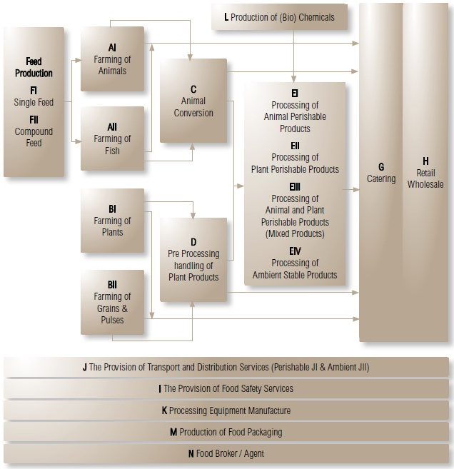
Building Confidence in Certification
GFSI’s Total Supply Chain Approach
The food supply chain as defined by the GFSI Supply Chain Working Group for the GFSI Guidance Document Sixth Edition.
8
Notes:
This is the Supply Chain in the GFSI Guidance Document Sixth Edition as based on ISO 22003. Over the next two years, working groups will be convened to specify the scope requirements for the recognition of food safety schemes for each of these sectors which were not included in the Sixth Edition Version 1 released in January 2011.
Currently being convened are working groups specifying scope requirements for Feed (FI and FII) and Transport and Distribution (J). The work on Animal Conversion (C) and Packaging (M) that are highlighted on this slide has been completed.

Slide 9
Building Confidence in Certification…
Through Sector Focus Areas
2011
Packaging (scope M)
2012
Transport and Distribution (scope J)
Equipment Manufacturing (scope K)
2013
Retail/Wholesale Outlets (scope H)
Animal Conversion (scope C)
Feed (scope F)
Catering (scope G)
Food Broker/Agents (scope N)
Food Safety Services (scope I)
2014
2015
Revision of Scopes A, B, C, D, E and L
Issue Guidance Document 7th Edition
9
Notes:
This is the workplan of the GFSI Technical Working Groups that have been mandated to develop sector-specific requirements along the entire supply chain, as prioritised by the GFSI Board, for inclusion in the GFSI Guidance Document.
They are mandated to:
• Review current best food safety practice in relation to the sector.
• Define and develop the scope(s) of recognition in relation to the sector and the key elements that shall be in place for the recognition of food safety requirements for that sector by GFSI in the GFSI Guidance Document.
• Review and define the competence of auditors required to be in place for schemes applying to the GFSI for recognition within the scope of that sector.
• Review and define the duration of audits in relation to that sector’s scope(s) of recognition.
• Provide technical recommendations and advice to the GFSI Board

Slide 10
GFSI Strategy for the Future
10
Notes:
Four key strategic priorities and critical action plans have been identified to support the delivery of GFSI’s key objectives:

Slide 11

GFSI Strategy for the Future
Governmental Organizations
i.e. China, FDA, USDA, DGSANCO
International Organizations
i.e. WTO, World Bank, CODEX, ISO
Other trade and industry organizations i.e. FMI, GMA, GS1
11
Notes:
Create Strategic Alliances with Appropriate Public and Private Sector Organisations
Continue to build and develop collaborative relationships with governments, international governmental organisations such as World Health Organisation, World Trade Organisation and the International standards Organisation
Support the roll out of the Global Markets Programme for less developed businesses in partnership with the United Nations and the World Bank

Slide 12
Creating Links with Key Organizations & Regulators
GFSI Global Regulatory Affairs Working Group
Published : a series of documents and position papers relating to third party certification.
Available for use by anyone involved in GFSI and regulatory affairs (download on www.mygfsi.com).
Topics cover:
  What is the Global Food Safety Initiative?
  What is the GFSI Guidance Document?
  Role and benefits of third party certification
  Perceived barriers to acceptance of third party certification
  Accreditation and Certification Framework
12

Slide 13
Building Confidence in Certification
Global Markets Capacity Building Programme
“A capacity building programme for small and/or less developed businesses that will develop effective food safety management systems through a systematic continuous improvement process.”
13

Slide 14







Building Confidence in Certification
GFSI
Recognized
Schemes
100%
12 Months
GFSI
Guidance
Document
Requirements
(6th Edition)
Part III
70%
Matching Level
Global
Markets
Basic Level
+
Intermediate Level
12 Months
30%
Global
Markets
Basic Level
14

Slide 15
GFSI Strategy for the Future
Building Global Awareness
Conferences
GFSI Focus Days
Press releases
Dedicated GFSI website
Social Media – Linked In/Twitter
15
Notes:
Communication
Continue to provide food safety workshops and events both on a global and regional basis
Improve and strengthen marketing and regular communication efforts through social media, press, newsletters and publications and the website

Slide 16
GFSI Strategy for the Future
Independence
Trust
Acceptance in the market place
Aid in defense of a product liability action
16
Notes:
Build Confidence in Third Party Acceptance
Develop the Guidance Document requirements in new sectors (transport and distribution, equipment, catering and retail sectors) to provide a true feed to fork approach to drive further harmonisation
Create an integrity programme to provide alignment in auditor competency which is critical to the delivery of food safety through audits
Improve data management using technology to support the ongoing business case on the ROI on the implementation of GFSI recognised schemes
Ensure continued growth in the number of food businesses deploying GFSI recognised schemes in their supply chains

Slide 17
Building Confidence in Certification
GFSI Auditor Competence Working Group launched in September 2010
Defining the generic food safety auditor competencies underpinning GFSI benchmarked schemes to:
  Determine the role, tasks, and expectations of auditors
  Define competencies (skills, knowledge and attributes) for each task
  Recommend options by which they can be assessed and verified
2012
Task analysis
Define competencies
Acquisition and assessment
Competency maintenance
Management of auditor competence
Integrate requirements into Guidance Document 6
2011
17
Notes:
In the first two meetings of the Auditor Competence Technical Working Group (October 2010 and February 2011), they considered the generic competencies (‘Foundation Skills & Knowledge’), and Technical Skills & Knowledge based on the key elements of food safety schemes identified in the GFSI Guidance document Sixth Edition.
In May 2011 they pulled together the knowledge and skill requirements discussed at previous meetings, and supplemented them with competencies identified in ISO 22003 and other documents. They also questioned whether foundation and technical competencies were sufficient and grouped some suggested ‘advanced’ competencies in to a third group under the heading ‘Critical Thinking’ as a discussion point.
In their meeting on Monday 3rd and Tuesday 4th October, this working group split into two sub-groups:
Group 1 : To further review and refine the competencies, and
Group 2 : To consider the options for adoption.
Their progress to date will be shared at the next GFSI Stakeholder Meeting on 15th February in Orlando, Florida.

Slide 18
GFSI Strategy for the Future
Facilitating Global Trade
Driving acceptance globally – Europe, North America, South America, Asia
Driving acceptance throughout the food chain
18
Notes:
Global Expansion beyond current focus areas of EU, North America, Japan, China and Brazil
Develop and implement a plan for deployment of GFSI recognised schemes, providing ongoing support to companies, governments and associations region by region to help with education and awareness efforts

Slide 19

Geographical Expansion
Impact of GFSI within the
Cost Reduction
12,000 audits of approx. 2 days or 24,000 working days
~100 employees for one year (220 wd)
~ 400,000 €
Decrease of Recalls
Decrease of recalls from Ø 20 to Ø 2 in the last years (90% decrease)
Capacity Building
Training of small suppliers and suppliers in emerging markets
e.g. Egypt, Russia, Vietnam, China with Global Markets Tool
Stabilization of supply availability and delivered quality
Reduction of post harvest losses up to 40%
19
Notes:
In driving acceptance globally, here are some of the benefits of implementing the GFSI principles that a global retailer has been able to capture.

Slide 20
Geographical Expansion
Value of GFSI to
$5mm/yr in reduced redundant audit costs so far
Estimated $15mm/yr savings once fully implemented
Example : Salt plant had 12 third party audits and 17 customer audits at a cost of $150k/yr before going to GFSI.
Now they do one audit in compliance to GFSI at a cost of $8k/yr.
20
Notes:
In driving acceptance globally, here are some of the benefits of implementing the GFSI principles that a global manufacturer has been able to capture.

Slide 21




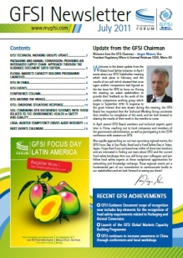
For More Information:
www.mygfsi.com
www.tcgffoodsafety.com
gfsinfo@theconsumergoodsforum.com
http://twitter.com/myGFSI
Search ‘Global Food Safety Initiative’
Sign up for the Newsletter on www.mygfsi.com
21
Notes:
GFSI is working towards reducing food safety risks through the acceptance of common food safety requirements by the marketplace, less cost and duplication and therefore greater trust and consistency in the supply chain.
www.mygfsi.com is the website for all information on the Global Food Safety Initiative
www.tcgffoodsafety.com is the website for all information about the Global Food Safety Conference
Follow us on Twitter and LinkedIn to get the latest GFSI updates
Join 9000 other readers around the world who get the latest GFSI Updates via the GFSI newsletter

