Slide 1
TRUSTe Certification & APEC
FTC Workshop on Enforceable Codes of Conduct
Panel on APEC’s CBPR System
November 29, 2012

Slide 2
TRUSTe Overview
Leader in Data Privacy Management Solutions
15 years of privacy experience
#1 privacy brand & trustmark
Robust technology infrastructure
Comprehensive Suite
All online channels
Global coverage
Strategy + Certifications + Technology
Large / Loyal Customer Base
Over 5,000 clients
Over 90% renewal rate
Cross industry solutions
Notes:
TRUSTe is the leader in Privacy Management Solutions
Over a decade of experience
Best knows for Certified Privacy Seal – seen on thousands of websites, billions of consumer impressions per year
“Gold-standard” for companies to demonstrate commitment to managing customer privacy
Robust technology infrastructure powers all of our solutions
Most popular offering is TRUSTed Websites Privacy Certification Solution
Thousands of Certified Websites
Now offer full suite addressing all your online channels – mobile, cloud, targeted advertising, etc.
Also have full EU Suite to address EU Cookie Directive
Not just services and certifications – deep technology offering and ongoing operational support – privacy management requires ongoing attention
Work with companies of all sizes
Across all industries
Very loyal / satisfied customer base – many for over 5 years
Sampling of the logos – some of the best known brands, but also many newer companies
We can help you assess your privacy management needs and put together a solution for you

Slide 3
TRUSTe Privacy Management Solutions
Comprehensive solutions addressing all geographies
35+ languages supported for TRUSTe dispute resolution services, program seals and seal validation pages
30+ countries with companies who display the TRUSTe seal

Slide 4
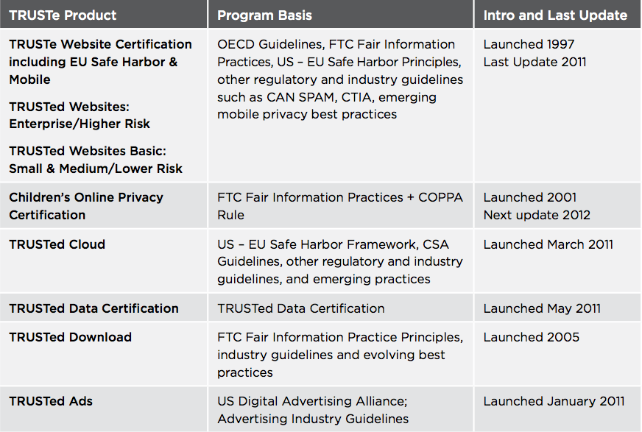
TRUSTe: The Program

Slide 5
APEC AA Application

Slide 6
TRUSTe’s APEC Application
TRUSTe has participated in the development of the APEC Cross Border Privacy Rules system as a private sector member of the US Delegation to APEC.
TRUSTe has applied to have its privacy certification recognized as an Accountability Agent (“AA”) for the US participation (every economy needs to identify an Accountability Agent to participate).
TRUSTe’s application has been forwarded to the Joint Oversight Panel (by the US Dept. of Commerce) for approval as an Accountability Agent. TRUSTe is the first AA to go through this process.

Slide 7
Approval as an APEC AA
Once TRUSTe is approved as an AA, those TRUSTe programs referenced in our approved APEC application will be deemed as officially endorsed by APEC for the CBPR system.
At present, there is no determination by the APEC Secretariat as to whether or not there will be a specialized APEC seal, or if the participating AAs will manage this via their own seals. Regardless, once approved as an AA, TRUSTe certification will signify compliance with the APEC CBPR Framework.
As TRUSTe is the first AA to go through this process, we anticipate it will take a couple of months to achieve endorsement and approval. Prior to the endorsement, TRUSTe can still provide certification services which can be later used to show participation in the APEC framework.

Slide 8
Certification & Enforcement

Slide 9
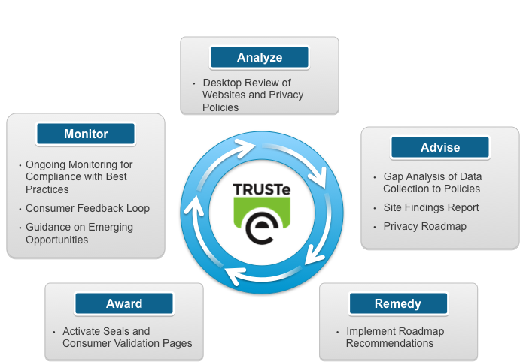
TRUSTe Certification Process

Slide 10
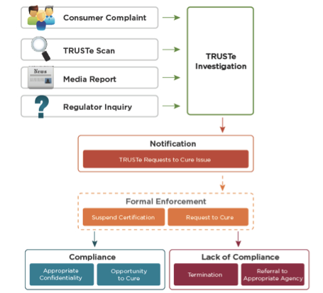
TRUSTe Consumer Dispute Resolution Process

Slide 11
Enforcement
TRUSTe works with clients to address a problem, without first penalizing the client for non-compliance. As a result, clients are incentivized towards better privacy practices.
This also reduces the number of formal enforcement actions we need to pursue - in 2011, TRUSTe initiated only 11 formal enforcement actions.

Slide 12
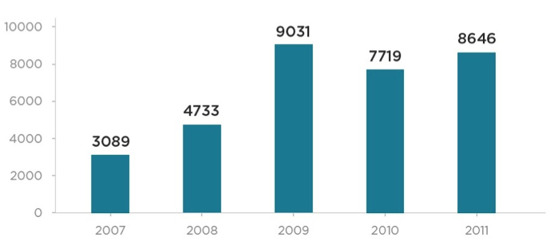
Consumer Complaints (2007 – 2011)

Slide 13
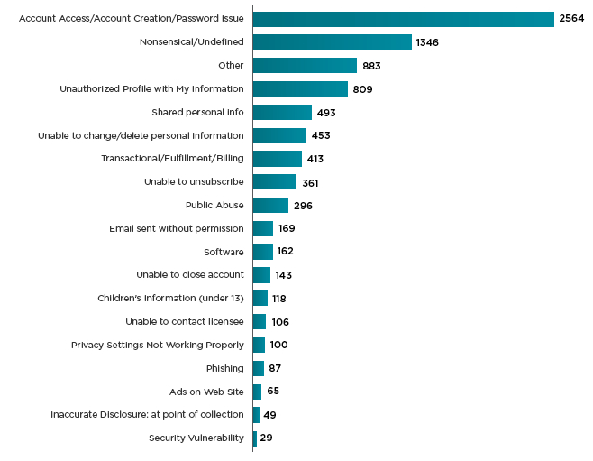
Consumer Complaints by Type
Nearly half of all consumer complaints were closed on procedural grounds because they were incomplete or nonsensical.
Of the remaining (valid) complaints, only 15.7% required specific action by the site relating to data practices (e.g. unsubscribe the user, close the account, remove unauthorized profile).

Slide 14
Questions? Saira Nayak – snayak@truste.com @SairaNayak

Slide 15
Appendix

Slide 16
TRUSTe Consumer Privacy Research Series
2012
US and UK Mobile and Behavioural Advertising Survey
2010
Social Media Survey
2011
Website Privacy Policy Index
2012
EU Cookie
Directive Index
2012
Consumer
Confidence Index
2011
Mobile Survey
2012
Pan EU Consumer Privacy Index
2012
Q1 Consumer Confidence Index
2011
Behavioural Advertising Survey
2012
Website Tracker &
Privacy Policy Index
2012
Q2 Consumer Confidence Index
www.truste.eu/resources

Slide 17
Website Privacy Certifications Increase Trust

