Slide 1
Cross-Border Codes of Conduct:
ICC Marketing Code
Sheila A. Millar, Partner
Keller and Heckman LLP
1001 G Street NW
Suite 500 West
Washington, DC 20001
+1 202.434.4143
millar@khlaw.com

Slide 2
Elements of Effective Codes
Process to identify issues of concern
  Address stakeholder concerns
  Establish level playing field for business
Flexible, fast, and amendable
Cost-effective
Enforcement/accountability mechanism
  Accountability procedures can be separate; need not be part of the code per se

Slide 3
ICC Code of Advertising and Marketing Practice
Code has been in place for 75 years
Forms the basis of many national advertising codes and effective self-regulatory programs around the globe
Periodically revised and updated
  Recent updates: digital marketing
  Framework Guides: environmental claims, food marketing
Currently available in 10 languages

Slide 4
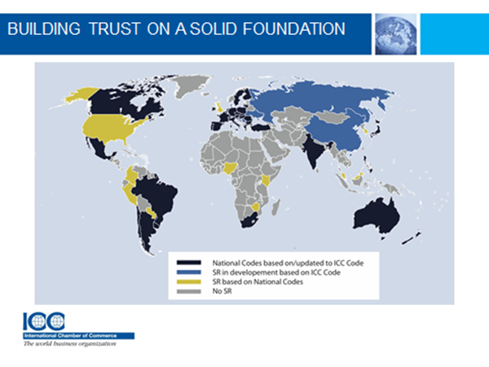

Slide 5

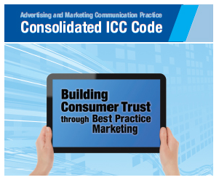
ICC Information and Resources

Slide 6
Considerations for Cross-Border Code Paradigms
Effective process for finding common ground
  Bridging different legal frameworks and cultural, social traditions, which vary depending on the issue
Assuring that codes advance consumer protection and trade
Education, capacity-building
One size doesn’t fit all

Slide 7
Thank you
Sheila A. Millar
Partner
Keller and Heckman LLP
1001 G Street NW
Suite 500 West
Washington, DC 20001
+1 202.434.XXXX
XXXXXXX@khlaw.com

