Slide 1
Combatting Charity Fraud: Enforcement Issues
Karin Kunstler Goldman
Tracy Thorleifson
Alissa Gardenswartz
David Vladeck
Lloyd Mayer

Slide 2
Give & Take: Consumers, Contributions, and Charity A Conference Exploring Consumer Protection Issues Associated with Charitable Solicitations March 21, 2017

Slide 3
Areas of authority
Solicitation
Criminal
Registration
Board Governance
State Charity Regulators
AG offices and other state offices
Registration Compliance
Wills/Trusts
Conservation Easements
Transaction Review
AG only
Other state regulator only
AG and other state regulator
11

Slide 4
Most common areas of enforcement
*39 offices interviewed
21
Notes:
Reorder enforcement

Slide 5
Fundraising methods regulated by offices
22
Notes:
Reorder enforcement

Slide 6
Approaches to enforcement
23

Slide 7
Inter-office cooperation
24

Slide 8
Combatting Charity Fraud: The Role of the Federal Trade Commission
Tracy S. Thorleifson
Attorney, Northwest Region.
Federal Trade Commission
The views expressed are my own and do not reflect the opinion of the Commission or any individual Commissioner.

Slide 9
The FTC Act
Section 5 empowers the Commission to: “prevent persons, partnerships, or corporations . . . from using . . . unfair or deceptive acts or practices in or affecting commerce.” 15 U.S.C. § 45.
Section 4 defines “Corporation” “to include. . . any company, trust, so-called Massachusetts trust, or association, incorporated or unincorporated, without shares of capital or capital stock or certificates of interest, except partnerships, which is organized to carry on business for its own profit or that of its members. 15 U.S.C. § 44

Slide 10
The Telemarketing Sales Rule
Jurisdiction co-extensive with FTC Act
Telemarketing = a plan, program, or campaign . . . to induce the purchase of goods or services or a charitable contribution” involving more than one interstate telephone call
Prohibits false and misleading charitable solicitations

Slide 11
Telemarketing Sales Rule (cont.)
For profit fundraisers must comply with the entity-specific Do Not Call requirements, but are exempt from the National Do Not Call Registry provision. Other calling restrictions also apply.
State attorneys general may bring actions to enforce the TSR in federal court.

Slide 12
FTC, All 50 States and D.C. v. Cancer Fund of America, et al.
First collective action by the FTC, 50 states and D.C. against a purported charity
Sued 4 charities and related individuals that:
raised more than $187 million from U.S. consumers over 5 years
Lied about how donations would be used, promising:
Pain medication for suffering children with cancer
Hospice care for indigent cancer patients
Medical equipment to needy cancer patients

Slide 13
Cancer Fund (cont.)
Donations spent on family, friends, and fundraisers.
Cruises and Disney World trips for board members
Jet ski rentals, meals at Hooters, and purchases at Victoria’s Secret on charity credit cards
Employed all family members, regardless of qualifications, paid tuition for and made loans to family and friends
Collectively spent less than 3% of funds on programs described to donors

Slide 14
Cancer Fund (cont.)
Complaint alleged deceptive practices that violated FTC Act and laws of all 50 states, plus violations of the Telemarketing Sales Rule
Settlements banned the responsible individuals from charitable solicitations and from oversight of charitable funds
“Charities” are now in receivership, their assets have been liquidated and their existence dissolved.

Slide 15
Other FTC Enforcement
Enforcement & Education Sweeps:
Operation False Alarm (March 1997) (with 50 states)
Operation Missed Giving (November 1998) (with 40 states)
Operation Phoney Philanthropy (May 2003)(with 34 states)
Operation False Charity (May 2009)(with 49 states)

Slide 16
Other FTC Enforcement
Actions against for-profit fundraisers violating Section 5 and/or the TSR, e.g.:
U.S. v. Civic Development Group
U.S. v. JAK Publications
Actions against for profit companies claiming a charitable benefit associated with the sale of goods or services, e.g.:
FTC v. American Handicapped and Disadvantaged Workers, Inc.

Slide 17
On the horizon ….
The FTC will combat charity fraud by:
Continuing to collaborate with state partners
Bringing enforcement actions against for profit fundraisers and sham charities that lie to consumers and misuse money intended to support charitable causes, when possible and appropriate
Educating consumers by providing them tools to avoid charity fraud and achieve their charitable purposes

Slide 18
Colorado Office of the Attorney General Consumer Protection Section
Recent State Charity Fraud Enforcement Actions
Alissa Gardenswartz
Deputy Attorney General

Slide 19
Colorado Office of the Attorney General Consumer Protection Section
Overview
Solicitation Fraud Actions Fall Into One of Three Categories:
Action Taken Against Charity
Action Taken Against Paid Solicitor
Action Taken Against Both

Slide 20
Colorado Office of the Attorney General Consumer Protection Section
Actions Against Charity Only
VietNow – MI
Used two paid solicitors (Corporations for Character and Courtesy Call)
Charity approved misrepresentations in solicitation scripts
Misrepresented local benefit (12% after expenses to MI Vets)
Misrepresented that money went to medical facilities and treatment
Noted de minimus amount given to charitable programs as support for fraud claims

Slide 21
Colorado Office of the Attorney General Consumer Protection Section
Actions Against Charity Only
National Vietnam Veterans Foundation/American Veteran Support Foundation – NY
Majority of funds went to professional fundraisers
Fraction that went to NVVF reduced by pattern of abuse and mismanagement
False and inaccurate registration filings

Slide 22
Colorado Office of the Attorney General Consumer Protection Section
Actions Against Charity Only
Florida Veteran’s Assistance Corp. and VFW-VA Assistance Programs Corp., – FL
Suggested association with VFW and VA in solicitations
Used unregistered paid solicitors
Both charity and solicitors pretended to be U.S. Military, promised specific benefits to veterans that were never provided
Misrepresented tax deductibility
Submitted false information in registrations

Slide 23
Colorado Office of the Attorney General Consumer Protection Section
Actions Against Charity Only
Breast Cancer Outreach Foundation - MI
Used several paid solicitors
All scripts represented that BCOF was raising money for breast cancer research/finding a vaccine for breast cancer
Only $8,235 of $1.4 M raised nationwide went to a grant
Money raised was used to pay for gift-in-kind (“GIK”) program
Improper use of SOP 98-2 and GIK program – basis for making false statements to the AG

Slide 24
Colorado Office of the Attorney General Consumer Protection Section
Actions Against Paid Solicitor
Associated Community Services, Inc. and Central Processing Services, LLC- MN
Arose out of solicitations for Foundation for American Veterans, Inc.
Numerous prior actions, including MI in 2016
Several issues:
Falsely representing donors had made a pledge
Falsely representing that the caller was from FAV
Failure to make statutorily-required disclosures

Slide 25
Colorado Office of the Attorney General Consumer Protection Section
Actions Against Paid Solicitor
Corporations for Character - MI
Soliciting for Michigan Fraternal Order of Police
Several variations on pledge-related misrepresentations
Did not pledge, but sent form stating pledge had been promised
Did not pledge, but sent form implying specific pledge was made
Did pledge, but form was addressed to non-pledging spouse stating he or she had pledged
Took advantage of caller’s clear inability to understand and consent to a pledge

Slide 26
Colorado Office of the Attorney General Consumer Protection Section
Actions Against Both
Quadriga Art/Disabled Veterans National Foundation -NY
Direct mail operation formed relationship with start-up charity
“Funded model” – direct mail company paid for costs of campaign, paid out of campaign revenues, has control over revenues and a lien on donor list
Mailings replete with misrepresentations
Multiple conflicts of interest among charity and fundraising professionals
Questionable GIK program

Slide 27
Colorado Office of the Attorney General Consumer Protection Section
Observations
Enforcement focus still on traditional fundraising models
Choices in who to enforce against
High fundraising costs as evidence of fraud
Notes:
Notes

Slide 28
Colorado Office of the Attorney General Consumer Protection Section
THANK YOU
Alissa Gardenswartz
Deputy Attorney General

Slide 29
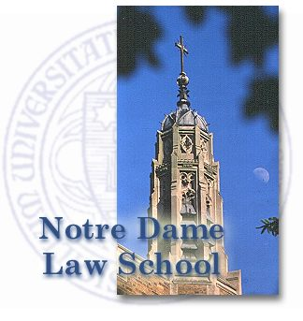
The Legal Challenges Posed by Social Media Viral Campaigns, Crowdfunding, and Hybrid Entities
March 21, 2017
Lloyd Hitoshi Mayer
Professor of Law
University of Notre Dame

Slide 30
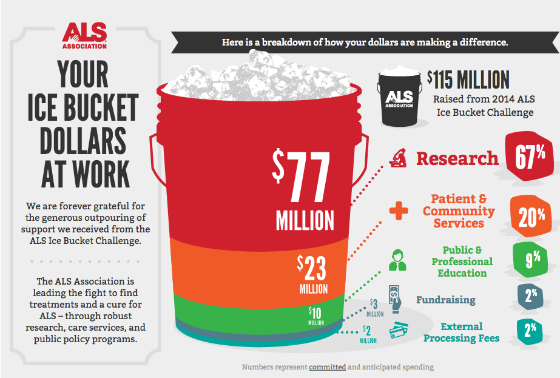
Social Media Viral Campaigns
ALS Association
Notable Successes:
ALS Ice Bucket Challenge ($115M in 8 weeks)
Movember ($710M since 2003)
Notable Scandals: none
Open Questions
Do (or should) charitable solicitation or consumer protection laws apply to individuals who solicit contributions for charities through social media?
Do (or should) such laws apply to social media sites used to promote viral campaigns?

Slide 31
Crowdfunding
Equality Florida Institute, Inc.
Notable Success: Equality Florida in wake of Orlando shooting ($9 million on GoFundMe)
Notable Scandals: Boston Marathon Bombing scammer ($9,350 on GoFundMe)
Open Questions
Do (or should) charitable solicitation or consumer protection laws apply to individuals who crowdfund for charities or charitable purposes?
Do (or should) such laws reach the operators of crowdfunding sites used by such crowdfunders?

Slide 32
Hybrid Entities
Patagonia
Notable Success: Patagonia, Kickstarter
Notable Scandals: none
Open Questions
If a hybrid entity utilizes its social benefitting mission to attract customers, do (or should) charitable solicitation or consumer protection laws apply to that entity’s representations?
Do (or should) such laws apply to “social enterprises” more generally – that is, even if they are not organized as a hybrid entity?

Slide 33
The Legal Challenges Posed by Social Media Viral Campaigns, Crowdfunding, and Hybrid Entities
March 21, 2017
Lloyd Hitoshi Mayer
Professor of Law
University of Notre Dame

