Slide 1


Slide 2
Welcome
Frank H. Wu
Chancellor and Dean, UC Hastings College of Law

Slide 3
Introductory Remarks
Tom Dahdouh
Regional Director, Federal Trade Commission

Slide 4
Opening Remarks
Chairwoman Edith Ramirez
Chairwoman, Federal Trade Commission

Slide 5
Starting up Security
Building a Security Culture

Slide 6
Featuring
Devdatta Akhawe, Security Engineer, Dropbox
Jonathan Carter, Project Lead, OWASP Mobile Top Ten
Frank Kim, Chief Information Security Officer, SANS Institute
Window Snyder, Chief Security Officer, Fastly
Moderator: Laura Riposo VanDruff, Division of Privacy and Identity Protection, FTC

Slide 7
Building a Security Culture
Founder Buy-In
  Founders and executives as security champions
Building Security Expertise
  Engineers with interest can become security evangelists
Leveraging the Security Community
  OWASP, BSides, SANS, and other free and proprietary resources
ntegrating Threat Modeling
  Consider potential threats early
ing Secure Frameworks
  Don’t reinvent the wheel: platforms often provide secure APIs
  Consider building secure abstractions for your developers

Slide 8
Cross-Site Scripting (XSS) Case Study
High-risk, easy to exploit vulnerability
  Victim visits your organization’s vulnerable page
  Hacker injects malicious software into page
  Victim executes this malicious software on their own machine
Why is XSS bad news for your customers?
  Hacker’s malicious software typically:
    Steals sensitive information about the user
    Does things on behalf of the user they didn’t authorize
    Injects malware / adware / spyware onto victim’s machine

Slide 9
How to Identify and Prevent XSS Risks
Are you vulnerable? Ask yourself:
  Is your server receiving data (even hidden data) that is coming from the user’s web browser?
    Inspect and verify every piece of data before you trust it in your own systems.
  Are you sending data coming from your server to the user’s web browser?
    HTML Encode that data before you send it to the user’s browser. HTML Encoding prevents malicious software from being executed on the user’s machine.
Consult the OWASP XSS Prevention Cheat Sheet

Slide 10
How does training help prevent XSS?
Training serves very important functions:
  Identify underlying assumptions and planned inputs coming from users.
  Think like a hacker by providing unexpected inputs. Observe how the system responds.
  Eliminate flaws during the design / implementation stages before a hacker has a chance to find them in a production environment.

Slide 11
Building a Security Culture
Founder Buy-In
  Founders and executives as security champions
Building Security Expertise
  Engineers with interest can become security evangelists
Leveraging the Security Community
  OWASP, BSides, SANS, and other free and proprietary resources
Integrating Threat Modeling
  Consider potential threats early
Using Secure Frameworks
  Don’t reinvent the wheel: platforms often provide secure APIs
  Consider building secure abstractions for your developers

Slide 12
Scaling Security
Adapting Security Testing for DevOps and Hyper-Growth

Slide 13
Featuring
Michael Coates, Trust and Information Security Officer , Twitter
Zane Lackey, Founder and Chief Security Officer, Signal Sciences
Jeff Williams, Founder and Chief Technology Officer, Contrast Security
Moderator: Laura Berger, Division of Privacy and Identity Protection, FTC

Slide 14
Scaling security
Start with the basics
Harness existing resources
Make security visible
Automate testing and feedback
Streamline feedback (and send it to the right people)
Detect risky changes/features

Slide 15


Slide 16
Investing in Security
Accel Partner Arun Mathew
FTC Chief Technologist Ashkan Soltani

Slide 17
Bugs and Bounties
Vulnerability Disclosure and Response

Slide 18
Featuring
Raymond Forbes, Security Engineer, Mozilla
Paul Moreno, Security Engineering Lead, Pinterest
Katie Moussouris, Chief Policy Officer, HackerOne
Moderator: Nithan Sannappa, Division of Privacy and Identity Protection, FTC

Slide 19
Develop Bug Disclosure Policy & Capability to Receive Bug Reports
Develop Bug Handling Policy & Organizational Framework
Response
Receive Bug Report
Identify Bug Internally
Disclosure
Acknowledge Receipt
Verify Bug
Inform Bug Reporter
Bug Verified?
No
Yes
Release Security Update
Develop Security Update
Adapted from Katie Moussouris, RSA 2013 presentation 'Application Security Response: When Hackers Come A-Knockin’
http://www.rsaconference.com/events/us13/agenda/sessions/122/application-security-response-when-hackers-come-a
Improve SDLC

Slide 20
Bug Response 101
Roll out the red carpet
  security@company.com (+ PGP key)
  company.com/security
Bug Verification Steps
  Initial Investigation
  Root Cause Analysis
Communicate
  Bug Reporters
  Customers
Improve SDLC
  Training
  Design
Industry Guidelines
ISO 29147 Vulnerability Disclosure
ISO 30111 Vulnerability Handling Processes

Slide 21



















1995
2002
2004
A Non-Exhaustive
History of Bug Bounties
2015
2012
2005
2010
2013
2011
2014
2007

Slide 22
Bug Bounties – No One Size Fits All
Scope
  What domains, apps, versions (e.g., beta) are in scope?
  What types of bugs are in scope?
Incentives
  Cash
  Swag
  Hall of Fame
Time & Resources
  Expect an initial ramp-up
  Consider outsourcing

Slide 23
Beyond Bugs
Embracing Security Features

Slide 24
Featuring
Pierre Far, Product Manager, Google
Jon Oberheide, Co-founder and Chief Technology Officer, Duo Security
Yan Zhu, Security Engineer, Yahoo!
Moderator: Jessica Lyon, Division of Privacy and Identity Protection, FTC

Slide 25
Embracing Security Features
Implement as soon as you can; it only gets harder with time
Optimize and configure smart and security features won’t slow down or break your product
Take advantage of tools that can automate the process
Put metrics to work for you

Slide 26
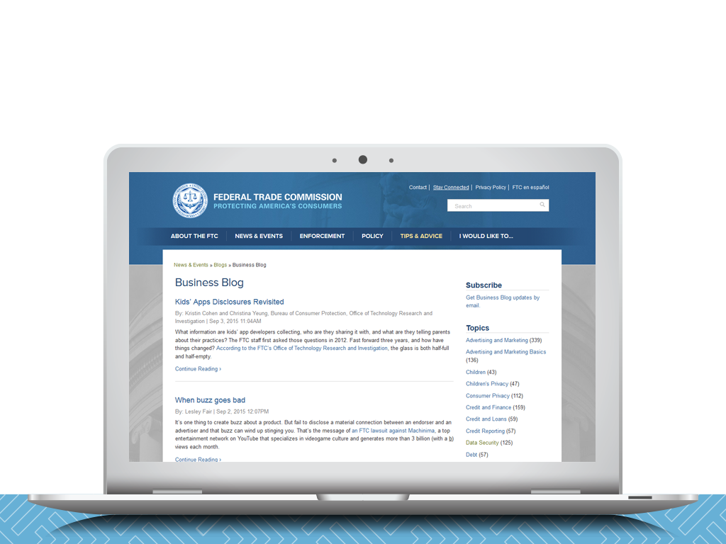
Subscribe to the FTC Business Blog
business.ftc.gov/blog
Notes:
Privacy & Security portal

Slide 27
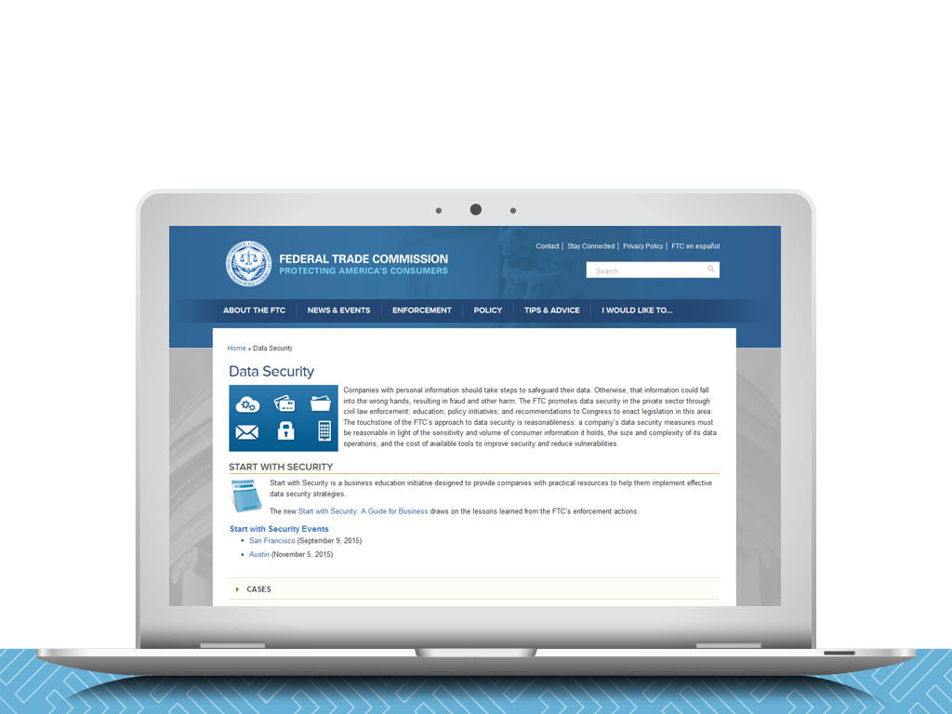
ftc.gov/datasecurity

Slide 28


