Slide 2
Welcome!

Slide 3
What is Cross-Device Tracking?
Presentation by Justin Brookman
Policy Director
Office of Technology Research and Investigation
FTC

Slide 4
What I’m Going to Cover
Background
Probabilistic vs Deterministic Matching Models
Snapshot of Top Sites
Open Questions

Slide 5
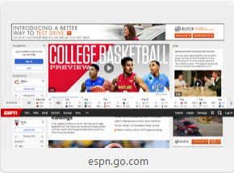
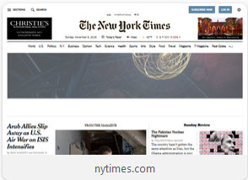
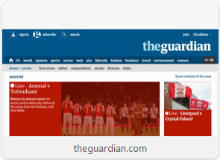
Traditional Third-Party Behavioral Tracking
Advertising Network
cookie=4qasr4sdf1
cookie=4qasr4sdf1
cookie=4qasr4sdf1

Slide 6
The Limitations of Third-Party Cookies
Fragile
Browser-specific
Not traditionally tied to personally-identifiable information
Often no direct relationship to get PII
Privacy concerns
DoubleClick-Abacus merger in 2001
PII (name, email)/non-PII (cookies, urls) distinction still reflected in a lot of practices, privacy policies

Slide 7
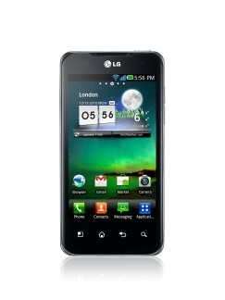
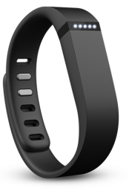
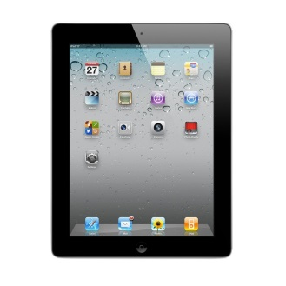
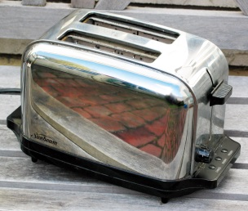
More devices, smarter devices

Slide 8
Reasons why you might want engage in cross-device tracking
Targeting
Security
Analytics
Measurement
Attribution

Slide 9
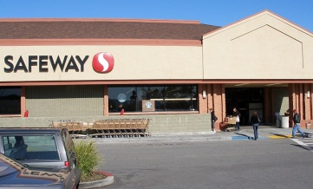
Reasons why you might want to engage in cross-device tracking
Attribution

Slide 10
Probabilistic vs Deterministic
Probabilistic: Based on inferences about likely connections between devices or users
Deterministic: Tying multiple devices to persistent unique identifier

Slide 11
Probabilistic Matching
cookie=4qasr4sdf1
Android Advertising Id=0436732361
cookie=f52dh64dhq

Slide 12
Probabilistic Matching
IP address:
164.62.9.0
(9am-6pm weekdays)
Cellular network
23.64.176.179
(early mornings, evenings, weekends)
IP address:
164.62.9.0
(9am-6pm weekdays)
IP address:
23.64.176.179
(early mornings, evenings, weekends)

Slide 13
Probabilistic Matching
Work??
80%
Cell??
80%
Home??
IP address:
164.62.9.0
(9am-6pm weekdays)
Cellular network
23.64.176.179
(early mornings, evenings, weekends)
IP address:
164.62.9.0
(9am-6pm weekdays)
IP address:
23.64.176.179
(early mornings, evenings, weekends)

Slide 14
Probabilistic Matching
Work?
95%
Cell?
95%
Home?
Weekday location:
38.883914, -77.020997
Evening location:
38.897634, -77.036544
Location:
38.883914, -77.020997
Location:
38.897634, -77.036544

Slide 15
Probabilistic Matching
Work
98%
Cell
98%
Home
cookie=4qasr4sdf1
Android Advertising Id=0436732361
cookie=f52dh64dhq
Technology news
UVa sports
Capitol Hill
Arsenal football
Technology news
UVa sports
Capitol Hill
Arsenal football
Technology news
UVa sports
Capitol Hill
Arsenal football

Slide 16
Device Graph
id=4qasr4sdf1
Android Advertising Id=0436732361
id=f52dh64dhq

Slide 17
Deterministic: Log-in PLUS Broad Reach
You log onto a lot of services (e.g., social networking, email) on different devices
BUT, some of those services also provide functionality on a lot of other websites too
They have visibility into your behavior on those other services, and can create a broad cross-device profile about you

Slide 18
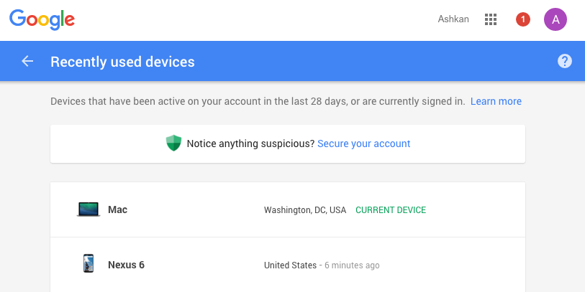

Slide 20
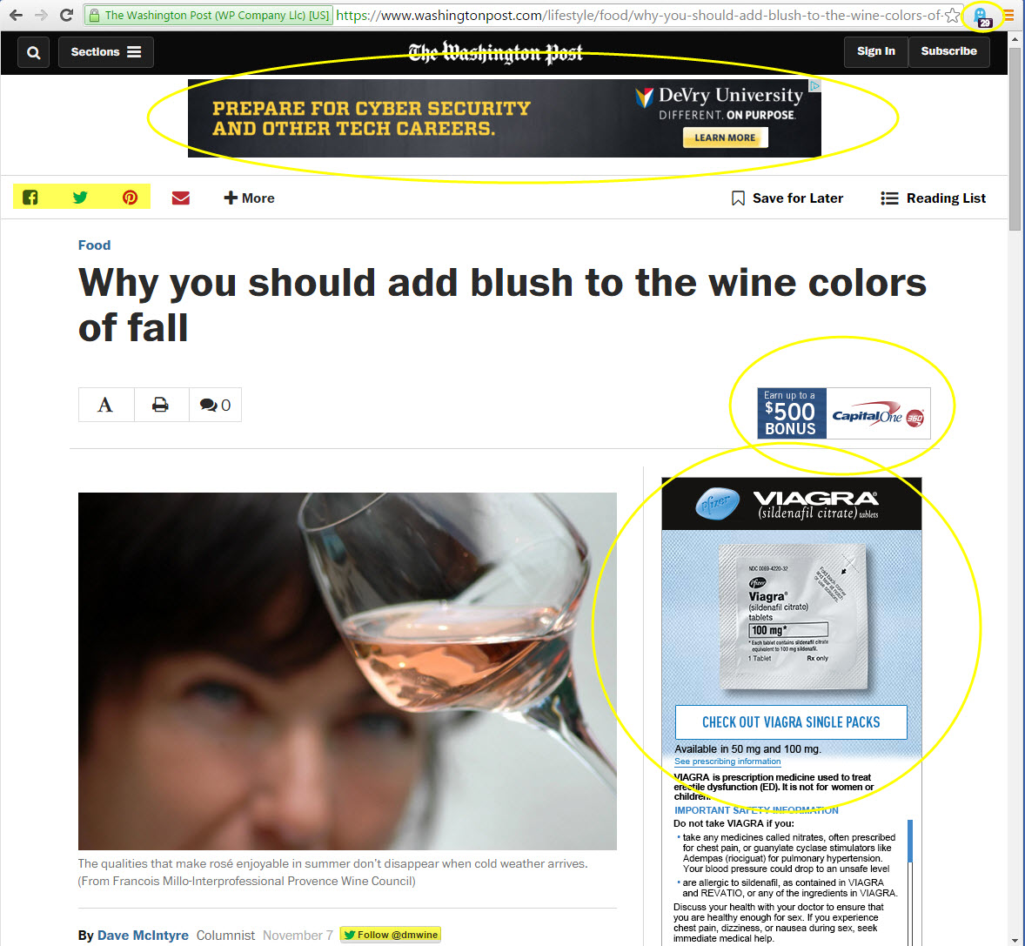

Slide 21
First-Party Deterministic Matching

Slide 22
First-Party Deterministic Matching
Login: JustinBrookman
Login: JustinBrookman
Login: JustinBrookman

Slide 23
First-Party Deterministic Matching
Login: JustinBrookman
Login: JustinBrookman
Login: JustinBrookman
Third-party sites/apps that embed first-party
Third-party sites/apps that embed first-party
Third-party sites/apps that embed first-party

Slide 24
Deterministic: Partnering with Log-in Sites
What if I don’t get log-in data?
Look for partnership with publisher who does
BUT trepidation about sharing PII . . . so identifiers often shared in hashed form
Use an algorithm to consistently convert an identifier into a different, pseudo-random identifier
E.g., justin@domain.com → b16f55bbe0ff554fb40003f8e5f96b99 (md5 hash)

Slide 25
Matching through hashed identifiers
IDFA=qpcm12d5a7
Device Id=038573421
cookie=4qasr4sdf1
Advertising Network

Slide 26
Matching through hashed identifiers
Log onto shopping site as:
justin@domain.com
Log onto video service as:
justin@domain.com
Log onto news site as:
justin@domain.com
IDFA=qpcm12d5a7
Device Id=038573421
cookie=4qasr4sdf1
md5=b16f55bbe0ff554fb40003f8e5f96b99
md5=b16f55bbe0ff554fb40003f8e5f96b99
md5=b16f55bbe0ff554fb40003f8e5f96b99
Advertising Network

Slide 27
Device Graph
cookie=4qasr4sdf1
IDFA=qpcm12d5a7
Device Id=038573421
Advertising Network

Slide 28
Use of Email to Enable Cross-Device Tracking
Purchase item at a shopping site as justin@domain.com

Slide 29
Use of Email to Enable Cross-Device Tracking
cookie=a035fs35fm
Android Advertising Id=0436732361
cookie=4qasr4sdf1
Purchase item at a shopping site as justin@domain.com
Click on email from shopping site
Open email from shopping site

Slide 30
Use of Email to Enable Cross-Device Tracking
Purchase item at a shopping site as justin@domain.com
Click on email from shopping site
Open email from shopping site
md5=b16f55bbe0ff554fb40003f8e5f96b99
Advertising Network

Slide 31
Is Hashed PII Still PII?
Provides a layer of protection, but doesn’t protect against all threats
Ed Felten’s blog post: “Does Hashing Make Data Anonymous?”
Would we prefer tracking by unhashed PII?

Slide 32
Variations of Probabilistic and Deterministic Cross-Device Tracking
Blended models
Deterministic company may extend to include probabilistic data for clients who prefer reach to certainty
Probabilistic companies may partner with deterministic companies to verify accuracy of algorithm, obtain data sets for modeling
Sharing device graphs
Leasing device graphs through cookie syncing

Slide 33
FTC Snapshot
Looked at top 20 sites in Alexa categories for News, Sports, Shopping, Games, and Reference
Cross-device tracking companies on a considerable majority of sites
Over 90% can collect PII from users
Numerous instances of emails, hashed emails sent to third parties
Few privacy policies discuss

Slide 34
How much transparency?
Self-regulatory codes
Whose responsibility?
Does it depend on the model?
AdChoices icon
How achieve transparency for IoT devices?

Slide 35
How much control?

Slide 36
How much control?

Slide 37
How much control?

Slide 38
How much control?
What should you be able to control?
Targeting?
Collection/sharing?
Rise of ad blocking?

Slide 39
Panel 1: A Technological Perspective
Ashkan Soltani
Chief Technologist, FTC
Joseph Lorenzo Hall
Chief Technologist and Director of the Internet Architecture Project, Center for Democracy & Technology
Jonathan Mayer
PhD Candidate, Computer Science, Stanford University
Andrew Sudbury
Co-founder and CTO, Abine, Inc.
Jurgen J. Van Staden
Director of Policy, Network Advertising Initiative

Slide 41
Panel 2: Policy Perspectives
Megan Cox
Attorney, FTC
Genie Barton
Vice President and Director, Online Interest-Based Advertising Accountability Program, Council of Better Business Bureaus
Leigh Freund
President and CEO, Network Advertising Initiative
Jason Kint
CEO, Digital Content Next
Laura Moy
Senior Policy Counsel, Open Technology Institute, New America
Joseph Turow
Professor, Annenberg School for Communication, University of Pennsylvania

